Slide 1

Social Media Analytics
Part III

Slide 2
Community detection
Community: It is formed by individuals such that those within a group interact with each other more frequently than with those outside the group
  a.k.a. group, cluster, cohesive subgroup, module in different contexts
Community detection: discovering groups in a network where individuals’ group memberships are not explicitly given
2
Notes:
The categorization are not necessarily disjoint
; social media is becoming an aspect of the physical world
2

Slide 3
Community detection
Why communities in social media?
  Human beings are social
  Easy-to-use social media allows people to extend their social life in unprecedented ways
  Difficult to meet friends in the physical world, but much easier to find friend online with similar interests
  Interactions between nodes can help determine communities

Slide 4
Communities in Social Media
Two types of groups in social media
  Explicit Groups: formed by user subscriptions (e.g. Google groups, Twitter lists)
  Implicit Groups: implicitly formed by social interactions
Some social media sites allow people to join groups, however it is still necessary to extract groups based on network topology
  Not all sites provide community platform
  Not all people want to make effort to join groups
  Groups can change dynamically
Network interaction provides rich information about the relationship between users
  Can complement other kinds of information, e.g. user profile
  Help network visualization and navigation
  Provide basic information for other tasks, e.g. recommendation
4
Notes:
Groups are not active: the group members seldom talk to each other
Explicitly vs. implicitly formed groups
4

Slide 5
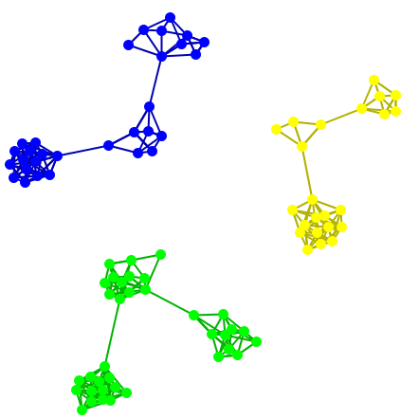
Subjectivity of Community Definition
Each component is a community
A densely-knit community
Definition of a community
can be subjective.
5
Notes:
No objective definition for a community
Visualization might help, but only for small networks
Real-world networks tend to be noisy
Need a proper criteria
5

Slide 6
Taxonomy of Community Detection Criteria
Criteria vary depending on the tasks
Roughly, community detection methods can be divided into 4 categories (not exclusive):
  Node-Centric Community
  Each node in a group satisfies certain properties
  Group-Centric Community
  Consider the connections within a group as a whole. The group has to satisfy certain properties without zooming into node-level
  Network-Centric Community
  Partition the whole network into several disjoint sets
  Hierarchy-Centric Community
  Construct a hierarchical structure of communities
6

Slide 7
Node-Centric Community Detection
Community Detection
Node-Centric
Group-Centric
Network-Centric
Hierarchy-Centric

Slide 8
1. Node-Centric Community Detection
Nodes in a community must satisfy specific properties, like:
  Complete Mutuality
    cliques
  Reachability of members
    k-clique, k-clan, k-club
  Nodal degrees
    k-plex, k-core
  Relative frequency of Within-Outside Ties
    LS sets, Lambda sets
Commonly used in traditional social network analysis
Here, we discuss only some of these properties
8

Slide 9
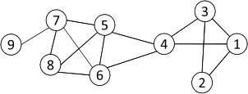
Complete Mutuality: Cliques
Nodes 5, 6, 7 and 8 form a clique
9
Clique: a maximum complete subgraph in which all nodes are adjacent to each other
NP-hard to find the maximum clique in a network
Straightforward implementation to find cliques is very expensive in time complexity

Slide 10
Finding the Maximum Clique
10
In a clique of size k, each node maintains degree >= k-1
  Nodes with degree < k-1 will not be included in the maximum clique
Recursively apply the following pruning procedure
  Sample a sub-network from the given network, and find a clique in the sub-network, say, by a greedy approach
  Suppose the clique above is size k, in order to find out a larger clique, all nodes with degree <= k-1 should be removed.
Repeat until the network is small enough
Many nodes will be pruned as social media networks follow a power law distribution for node degrees (Zipfian low, previous lessons)

Slide 11
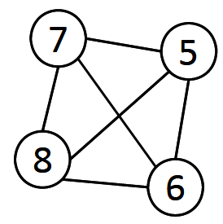
Maximum Clique Example
Suppose we sample a sub-network with nodes {1-9} and find a clique {1, 2, 3} of size 3
In order to find a clique >3, remove all nodes with degree <=3-1=2
  Remove nodes 2 and 9
  Remove nodes 1 and 3
  Remove node 4
11

Slide 12
Clique Percolation Method (CPM)
12
Clique is a very strict definition, unstable
Normally use cliques as a core or a seed to find larger communities
CPM is such a method to find overlapping communities
  Input
    A parameter k, and a network
  Procedure
    Find out all cliques of size k in a given network
    Construct a clique graph. Two cliques are adjacent if they share k-1 nodes
    Each connected components in the clique graph form a community

Slide 13
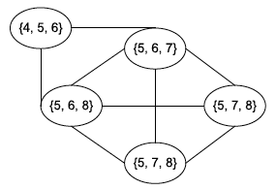

CPM Example
Cliques of size 3:
{1, 2, 3}, {1, 3, 4}, {4, 5, 6}, {5, 6, 7}, {5, 6, 8}, {5, 7, 8},
{6, 7, 8}
    Construct a clique graph. Two cliques are adjacent if they share k-1 nodes (2 if k=3)
Communities:
{1, 2, 3, 4}
{4, 5, 6, 7, 8}
    Each connected component in the clique graph forms a community
13

Slide 14
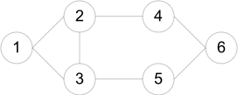
Reachability : k-clique, k-club
Any node in a group should be reachable in k hops
k-clique: a maximal subgraph in which the largest geodesic distance between any two nodes <= k
k-club: a substructure of diameter <= k
A k-clique might have diameter larger than k in the subgraph
  E.g. {1, 2, 3, 4, 5}
  Commonly used in traditional SNA
Often involves combinatorial optimization
Cliques: {1, 2, 3}
2-cliques: {1, 2, 3, 4,5}, {2, 3, 4, 5, 6}
2-clubs: {1,2,3,4}, {1, 2, 3, 5}, {2, 3, 4, 5, 6}
Note that the path of length k or less linking a member of the k-clique to another
member may pass through an intermediary who is not in the group (e.g. for nodes 4
and 5).
14

Slide 15
Group-Centric Community Detection
Community Detection
Node-Centric
Group-Centric
Network-Centric
Hierarchy-Centric

Slide 16
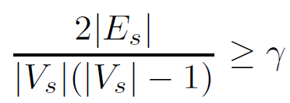
2. Group-Centric Community Detection: Density-Based Groups
The group-centric criterion requires the whole group to satisfy a certain condition
  E.g., the group density >= of a given threshold
A subgraph is a quasi-clique if
  where the denominator is the maximum possible node degree (any node connected to any node).
To detect quasi-cliques we can use a strategy similar to that of cliques
  Sample a subgraph, and find a maximal quasi-clique (say, of size )
  Remove nodes with degree less than the average degree
  iterate
,
<
16

Slide 17
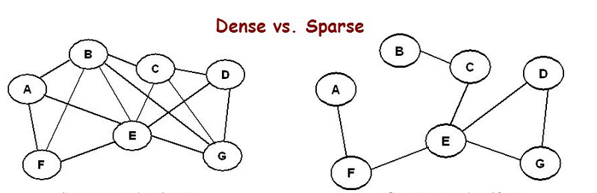
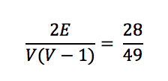
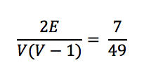

Slide 18
Network-Centric Community Detection
Community Detection
Node-Centric
Group-Centric
Network-Centric
Hierarchy-Centric

Slide 19
3. Network-Centric Community Detection
Network-centric criterion needs to consider the connections within a network globally
Goal: partition nodes of a network into disjoint sets such that members (i,j) of a set are more similar to each other than any to members (i,j) such that i belongs to a set and j to a different set.
Many approaches to identify such sets, or CLUSTERS:
  (1) Clustering based on vertex similarity
  (2) Latent space models (multi-dimensional scaling )
  (3) Block model approximation
  (4) Spectral clustering
  (5) Modularity maximization
19
Notes:
A typical goal is to partition a network into disjoint sets. But that can be extended to soft clustering as well
19

Slide 20
Clustering based on Vertex Similarity
(1) Clustering based on vertex similarity
Nodes 1 and 3 are structurally equivalent;
So are nodes 5 and 6.
20
Define a measure of vertex similarity
Use an algorithm to group nodes based on similarity (e.g. k-means, see later)
Vertex similarity is defined in terms of the similarity of their neighborhood
Example of similarity measure: Structural equivalence
Two nodes are structurally equivalent iff they are connecting to the same set of actors
Structural equivalence is too restricted for practical use.

Slide 21



Clustering based on Vertex Similarity
21
Jaccard Similarity
Cosine similarity

Slide 22
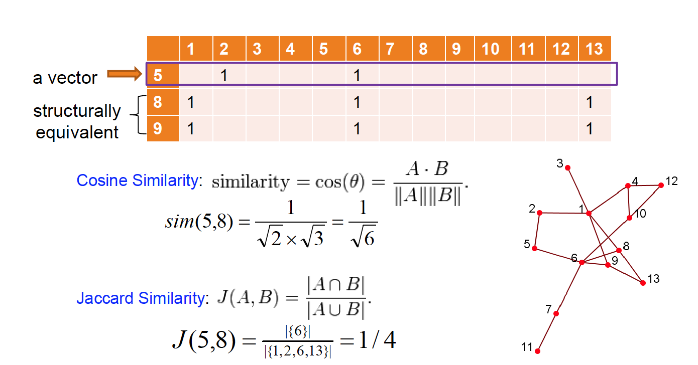
Clustering based on Vertex Similarity

Slide 23
Clustering based on vertex similarity (K-means)
Given some similarity function (e.g. Jaccard)
K-Means Clustering:
Pick K objects as centers of K clusters and assign all the remaining objects to these centers
  Each object will be assigned to the center that has minimal distance to it (distance= inverse of similarity)
  Solve any ties randomly (if distance is the same, assign randomly)
In each cluster C, find a new center X_{C} so as to minimize the total sum of distances between X_{C} and all other elements in C
Reassign all elements to new centers as explained in step (1)
Repeat the previous two steps until the algorithm converges (clusters stay the same)

Slide 24
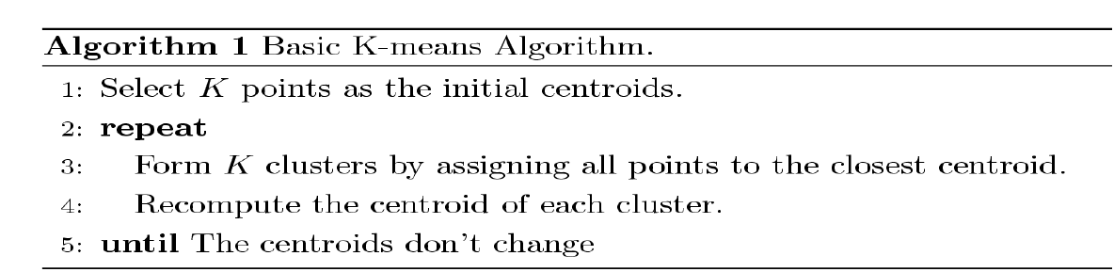
Clustering based on vertex similarity (K-means)
Each cluster is associated with a centroid
Each node is assigned to the cluster with the closest centroid

Slide 25
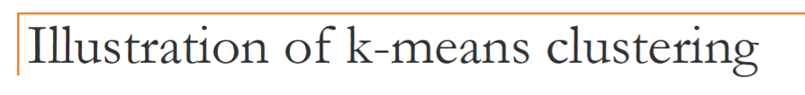
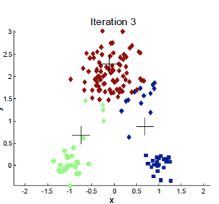
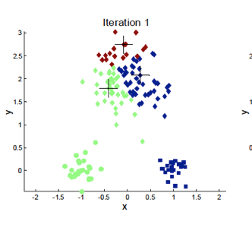
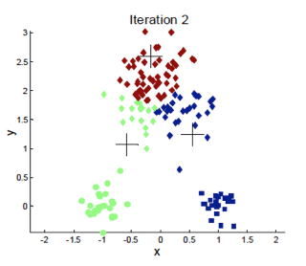
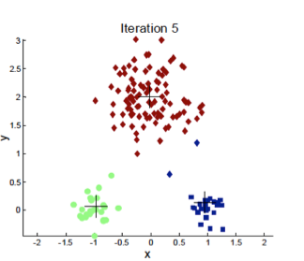
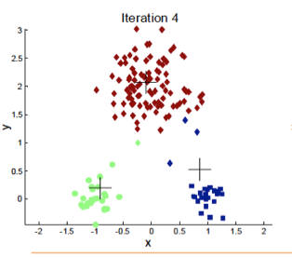
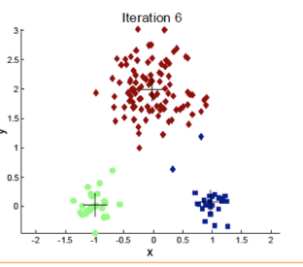

Slide 26
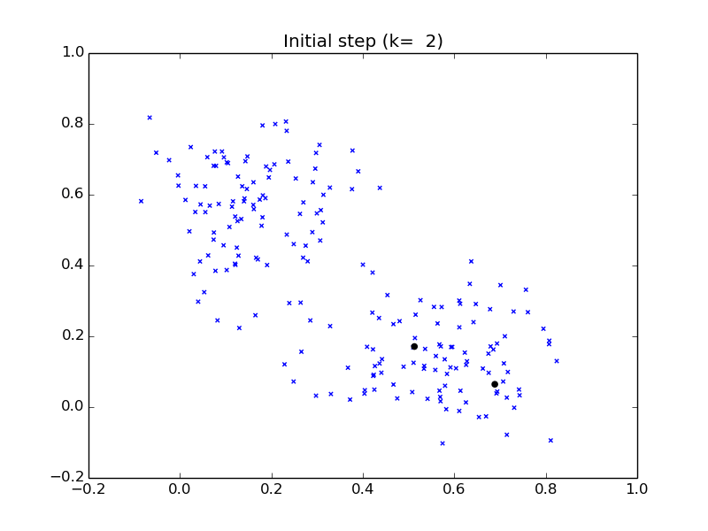


Slide 27
Clustering based on Min Cut
27
Target: find clusters such that most interactions (edges) are within groups whereas interactions between members of different groups are fewer
community detection → minimum cut problem
Cut: A partition of vertices of a graph into two disjoint sets
Minimum cut problem: find a graph partition such that the number of edges between the two sets is minimized
(http://en.wikipedia.org/wiki/Max-flow_min-cut_theorem)

Slide 28
Cut Example
Cut: set of edges whose removal disconnects G
Min-Cut: a cut in G of minimum cost
Weight of this cut: 2 Weight of min cut: 1

Slide 29
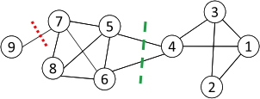


Ratio Cut & Normalized Cut
Minimum cut often returns an imbalanced partition, with one set being a singleton, e.g. node 9
Change the objective function to consider community size (above formulas apply to a k-partition):
C_{i,}: a community
C_{i,}: the remaining graph
|C_{i}|: number of nodes in C_{i}
vol(C_{i}): sum of degrees in C_{i}
Typically, graph partition problems fall under the category of NP-hard problems. Practical solutions based on heuristics
29

Slide 30


Ratio Cut & Normalized Cut Example
For partition in red:
For partition in green:
Both ratio cut and normalized cut prefer a balanced partition
30

Slide 31
Hierarchy-Centric Community Detection
Community Detection
Node-Centric
Group-Centric
Network-Centric
Hierarchy-Centric

Slide 32
4. Hierarchy-Centric Community Detection
32
Goal: build a hierarchical structure of communities based on network topology
Allow the analysis of a network at different resolutions
Representative approaches:
  Divisive Hierarchical Clustering (top-down)
  Agglomerative Hierarchical clustering (bottom-up)

Slide 33
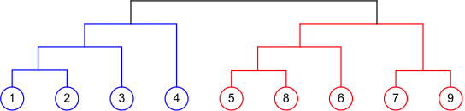
Agglomerative Hierarchical Clustering
Dendrogram according to Agglomerative Clustering
33
Initialize each node as a community (singleton clusters)
Merge communities successively into larger communities following a certain criterion
  E.g., based on vertex similarity

Slide 34
Divisive Hierarchical Clustering
Divisive clustering
  Partition nodes into several sets
  Each set is further divided into smaller ones
  Network-centric partition can be applied for the partition
One particular example: recursively remove the “weakest” edge
  Find the edge with the least strength
  Remove the edge and update the corresponding strength of each edge (according to some measure of strength)
Recursively apply the above two steps until a network is decomposed into desired number of connected components.
Each component forms a community
34

Slide 35
Divisive clustering based on
Edge Betweenness
The strength of an edge can be measured by edge betweenness
(remember) Edge betweenness: the number of shortest paths that pass along with the edge
The edges with higher betweenness tends to be the bridge between two communities.
35
Notes:
Nodes 4-9 have two paths to reach Node2: e(1,2) and e(2,3), hence, 6/2 = 3, Node 3 can reach Node 2 directly, and Node 1 reaches Node 2 via e(1,2). Hence, edge betweenness of e(1,2) is 4.
35

Slide 36
Girvan-Newman Algorithm
Calculate betweenness of all edges
Remove the edge(s) with highest betweenness
Repeat steps 1 and 2 until graph is partitioned into as many regions as desired

Slide 37
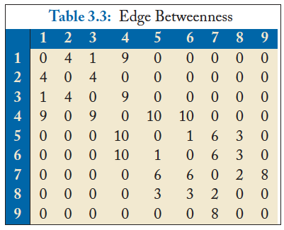
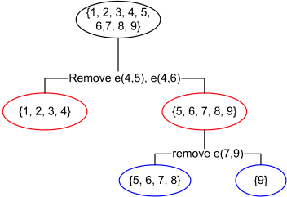
Divisive clustering based on edge betweenness
Initial betweenness value
After removing e(4,5), the betweenness of e(4, 6) becomes 20, which is the highest;
After removing e(4,6), the edge e(7,9) has the highest betweenness value 4, and should be removed.
Idea: progressively removing edges with the highest betweenness
37

Slide 38
Edge Betweenness Example
1
10
2
3
Calculate total flow over edge 7-8
9
11
7
8
4
6
12
13
5
14

Slide 39
1
10
2
3
One unit flows over 7-8 to get from 1 to 8
9
11
7
8
4
6
12
13
5
14

Slide 40
1
10
2
3
One unit flows over 7-8 to get from 1 to 9
9
11
7
8
4
6
12
13
5
14

Slide 41
1
10
2
3
One unit flows over 7-8 to get from 1 to 10
9
11
7
8
4
6
12
13
5
14

Slide 42
1
10
2
3
9
11
7
8
4
6
12
13
5
7 total units flow over 7-8 to get from 1 to nodes 8-14
14

Slide 43
1
10
2
3
9
11
7
8
4
6
12
13
5
7 total units flow over 7-8 to get from 2 to nodes 8-14
14

Slide 44
1
10
2
3
9
11
7
8
4
6
12
13
5
7 total units flow over 7-8 to get from 3 to nodes 8-14
14

Slide 45
7 x 7 = 49 total units flow over 7-8 from nodes 1-7 to 8-14
1
10
2
3
9
11
7
8
4
6
12
13
5
14

Slide 46
1
Edge betweenness = 49
10
2
3
9
11
7
8
4
6
12
13
5
14

Slide 47
1
10
Calculate betweenness for edge 3-7
2
3
9
11
7
8
4
6
12
13
5
14

Slide 48
1
10
3 units flow from
1-3 to each 4-14 node,
so total =
3 x 11 = 33
2
3
9
11
7
8
4
6
12
13
5
14

Slide 49
1
Betweenness = 33
for each
symmetric edge
10
2
3
9
11
33
33
7
8
33
33
4
6
12
13
5
14

Slide 50
1
10
Calculate betweenness for edge 1-3
2
3
9
11
7
8
4
6
12
13
5
14

Slide 51
1
10
Carries all flow to node 1 except from node 2,
so betweenness = 12
2
3
9
11
7
8
4
6
12
13
5
14

Slide 52
1
10
betweenness = 12
for each
symmetric edge
12
12
2
3
9
11
12
12
7
8
4
12
6
12
12
13
12
12
5
14

Slide 53
1
10
Calculate betweenness for edge 1-2
2
3
9
11
7
8
4
6
12
13
5
14

Slide 54
1
10
Only carries flow
from 1 to 2, so
betweenness = 1
2
3
9
11
7
8
4
6
12
13
5
14

Slide 55
1
10
betweenness = 1
for each symmetric edge
1
1
2
3
9
11
7
8
4
6
12
13
1
1
5
14

Slide 56
1
10
Edge with highest betweenness
1
12
12
1
2
3
9
11
12
12
33
33
7
49
8
33
33
4
12
6
12
12
13
1
12
12
1
5
14
Now progressively remove edges with highest betweenness

Slide 57
1
10
1
12
12
1
2
3
9
11
12
12
33
33
7
8
33
33
4
12
6
12
12
13
1
12
12
1
5
14

Slide 58
1
10
1
12
12
1
2
3
9
11
12
12
7
8
4
12
6
12
12
13
1
12
12
1
5
14

Slide 59
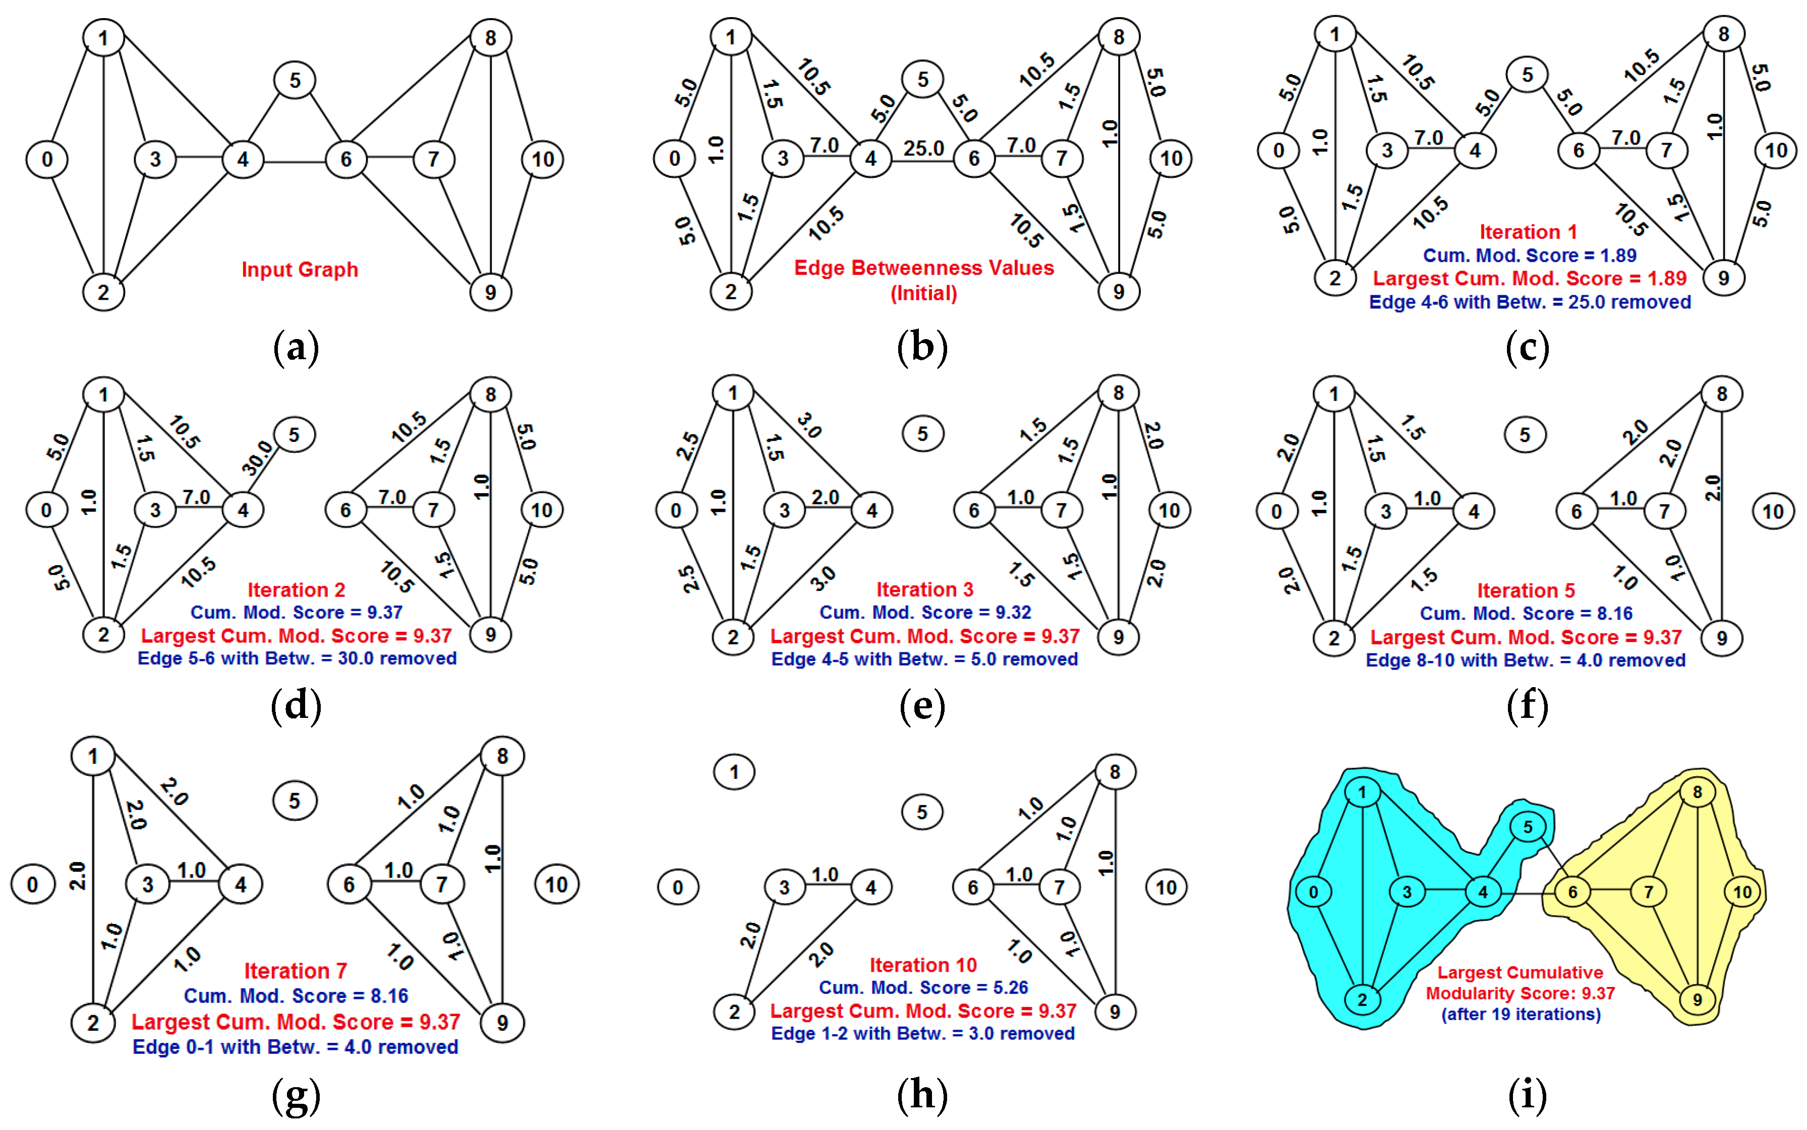
Another example

Slide 60
Complexity of Girvan-Newman
How much computation does this require?
Newman (2001) and Brandes (2001) independently developed similar algorithms that reduce the complexity from O(mn²) to O(mn) where m = # of edges, n = # of nodes

Slide 61
Computing Edge
Betweenness Efficiently
Repeat for B, C, etc.
For each node N in the graph
  Perform breadth-first search of graph starting at node N
  Determine the number of shortest paths from N to every other node
  Based on these numbers, determine the amount of flow from N to all other nodes that use each edge
Divide sum of flow of all edges by 2
Since sum includes flow from A → B and B → A, etc.

Slide 62
A
1
B
C
1
D
1
E
1
F
2
G
1
H
2
I
3
J
3
Work from bottom-up
starting with K
K
6

Slide 63
A
1
B
C
1
D
1
E
1
F
2
G
1
H
2
I
3
J
3
K gets 1 unit; equal, so evenly divide 1 unit
½
½
K
6

Slide 64
A
1
B
C
1
D
1
E
1
F
2
G
1
H
2
1
½
I keeps 1 unit & passes along ½ unit; gets 2 times as much from F
I
3
J
3
½
½
K
6

Slide 65
A
1
B
C
1
D
1
E
1
F
2
G
1
H
2
1
½
½
1
J keeps 1 unit & passes along ½ unit; gets 2 times as much from H
I
3
J
3
½
½
K
6

Slide 66
A
1
B
C
1
D
1
E
1
1
1
F
2
G
1
H
2
1
½
½
1
F keeps 1 unit & passes along 1 unit; equal, so divide evenly
I
3
J
3
½
½
K
6

Slide 67
A
1
B
C
1
D
1
E
1
1
1
2
F
2
G
1
H
2
1
½
½
1
G keeps 1 unit & passes along 1 unit
I
3
J
3
½
½
K
6

Slide 68
A
1
B
C
1
D
1
E
1
1
1
2
1
1
F
2
G
1
H
2
1
½
½
1
H keeps 1 unit & passes along 1 unit; equal, so divide evenly
I
3
J
3
½
½
K
6

Slide 69
B keeps 1 & passes 1
A
2
1
B
C
1
D
1
E
1
1
1
2
1
1
F
2
G
1
H
2
1
½
½
1
I
3
J
3
½
½
K
6

Slide 70
C keeps 1 & passes 1
A
2
2
1
B
C
1
D
1
E
1
1
1
2
1
1
F
2
G
1
H
2
1
½
½
1
I
3
J
3
½
½
K
6

Slide 71
A
D keeps 1 & passes along 3
2
2
4
1
B
C
1
D
1
E
1
1
1
2
1
1
F
2
G
1
H
2
1
½
½
1
I
3
J
3
½
½
K
6

Slide 72
A
E keeps 1 & passes along 1
2
2
4
2
1
B
C
1
D
1
E
1
1
1
2
1
1
F
2
G
1
H
2
1
½
½
1
I
3
J
3
½
½
K
6

Slide 73
No flow yet…
A
2
2
4
2
1
B
C
1
D
1
E
1
1
1
2
1
1
F
2
G
1
H
2
1
½
½
1
I
3
J
3
½
½
K
6

Slide 74
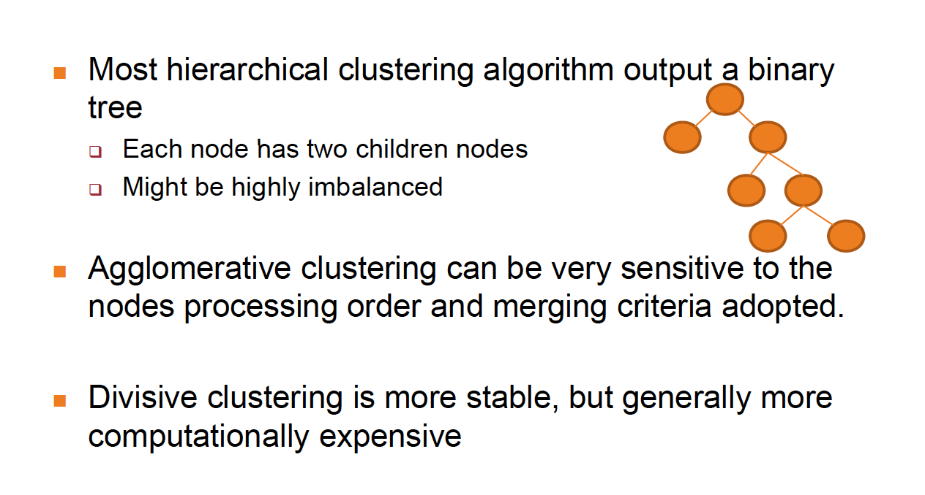
Summary of Hierarchical Clustering

Slide 75
Summary of Community Detection
75
Node-Centric Community Detection
  cliques, k-cliques, k-clubs
Group-Centric Community Detection
  quasi-cliques
Network-Centric Community Detection
  Clustering based on vertex similarity
Hierarchy-Centric Community Detection
  Divisive clustering
  Agglomerative clustering

Slide 76
COMMUNITY EVALUATION
76

Slide 77
Evaluating Community Detection (1)
For groups with clear definitions
  E.g., Cliques, k-cliques, k-clubs, quasi-cliques
  Verify whether extracted communities satisfy the definition (e.g. if they are k-cliques etc.)
For networks with ground truth information (e.g. we know already the communities)
  Normalized mutual information
  Accuracy of pairwise community memberships
77

Slide 78
Measuring a Clustering Result (when “ground truth” is available)
1, 2, 3
4, 5, 6
1, 3
2
4, 5, 6
Ground Truth
Clustering Result
How to measure the
clustering quality?
The number of communities after grouping can be different from the ground truth
No clear community correspondence between clustering result and the ground truth
78
Notes:
Normalized mutual information considers all the possible community matching between the ground truth and the clustering result
78

Slide 79
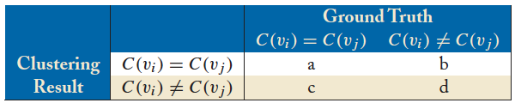

Accuracy of Pairwise Community Memberships
79
Basic idea: Consider all the possible pairs of nodes and check whether they reside in the same community
An error occurs if
  Two nodes belonging to the same (ground truth) community are assigned to different communities after clustering
  Two nodes belonging to different communities (in ground truth) are assigned to the same community
Construct a contingency table or confusion matrix

Slide 80
Accuracy Example
1, 2, 3
4, 5, 6
1, 3
2
4, 5, 6
Ground Truth
Clustering Result
Pairs: (1,2) (1,3) (1,4) (1,5) (1,6) (2,3) (2,4) (2,5) (2,6) (3,4) (3,5) (3,6) (4,5) (4,6) (5,6)
 |  | Ground Truth
 |  | C(v_{i}) = C(v_{j}) | C(v_{i}) ≠ C(v_{j})
Clustering Result | C(v_{i}) = C(v_{j}) | 4 | 0
 | C(v_{i}) ≠ C(v_{j}) | 2 | 9
Accuracy = (4+9)/ (4+2+9+0) = 13/15
80

Slide 81

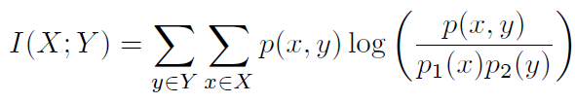

Alternative performance measures:
Entropy: the information contained in a distribution
Mutual Information: the shared information between two distributions
Normalized Mutual Information (between 0 and 1)
Consider a partition as a distribution (probability of one node falling into one community), we can compute the matching between the clustering result and the ground truth
or
81
Notes:
We normalize MI so that we can compare more than two clusterings, e.g., clusterings A, B, C
81

Slide 82



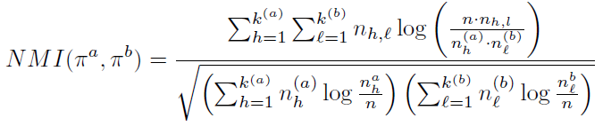
kª, k^{b} = set of clusters generated by partitions πª, π^{b} (e.g ground truth and
output of clustering), h and l are cluster indexes in partitions, n_{h}ª dimension of
cluster h in πª, n_{h,l} common nodes is two clusters of πª, π^{b}
Is the ratio between
the nodes in cluster
h of partition a
divided by the total
number of nodes
Are common nodes
In cluster h of a and
cluster l of b (a sort of
Jaccard between two
clusters)
Notes:
Pi_a, Pi_b denote different partitions.
n_h^a is the number of nodes in Partition a assigned to h-th community;
n_l^b is the number of nodes in Partition b assigned to l-th community;
n_h, l is the number of nodes assigned to h-th community in partitition a, and l-th community in partition b.
k^{(a)} is the number of communities in partition a,
k^{(b)} is the number of communities in partition b.
82

Slide 83
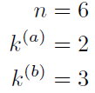
NMI-Example
in a partition each node is assigned a number corresponding to its cluster
Partition a: [1, 1, 1, 2, 2, 2]
Partition b: [1, 2, 1, 3, 3, 3]
1, 2, 3
4, 5, 6
1, 3
2
4, 5,6
h=1 | 3
h=2 | 3
l=1 | 2
l=2 | 1
l=3 | 3
 | l=1 | l=2 | l=3
h=1 | 2 | 1 | 0
h=2 | 0 | 0 | 3
k=# of clusters
# of nodes in each
cluster
contingency table or confusion matrix
=0.8278
Reference: http://www.cse.ust.hk/~weikep/notes/NormalizedMI.m
83

Slide 84
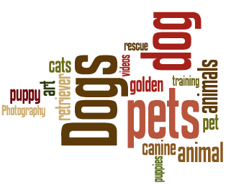
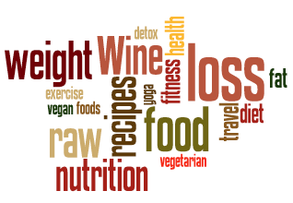
Evaluation using Semantics
An animal
community
A health
community
84
For networks with semantics
  Networks come with semantic or attribute information of nodes or connections
  Human subjects can verify whether the extracted communities are coherent
Evaluation is qualitative
It is also intuitive and helps understand a community

Slide 85
Next lessons
Information Flow and maximization of Influence in social networks
Recommenders

