Slide 1
Module 9
System V IPC
Computer Systems & Programming
Academic Year 2023-2024
Copyright © 2023-2024 Francesco Pedullà
Copyright © 2005-2007 Alex Delis (delis@pitt.edu)
Notes:
Read chapter 4 of the GFDL carefully, to correctly formulate the copyright statement (do we need to cite professors Davoli and Montresor? Do we inform them that we are using and modifying their material with an email, for correctness?)

Slide 2
Mechanisms for IPCs
Three (more) types of IPCs:
◮ Message Queues (not discussed)
◮ Shared Memory
◮ Semaphores
Each IPC structure is referred to by a non-negative integer identifier.
◮ When an IPC is created, the program responsible for this creation provides a key of type key_t.
◮ The Operating System converts this key into an IPC identifier.

Slide 3
Keys in the IPC Client-Server Paradigm
⇒ Keys can be created in three ways:
The “server” program creates a new structure by specifying a private key that is IPC PRIVATE.
◮ Client has to become explicitly aware of this private key.
◮ This is often accomplished with the help of a file generated by the server and then looked-up by the client.
Server and client do agree on a key value (often pre-defined and hard-coded in a shared place).
Server and client can agree on a pathname to an existing file in the file system AND a project-ID (0..255) and then call ftok() to convert these two values into a unique key!

Slide 4
Keys
Keys help identify resources and offer access to the internal structures of the 2 IPC mechanisms (through systems calls):
◮ struct shmid ds
◮ struct semid ds
// for shared segments
// for semaphores
Wrongly accessing resources returns -1
Access rights for IPC mechanisms: read/write stored in struct ipc_perm Included header files: #include <sys/ipc.h> #include <sys/types.h>

Slide 5
The ftok() function
converts a pathname and a project identifier to an IPC-key
key_t ftok(const char *pathname, int proj_id)
◮
if ((thekey=ftok("/tmp/ad.tempfile",23))==-1)
perror("Cannot create key from /tmp/ad.tempfile");
The file /tmp/ad.tempfile must be accessible by the invoking process.

Slide 6
Shared Memory
A shared memory region is a portion of physical memory that is shared by multiple processes.
memory map of Process A memory map of process B
0
0
0x30000
ox50000
0x50000
shared memory
0x70000
region
In this region, structures can be set up by processes and others may read/write on them.
Synchronization (when it is required) is achieved with the help of semaphores.

Slide 7
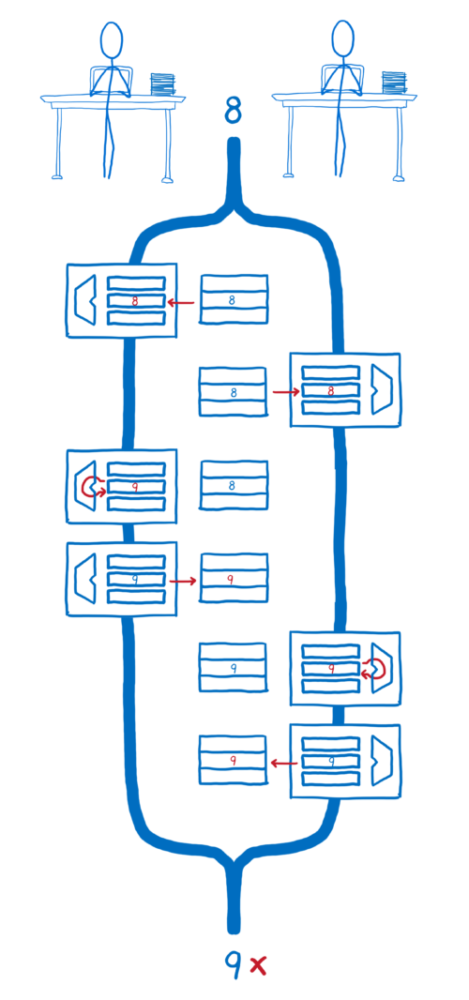
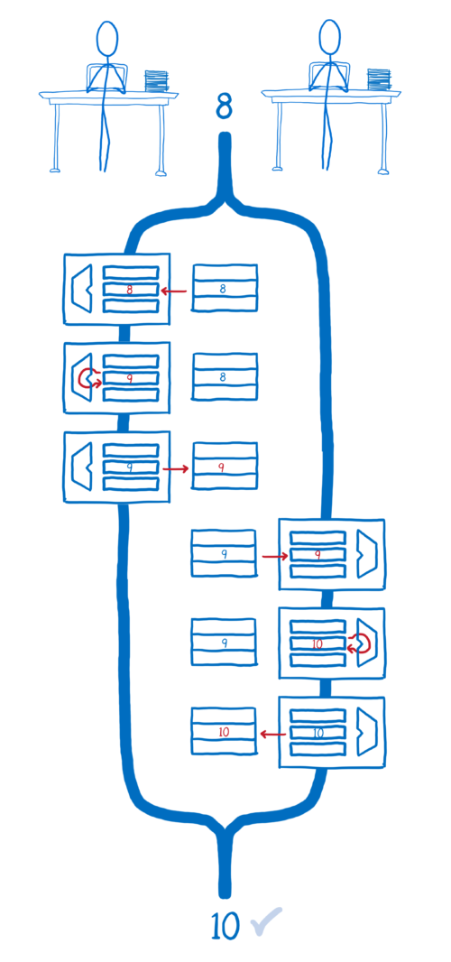
Race Condition Example
Source: https://hacks.mozilla.org/2017/06/avoiding-race-conditions-in-sharedarraybuffers-with-atomics/

Slide 8
Creating a shared segment with shmget()
#include <sys/ipc.h>
#include <sys/shm.h>
int shmget(key_t key, size_t size, int shmflg)
returns the identifier of the shared memory segment associated with the value of the argument key.
the returned size of the segment is equal to size rounded up to a multiple of PAGE SIZE.
shmflg helps designate the access rights for the segment
(IPC_CREAT and IPC_EXCL macros are used).
If shmflg specifies both IPC_CREAT and IPC_EXCL and a shared memory segment already exists for key, then shmget() fails with errno set to EEXIST.

Slide 9
Attach- and Detach-ing a segment:shmat()/shmdt()
void *shmat(int shmid, const void *shmaddr, int shmflg)
attaches the shared memory segment identified by shmid to the address space of the calling process.
If shmaddr is NULL, the OS chooses a suitable (unused) address at which to attach the segment (frequent choice).
Otherwise, shmaddr must be a page-aligned address at which the attach occurs.
int shmdt(const void *shmaddr)
detaches the shared memory segment located at the address specified by shmaddr from the address space of the calling process.

Slide 10
The function shmctl() - I
int shmctl(int shmid, int cmd, struct shmid ds *buf)
performs the control operation specified by cmd on the shared memory segment whose identifier is given in shmid.
The buf argument is a pointer to a shmid_ds structure:
struct shmid_ds {
struct ipc_perm shm_perm ;
/* Ownership and permissions */
/* Size of segment ( bytes) */
/* Last attach time */
/* Last detach time */
/* Last change time */
/* PID of creator */
/* PID of last shmat(2)/ shmdt(2) */
/* No. of current attaches */
size_t time_t time_t time_t pid_t pid_t shmatt_t
...
shm_segsz ; shm_atime ; shm_dtime ; shm_ctime ; shm_cpid ; shm_lpid ; shm_nattch ;
};

Slide 11
The function shmctl() - II
Usual values for cmd are:
IPC STAT: copy information from the kernel data structure associated with shmid into the shmid ds structure pointed to by buf.
IPC SET: write the value of some member of the shmid ds structure pointed to by buf to the kernel data structure associated with this shared memory segment, updating also its shm ctime member.
IPC RMID: mark the segment to be destroyed. The segment will be destroyed after the last process detaches it (i.e.,
shm nattch is zero).

Slide 12
Main Use Cases of Calls
Only one process creates the segment:
int id ;
id = shmget ( IPC_PRIVATE , 10 , 0666);
if ( id == -1 ) perror (" Creating ");
Every (interested) process attaches the segment:
int * mem ;
mem = ( int *) shmat (id , ( void *) 0 , 0);
if ( ( int ) mem == -1 ) perror (" Attachment ");
Every process detaches the segment:
int err;
err = shmdt (( void *) mem );
if ( err == -1 ) perror (" Detachment ");
Only one process has to remove the segment:
int err;
err = shmctl (id , IPC_RMID , 0);
if ( err == -1 ) perror (" Removal ");

Slide 13
Creating and accessing shared memory - I
# include <stdio .h >
# include <sys/types.h>
# include <sys/ipc.h>
# include <sys/shm.h>
int main(int argc, char** argv){
int id=0, err =0;
int *mem;
id=shmget(IPC_PRIVATE, 10, 0666); /* Make shared memory segment */
if (id == -1) perror("Creation");
else printf("Allocated. %d\n", (int)id);
mem=(int*)shmat(id, (void*)0, 0); /* Attach the segment */
if ((int)mem == -1) perror("Attachment.");
else printf("Attached. Mem contents %d\n", *mem);
*mem=1; /* Give it initial value */
printf("Start other process. >"); getchar();
printf("mem is now %d\n", *mem); /* Print out new value */
err=shmctl(id, IPC_RMID, 0); /* Remove segment */
if (err == -1) perror("Removal.");
else printf(" Removed. %d\n", (int)(err));
return 0;
}

Slide 14
Creating and accessing shared memory - II
# include <stdio.h>
# include <stdlib.h>
# include <sys/types.h >
# include <sys/ipc.h>
# include <sys/shm.h>
int main(int argc, char** argv) {
int id, err;
int *mem;
if (argc <= 1) { printf("Need shared memory id.\n"); exit (1);}
sscanf(argv[1], "%d", &id); /* Get id from command line */
printf("Id is %d\n", id);
mem=(int*)shmat(id, (void*)0, 0); /* Attach the segment */
if ((int)mem == -1) perror("Attachment.");
else printf("Attached. Mem contents %d\n", *mem);
*mem=2; /* Give it a different value */
printf("Changed mem is now %d\n", *mem);
err=shmdt((void*)mem); /* Detach segment */
if (err == -1) perror("Detachment.");
else printf("Detachment %d\n", err);
return 0;
}

Slide 15
Running the two programs:
Starting off with executing ”I”:
ad@ad - desktop :~/ Set008 / src / Shared Segments$ ./ share Mem 1
Allocated . 1769489
Attached .
Mem contents 0
Start other process . >
Executing ”II”:
ad@ad - desktop :~/ Set008 / src / Shared Segments$ ./ share Mem 2 1769489
Id is 1769489
Attached .
Mem content is 1
Changed mem is now 2
Detachment 0
ad@ad - desktop :~/ Set008 / src / Shared Segments$
Providing the final input to ”I”:
Start other process . >s
mem is now 2
Removed . 0
ad@ad - desktop :~/ Set008 / src / Shared Segments$

Slide 16
Semaphores
Fundamental mechanism that facilitates the synchronization of accessing resources placed in shared memory.
A semaphore is an integer whose value is never allowed to fall below zero.
Two operations can be performed on a semaphore:
increment the semaphore value by one (UP or V() ala Dijkstra).
decrement a semaphore value by one (DOWN or P() ala Dijkstra). If the value of semaphore is currently zero, then the invoking process will block until the value becomes greater than zero.

Slide 17
POSIX Semaphores
#include <semaphore.h>
sem_init, sem_destroy, sem_post, sem_wait, sem_trywait
int sem_init(sem_t *sem, int pshared, unsigned int value);
◮ The above initializes a semaphore.
◮ Compile either with -lrt or -lpthread
◮ pshared indicates whether this semaphore is to be shared between the threads of a process, or between processes:
◮ zero: semaphore is shared between the threads of a process; should be located at an address visible to all threads.
◮ non-zero: semaphore is shared among processes and should be located in a region of shared memory.

Slide 18
POSIX Semaphore Operations
sem_wait(), sem_trywait()
◮ int sem_wait(sem_t *sem);
◮ int sem_trywait(sem_t *sem);
◮ Perform P(s) operation.
◮ sem_wait blocks; sem_trywait will fail rather than block.
sem_post()
◮ int sem_post(sem_t *sem);
◮ Perform V(s) operation.
sem_destroy()
◮ int sem_destroy(sem_t *sem);
◮ Destroys a semaphore.

Slide 19
Creating and using a POSIX Semaphore
#include <stdio.h>
#include <stdlib.h>
#include <semaphore.h>
#include <sys/types.h>
#include <sys/ipc.h>
extern int errno;
int main(int argc, char** argv) {
sem_t sp; int retval ;
/* Initialize the semaphore . */
retval=sem_init(&sp, 1, 2);
if (retval != 0) {perror(" Couldn ’t initialize ."); exit (3) ; }
retval=sem_trywait(&sp);
printf("Did trywait. Returned %d>\n", retval); getchar ();
retval=sem_trywait(&sp);
printf("Did trywait. Returned %d>\n", retval); getchar ();
retval=sem_trywait(&sp);
printf("Did trywait. Returned %d>\n", retval); getchar ();
sem_destroy(&sp);
return 0;
}

Slide 20
Executing the Program
ad@ad - desktop :~/ src/ PosixSems$ ./ semtest
Did trywait . Returned 0 >
Did trywait . Returned 0 >
Did trywait . Returned -1 >
ad@ad - desktop :~/ src/ PosixSems$

Slide 21
Example: semtest3.c - I
/*semtest3.c:POSIX Semaphore test example using shared memory*/
#include <stdio.h >
#include <stdlib.h>
#include <semaphore.h >
#include <sys/types.h >
#include <sys/ipc.h>
#include <sys/shm.h>
# define SEGMENTSIZE sizeof(sem_t)
# define SEGMENTPERM 0666
int main(int argc,char** argv)
{
sem_t *sp;
int retval; int id , err;
/*Make shared memory segment*/
id = shmget(IPC_PRIVATE, SEGMENTSIZE, SEGMENTPERM);
if (id == -1) perror("Creation");
else printf("Allocated %d\n", id);
/*Attach the segment.*/
sp = (sem_t *)shmat(id ,(void *)0, 0);
if ((int)sp == -1) {perror("Attachment."); exit(2) ;}

Slide 22
Example: semtest3.c - II
/* Initialize the semaphore. */
retval=sem_init(sp, 1, 2);
if (retval != 0) {perror("Couldn’t initialize.");
exit(3);
}
retval=sem_trywait(sp);
printf("Did trywait. Returned %d>\n", retval); getchar ();
retval=sem_trywait(sp);
printf("Did trywait. Returned %d>\n", retval); getchar ();
retval=sem_trywait(sp);
printf("Did trywait. Returned %d>\n", retval); getchar ();
sem_destroy(sp);
/* Remove segment. */
err=shmctl(id, IPC_RMID, 0);
if (err == -1) perror("Removal.");
else printf("Removed. %d\n", err);
return 0;
}

Slide 23
Example: semtest3a.c - I
/* semtest3 a . c POSIX Semaphore test example using shared memory */
#include <stdio.h >
#include <stdlib.h>
#include <semaphore.h >
#include <sys/types.h >
#include <sys/ipc .h>
#include <sys/shm.h>
# define SEGMENTSIZE sizeof ( sem_t )
# define SEGMENTPERM 0666
extern int errno ;
int main(int argc, char** argv) {
sem_t *sp; int retval; int id, err ;
if (argc <= 1) {printf("Need shmem id.\n"); exit (1) ; }
sscanf(argv[1], "%d", &id); /* Get id from command line. */
printf(" Allocated %d\n", id);
sp=(sem_t *)shmat(id ,(void *)0, 0); /* Attach the segment. */
if ((int)sp == -1) {perror ("Attachment ."); exit (2);}

Slide 24
Example: semtest3a.c - II
/* Initialize the semaphore. */
retval=sem_init(sp, 1, 1);
if (retval != 0) {perror("Couldn’t initialize.");
exit (3) ;
}
retval=sem_trywait(sp);
printf("Did trywait. Returned %d>\n", retval); getchar();
retval=sem_trywait(sp);
printf("Did trywait. Returned %d>\n", retval); getchar();
retval=sem_trywait ( sp);
printf("Did trywait. Returned %d>\n", retval); getchar();
/* Remove segment. */
err=shmdt((void*)sp);
if (err == -1) perror("Detachment.");
return 0;
}

Slide 25
Running the two programs: semtest and semtest3a - I
Starting off with executing ”semtest”:
ad@ serifos :~/ Recitation 4 / src$ ./ semtest3
Allocated 14549024
Did trywait . Returned 0 >
Executing ”semtest3a” in another tty:
ad@ serifos :~/ Recitation 4 / src$ ./ semtest3a 14549024
Allocated 14549024
Did trywait . Returned 0 >
Did trywait . Returned -1 >
Continue with ”semtest3”:
Did trywait . Returned -1 >
Did trywait . Returned -1 >

Slide 26
Running the two programs: semtest and semtest3a - II
Continue with ”semtest3a”:
Did trywait . Returned -1 >
Follow up with ”semtest3”:
Removed . 0
ad@ serifos :~/ Recitation 4 / src$
Finish with ”semtest3a”:
ad@ serifos :~/ Recitation 4 / src$

Slide 27
Initialize and Open a named Semaphore
sem t *sem_open(const char *name, int oflag); sem t *sem_open(const char *name, int oflag,
mode t_mode, unsigned int value);
creates a new POSIX semaphore OR opens an existing semaphore whose name is name.
oflag specifies flags that control the operation of the call
O CREAT creates the semaphore;
provided that both O CREAT and O EXCL are specified, an
error is returned if a semaphore with name already exists.
if oflag is O_CREAT then two more arguments have to be used:
mode specifies the permissions to be placed on the new semaphore.
value specifies the initial value for the new semaphore.

Slide 28
More on Named POSIX Semaphores
A named semaphore is identified by a (persistent) name that has the form /this_is_a_sample_named_semaphore.
consists of an initial slash followed by a (large) number of character (but no slashes).
If you want to “see”(list) all named sempahores in your (Linux) system look at directory /dev/shm
int sem_close(sem_t *sem)
closes the named semaphore referred to by sem freeing the system resources the invoking process has used.
int sem_unlink(const char *name)
removes the named semaphore in question.
int sem_getvalue(sem_t *sem, int *sval)
obtains the current value of semaphore..
the cheater API-call!

Slide 29
Named POSIX Semaphore - I
# include <stdio.h>
...
# include <sys/stat.h>
# include <semaphore.h>
int main(int argc, char* argv[]) {
const char *semname;
int op =0; int val =0;
if (argc==3) {
semname = argv[1]; op = atoi(argv[2]) ;
}
else {
printf ("Usage: nameSem nameOfSem Operation \n"); exit(1);
}
sem_t *sem = sem_open(semname, O_CREAT|O_EXCL, S_IRUSR|S_IWUSR, 0);
if (sem != SEM_FAILED )
printf ("Created new semaphore !\n");
else if (errno == EEXIST ) {
printf ("Semaphore appears to exist already!\n");
sem = sem_open(semname,0);
}
else;
assert(sem != SEM_FAILED);
sem_getvalue(sem, &val);
printf("Semaphore’s before action value is %d\n", val);

Slide 30
Named Posix Semaphore - II
if (op == 1) {
printf("Incrementing semaphore \n");
sem_post(sem);
}
else if (op == -1) {
printf("Decrementing semaphore \n");
sem_wait(sem);
}
else if (op == 2){
printf("Clearing up named semaphore \n");
sem_close(sem); // close the sem
sem_unlink(semname); // remove it from system
exit(1);
}
else printf("Not defined operation!\n");
sem_getvalue(sem, &val);
printf("Semaphore’s current value is %d\n", val);
sem_close(sem);
return(0);
}

Slide 31
Execution Outcome - I
ad@ serifos :~/ PosixSems$ ls / dev / shm /
pulse - shm -1024070233 pulse - shm -1294442337 pulse - shm -2927836935
pulse - shm -1274848112 pulse - shm -2305588894 pulse - shm -3888866544
ad@ serifos :~/ PosixSems$ ./ named Sem / delis 1
created new semaphore !
semaphore ’s before action value is 0
incrementing semaphore
semaphore ’s current value is 1
ad@ serifos :~/ PosixSems$ ls / dev / shm /
pulse - shm -1024070233 pulse - shm -1294442337 pulse – shm-2927836935 sem.delis
pulse - shm -1274848112 pulse - shm -2305588894 pulse - shm -3888866544
ad@ serifos :~/ PosixSems$ ./ named Sem / delis -1
semaphore appears to exist already !
semaphore ’s before action value is 1
decrementing semaphore
semaphore ’s current value is 0
ad@ serifos :~/ PosixSems$ ./ named Sem / delis 2
semaphore appears to exist already !
semaphore ’s before action value is 0
clearing up named semaphore
ad@ serifos :~/ PosixSems$ ls / dev / shm /
pulse - shm -1024070233 pulse - shm -1294442337 pulse - shm -2927836935
pulse - shm -1274848112 pulse - shm -2305588894 pulse - shm -3888866544
ad@ serifos :~/ PosixSems$ ./ named Sem / delis 1
created new semaphore !
semaphore ’s before action value is 0
incrementing semaphore
semaphore ’s current value is 1

Slide 32
Execution Outcome - II
ad@ serifos :~/ PosixSems$ ./ named Sem / delis 1
semaphore appears to exist already !
semaphore ’s before action value is 1
incrementing semaphore
semaphore ’s current value is 2
ad@ serifos :~/ PosixSems$ ls / dev / shm /
pulse - shm -1024070233 pulse - shm -1294442337 pulse - shm -2927836935 sem.delis
pulse - shm -1274848112 pulse - shm -2305588894 pulse - shm -3888866544
ad@ serifos :~/ PosixSems$ ./ named Sem / delis -1
semaphore appears to exist already !
semaphore ’s before action value is 2
decrementing semaphore
semaphore ’s current value is 1
ad@ serifos :~/ PosixSems$ ./ named Sem / delis -1
semaphore appears to exist already !
semaphore ’s before action value is 1
decrementing semaphore
semaphore ’s current value is 0
ad@ serifos :~/ PosixSems$ ./ named Sem / delis 2
semaphore appears to exist already !
semaphore ’s before action value is 0
clearing up named semaphore
ad@ serifos :~/ PosixSems$ ls / dev / shm /
pulse - shm -1024070233 pulse - shm -1294442337 pulse - shm -2927836935
pulse - shm -1274848112 pulse - shm -2305588894 pulse - shm -3888866544
ad@ serifos :~/ PosixSems$

