Slide 1
Module 7
The exec family
Computer Systems & Programming
Academic Year 2023-2024
Copyright © 2023-2024 Francesco Pedullà
Copyright © 2005-2007 Francesco Pedullà, Massimo Verola
Copyright © 2001-2005 Renzo Davoli, Alberto Montresor (University of Bologna)
Permission is granted to copy, distribute and/or modify this document under the terms of the GNU Free Documentation License, Version 1.2 or any later version published by the Free Software Foundation; with no Invariant Sections, no Front-Cover Texts, and no Back-Cover Texts. A copy of the license can be found at: http://www.gnu.org/licenses/fdl.html#TOC1

Slide 2
The exec family
If fork were the only primitive for creating new processes, programming in a Unix environment would be quite difficult, since you could only create copies of the same process.
The family of exec primitives can be used to overcome this limit as the various exec’s allow you to start the execution of another program by overwriting the memory of the calling process.
execl
execle
execlp
execv
execvp
execve
In fact, all functions ultimately call execve which is the only real system call in the family. The differences between the variants are in how parameters are passed.

Slide 3
Example of using execl
#include <stdio.h>
#include <unistd.h>
main()
{
printf("Executing ls\n");
execl("/bin/ls", "ls", "-l", (char *)0);
perror("The execl call generated an error\n");
exit(1);
}
Note that execl eliminates the original program by overwriting it with the one passed as a parameter. So, instructions that follow a call to execl will only be executed if an error occurs during execl's execution and control returns to the caller.

Slide 4
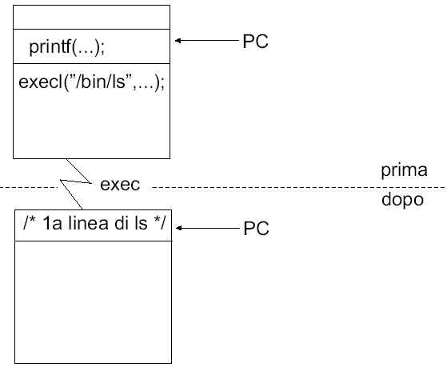
Example of using execl

Slide 5
Calling exec
When a process calls one of the exec functions :
the process is completely replaced by a new program (text, data, heap, stack are replaced)
the new program starts from its main function
the process ID does not change
There are six versions of exec :
With or w/o the PATH environment variable: if the environment variable is handled, a command matching a single filename will be searched in the PATH
with inherited environment variables or with specified environment variables
with array of arguments or with arguments in the call (null terminated)

Slide 6
Variants of exec
int execl(char *pathname, char *arg0, … );
int execv(char *pathname, char *argv[]);
int execle(char *pathname, char *arg0, …, char* envp[]);
int execve(char *pathname, char *argv[], char* envp[]);
int execlp(char *filename, char *arg0, … );
int execvp(char *filename, char *argv[]);

Slide 7
exec parameters
Function
pathname
filename
arg list
argv[ ]
environ
envp[ ]
execl
•
•
•
execlp
•
•
•
execle
•
•
•
execv
•
•
•
execvp
•
•
•
execve
•
•
•
suffix letters
p
l
v
e

Slide 8
Inherited Properties
What is inherited from exec ?
process ID and parent process ID
real uid and real gid
supplementary gid
process group ID
sessionID
control terminal
current working directory
root directory
file creation mask (umask)
file locks
signal mask
waiting signals

Slide 9
Not-inherited Properties
What is NOT inherited from exec ?
effective user ID and effective group ID, as they are set based on the values of the protection bits
What happens to open files?
It depends on the close-on-exec flag that is associated with each descriptor
If close-on-exec is true, they are closed
Otherwise, they are left open (default behaviour)

Slide 10
Combined use of fork and exec
The combined use of fork to create a new process and exec to execute a new program in the child process is a powerful programming tool in the Linux environment
Example:
#include <stdio.h>
#include <stdlib.h>
#include <unistd.h>
#include <sys/wait.h>
void fatal(char *s)
{
perror(s);
exit(1);
}
/* continues ... */

Slide 11
Combined use of fork and exec
main()
{
pid_t pid;
switch(pid = fork()) {
case -1: fatal("fork failed");
break;
case 0: execl("/bin/ls", "ls", "-l", (char *)0);
fatal("exec failed");
break;
Default: wait((int *)0);
printf("ls completed\n");
exit(0);
}
}

Slide 12
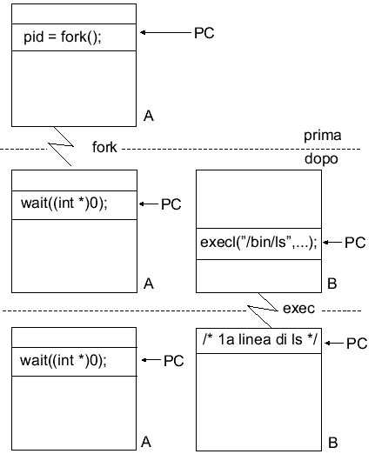
Combined use of fork and exec

Slide 13
Exercise 1
Write a program that executes an executable whose filename is inserted as an argument on the command line and waits for termination.
Optionally, support the $PATH environment variable

Slide 14
The system function
int system(char* command);
Executes a command, waiting for it to terminate
It is a function of the standard library defined in ANSI C (therefore it is not a system call, even if it performs a function similar to fork+exec )
Its way of operating is highly system dependent; typically calls /bin/sh -c command
It is not defined in POSIX.1, because it is not an interface to the operating system, but it is defined in POSIX.2

Slide 15
The environment of a process - I
The environment of a process is a collection of strings (terminated by \0 ).
An environment is represented by an array of character pointers terminated by a null pointer.
Each pointer (other than the null one) points to a string of the form: identifier = value
To access the environment from a C program, simply add the envp parameter to those of the main:
/* showmyenv */
#include <stdio.h>
main(int argc, char **argv, char **envp)
{
while(*envp)
printf("%s\n",*envp++);
}
or use the following global variable: extern char **environ;

Slide 16
The environment of a process - II
The default environment of a process is the same as that of the parent process.
To specify a new environment you need to use one of the following two variants of the exec family, storing the desired environment in envp :
execle(path, arg0, arg1, ..., argn, (char *)0, envp);
execve(path, argv, envp);

Slide 17
The environment of a process - III
/* setmyenv */
#include <unistd.h>
#include <stdio.h>
main()
{ char *argv[2], *envp[3];
argv[0] = "setmyenv";
argv[1] = (char *)0;
envp[0] = "var1=value1";
envp[1] = "var2=value2";
envp[2] = (char *)0;
execve("./showmyenv", argv, envp);
perror("execve failed");
}
Running the above code we obtain the following:
$ ./setmyenv
var1=value1
var2=value2

Slide 18
The environment of a process - IV
There is a standard library function that allows you to search in environ the value corresponding to a specific environment variable:
#include <stdlib.h>
char *getenv(const char *name);
getenv takes as an argument the name of the variable to search for and returns the pointer to the value (what is to the right of the = symbol) or NULL if it is not found:
#include <stdio.h>
#include <stdlib.h>
main()
{
printf("PATH=%s\n", getenv("PATH"));
}
Dually, putenv allows you to modify or extend the environment:
putenv("variable=value");

Slide 19
Current working directory and root directory
Each process is associated with a current working directory that is inherited from the parent process.
The following system call allows you to change this:
#include <unistd.h>
int chdir(const char *path);
Furthermore, each process is associated with a root directory which specifies the starting point of the file system visible by the process itself.
To change the root directory you can use the following system call:
#include <unistd.h>
int chroot(const char *path);

Slide 20
Exercise 2
Modify the program of Exercise 1 (slide 13) according to the following additional specifications:
the program must correctly support the launch of executables that require options and arguments
the programming pattern composed of the call to the fork+exec system calls must be inserted inside a spawn() function whose prototype must be appropriately defined
Add to the previous program the ability to read the executable to be launched from standard input (and not as an argument on the command line) and then launch it when Enter is pressed ; this operation must be repeated iteratively until an end-of-file EOF character is read ( ctrl+d sequence ).

Slide 21
Exercise 3
Add to the program of Exercise 2 (previous page):
the printing at the beginning of each new command line (and therefore at the end of each launched executable) of a prompt containing the name of the user and that of the computer, in the format: username@hostname $
the ability to launch a new executable without having to wait for the previous one to terminate if the & character is found at the end of the input string
Develop your own implementation of the system() function (see man 3 system ), respecting its prototype and functionality; the signal handling defined for system() can be ignored.

