Slide 1
Module 6 System call for process control
(fork, exit, wait )
Computer Systems & Programming
Academic Year 2023-2024
Copyright © 2023-2024 Francesco Pedullà
Copyright © 2005-2007 Francesco Pedullà, Massimo Verola
Copyright © 2001-2005 Renzo Davoli, Alberto Montresor (University of Bologna)
Permission is granted to copy, distribute and/or modify this document under the terms of the GNU Free Documentation License, Version 1.2 or any later version published by the Free Software Foundation; with no Invariant Sections, no Front-Cover Texts, and no Back-Cover Texts. A copy of the license can be found at: http://www.gnu.org/licenses/fdl.html#TOC1

Slide 2
Summary of process-related library calls
getpid , getppid , getgid, .... . : Provide process attributes (PID, PPID, group, etc.).
fork : Creates a child process by duplicating the calling process.
exec : Transforms a process by replacing a new program in the caller's memory space.
wait : allows synchronization between processes.
exit : End a process.

Slide 3
Process identifier
Process identifier
Each process has a unique identifier (non-negative integer) called Process Identifier or PID for short
Generally the PID is a 16-bit number (of type pid_t) assigned sequentially by the kernel each time a new process is created
Each process also has an associated Parent Process Identifier (PPID), i.e. the pid of the process from which it was generated (we will shortly see the mechanism for creating a new process)
Standard identifiers:
PID 0: Unassigned or assigned to a kernel process
PID 1: Process init (/sbin/init )
it is created by the kernel at the end of the bootstrap procedure
carries out a whole series of actions to bring the system to a certain state (e.g. multiuser)

Slide 4
Process identifier functions
pid_t getpid(); // Process ID of calling process
pid_t getppid(); // Process ID of parent process
#include <stdio.h>
#include <unistd.h>
int main()
{
printf("The process PID is %d.\n",(int)getpid());
printf("The PID of the parent process is %d.\n",(int)getppid());
return(0);
}

Slide 5
User-ID and group-ID
Each process is also associated with user identifiers ( user-IDs ) and group identifiers ( group-IDs ) which determine its privileges, i.e. which system calls it has the right to invoke and on which resources
There are six identifiers (or more, considering the supplementary group IDs ):
real user ID, real group ID : user who launched the process and group associated with the user
effective user ID, effective group ID, supplementary group IDs : user and group that the kernel considers to determine file access privileges; they may not coincide with real user ID, real group ID in case the executable file has the set-use-id or set-group-id bit active (read info coreutils 'File permissions' 'Mode Structure')
saved set-user-ID, saved set-group-ID : saved by the exec system call, are the effective user ID and effective group ID values immediately after an exec of an executable file whose set-user-id or set-group -id are active

Slide 6
User-ID and group-ID
real user-id and real group-id values do not change throughout the login session (only superuser has the power to change them)
In most cases the effective user ID and the effective group ID coincide respectively with the real user-id and the real group-id .
Each file (and therefore each program file) has an owner and a group owner: if the program file has the permissions bit known as set-user-id (set-group-id) active, then, when it is invoked with an exec call , the effective user-id (effective group-id) will become that of the owner of the file and not that of the user who launched it.
For example, if a program file belongs to the superuser and has the set-user-ID bit enabled, the user who launches the program gains superuser privileges during program execution
A typical case is the passwd executable to change your password: $ ls -l /usr/bin/passwd -rs--x--x 1 root root 19336 Sep 7 2004 /usr/bin/passwd

Slide 7
User-ID and group-ID set functions
int setuid(uid_t uid);
int setgid(gid_t gid);
Real user/group ID and effective user/group ID change
There are rules to allow the program to change these IDs:
if the process has superuser privileges, the setuid function changes real uid / effective uid / saved-set-uid to uid
if the process does not have superuser privileges and uid is equal to real uid or saved-set-uid, the setuid function changes effective uid
if none of these conditions are true, an error is returned and errno is set equal to EPERM
As for group ID, the rules are the same.

Slide 8
Process attribute functions
uid_t getuid(); // get real user id
gid_t getgid(); // get real group id
uid_t geteuid(); // get effective user id
gid_t getegid(); // get effective group id
int getresuid(uid_t *ruid, uid_t *euid, uid_t *suid); // get real, effective and saved user id
int getresgid(gid_t *rgid, gid_t *egid, gid_t *sgid); // get real, effective and saved group id
int setuid(uid_t uid); // set real user id
int setgid(gid_t gid); // set real group id
int seteuid(uid_t euid); // set effective user id
int setegid(gid_t egid); // set effective group id
int setresuid(uid_t ruid, uid_t euid, uid_t suid); // set real, effective and saved user id
int setresgid(gid_t rgid, gid_t egid, gid_t sgid); // set real, effective and saved group id

Slide 9
Example
#include <unistd.h>
main()
{
uid_t uid, euid, newuid;
gid_t gid, egid, newgid;
int status;
uid = getuid();
euid = geteuid();
gid = getgid();
egid = getegid();
printf(“real uid: %d, effective uid: %d\n”,(int)uid,(int)euid);
printf(“real gid: %d, effective gid: %d\n”,(int)gid,(int)egid);
if ((status = setuid(newuid))==0) /* change effective uid */
printf(“new effective uid: %d\n”, (int)newuid);
if ((status = setgid(newgid))==0) /* change effective gid */
printf(“new effective gid: %d\n”, (int)newgid);
}

Slide 10
Creating processes
pid_t fork(); Creates a new child process, completely copying the memory image of the parent process:
data, heap, stack are copied
copy-on-write is performed , i.e. the memory pages of the parent process are actually copied only when they are modified
Both the child process and the parent process continue to execute the instruction following the fork
fork is called once by the parent process, but returns twice
it returns to the child process with return code=0
it returns the PID of the child process to the parent process
in case of error it returns a negative value

Slide 11
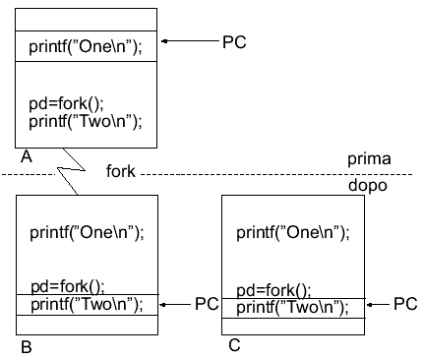
Creating processes
PID=3627
PPID=3282
PID=3627
PPID=3282
PID=3630
PPID=3627

Slide 12
Example of using fork
#include <stdio.h>
#include <unistd.h>
#include <sys/types.h>
main()
{
pid_t pid;
printf("A single process with PID %d.\n",(int)getpid());
printf("Call to fork...\n");
pid=fork();
if(pid == 0)
printf("I am the child process (PID: %d).\n",(int)getpid());
else if(pid>0)
printf("I am the parent of the process with PID %d.\n",pid);
else
printf("An error occurred while calling fork.\n");
}

Slide 13
Properties inherited from the parent process
real user ID, real group ID, effective user ID, effective group ID
additional group IDs
process group ID
sessionID
control terminal
set-user-ID flag and set-group-ID flag
current directory
root directory
file creation mask (umask)
signal mask
close-on-exec flag for all open descriptors
environment
shared memory segments
limits on resources

Slide 14
Properties NOT inherited from the parent process
fork return value
processID
process ID of the parent process
process timing values
file locks
pending alarms (cancelled in child)
set of pending signals (emptied)

Slide 15
Fork usage and errors
fork failure
the maximum number of processes in the system has been reached
the maximum number of processes per user id has been reached
Use fork:
when a process wants to duplicate itself so that parent and child execute different parts of the code, for example:
network servers (daemons) : the parent is always waiting for requests from the network; when a request arrives, it is assigned to a child, while the parent can immediately return to waiting for a new request
when a process wants to run a different program (using the exec call )

Slide 16
fork and open files (I)
All descriptors that are open in the parent process are duplicated in the child process
Before the fork :
process table
open file table
v-node table
process
0
status flag file
v-node info
1
current offset
i-node info
file size
2
vnode ptr
status flag file
v-node info
current offset
i-node info
file size
vnode ptr

Slide 17
forks and open files (II)
After the fork:
process table
open file table
v-node table
parent
0
status flag file
v-node info
1
current offset
i-node info
file size
2
vnode ptr
status flag file
v-node info
child
0
current offset
i-node info
file size
1
vnode ptr
2

Slide 18
fork and open files (III)
It is important to note that parent and child share the file offset
Let's consider the following case:
a process forks and then waits for the child process to terminate (system call wait )
suppose that stdout is redirected to a file, and that both processes write to stdout
if parent and child didn't share the same offset, we would have a problem:
the child writes to stdout and updates its current offset
the parent overrides stdout and updates its current offset

Slide 19
How to manage file descriptors
Case 1: The parent process waits for the child process to finish
in this case, the file descriptors are left unchanged
any file changes made by the child process will be reflected in the file table entry and v-node entry of the child process
Case 2: Parent and child processes are independent
in this case, everyone will close unnecessary descriptors and continue appropriately

Slide 20
Exercises
Write a C program that open()s a file, fork()s, and write()s different messages to the file depending on whether it is parent or child. How do you alternate messages in the file?
In the program described above, move the open() after the fork() and check whether the contents of the file have changed compared to the previous program and explain why.

Slide 21
Termination of processes (I)
There are three ways to end NORMALLY:
execute a return from main (this is equivalent to calling exit )
call the exit function:
void exit(int status);
invokes all exit handlers that have been registered
closes all standard I/O streams
is specified in ANSI C
call the _exit system call:
void _exit(int status);
returns to the kernel immediately
it is called as the last operation by exit
is specified in the POSIX.1 standard

Slide 22
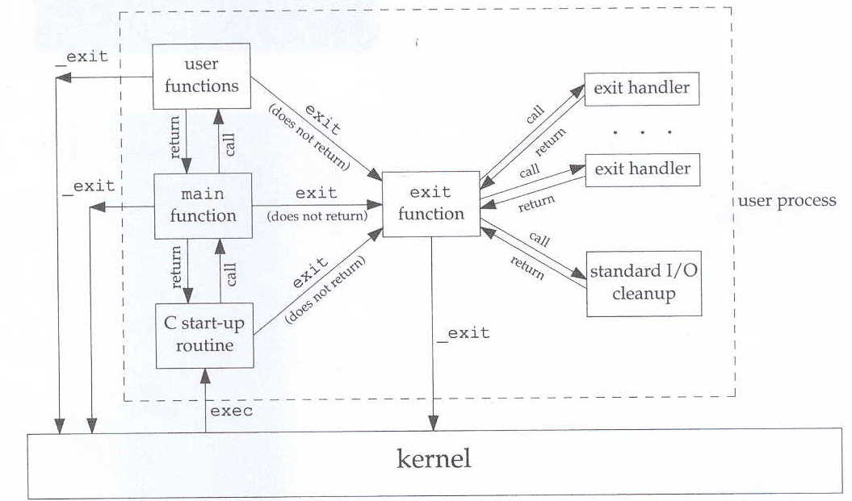
Termination of processes (II)

Slide 23
Termination of processes (III)
There are two ways to terminate ABNORMALLY:
When a process receives certain signals
generated by the process itself
generated by other processes
generated by the kernel
Calling abort:
void abort();
The call to abort constitutes a special case of the first case of the three listed above, as it generates the SIGABRT signal
NOTE: For signal information use man 7 signal

Slide 24
Kernel actions upon process termination
Both in the case of normal and abnormal termination the actions implemented by the kernel are the same:
removing memory used by the process
closing of open descriptors

Slide 25
Return values at process termination
Exit status:
Value that is passed to exit (and _exit) and that notifies the parent process about how the process ended (successful, with error)
Termination status:
Value that is generated by the kernel in the case of a normal/abnormal termination
In case of abnormal termination, the reason for this abnormal termination is specified
The exit status is converted by the kernel to termination status when _exit is finally called
How to obtain these values?
wait and waitpid functions (described later)

Slide 26
Zombie processes
What happens if the parent process finishes before the child process?
when a process terminates, the kernel examines the process table to see if it had children; in this case, the PPID of each child is set equal to 1
init process (PID=1), as the kernel wants to prevent a process from becoming "orphan" (i.e. without a PPID)
What happens if the child process finishes before the parent process?
generally the parent waits using the wait function for the child to finish and obtains various information on the exit status
if the child ends without the parent "waiting" for him, the parent would no longer have any way to obtain information on the exit status of the child
for this reason, some information about the child is kept in memory and the process becomes a zombie

Slide 27
zombie state
When a process enters the zombie state, the kernel maintains information that may be requested by the parent process via wait and waitpid
processID
termination status
accounting information (time taken by the process)
The process will remain a zombie until the parent executes one of the wait or waitpid system calls
As for the children of the process init :
they cannot become zombies
whenever a child of init terminates, init executes a wait call and collects any information: this is how zombies are eliminated from the system

Slide 28
Library calls wait and waitpid
pid_t wait(int *status);
pid_t waitpid(pid_t pid, int *status, int options);
wait and waitpid are used to obtain information about the termination of child processes
When a process calls wait or waitpid :
it may stop, if all its children are still running
can return immediately with a child's termination status, if a child has terminated and its termination status is waiting to be collected
may return immediately with an error, if the process has no children
Note:
if we call wait when we have already received SIGCHLD, it returns immediately, otherwise it blocks

Slide 29
System call wait and waitpid
Meaning of the arguments:
status is a pointer to an integer; if different from NULL, the termination status is placed in this location
The return value is the process id of the terminating child
Difference between wait and waitpid :
wait blocks the caller until any child has finished
waitpid has options to avoid crashing
waitpid can wait for a specific process
The content of the termination status depends on the implementation:
bits for normal termination, bits for exit status, etc.

Slide 30
Notes on waitpid
pid_t waitpid(pid_t pid, int *status, int options);
pid argument :
pid == -1 behaves like wait
pid > 0 waits for the child with proces id equal to pid to terminate
pid == 0 awaits termination of any child with process group ID the same as the caller's
pid < -1 awaits termination of any child with process group ID equal to –pid
Options (options argument):
WNOHANG does not block if the child has not finished

Slide 31
Notification of a child's termination
When a process terminates (normally or not), the parent is informed by receiving a SIGCHLD signal
The notification is asynchronous
The father has the possibility to:
ignore signal (default)
set up a special function, called signal handler , which is automatically invoked when the signal is received

Slide 32
Exercises
Write a program that forks, waits for its child to successfully print a message to the screen, and prints another message before exiting.
Modify the previous program so that a given number of children are generated on the command line. What happens to the other children?

