Slide 1
Module 1
Introduction to using Linux
Computer Systems & Programming
Academic Year 2023-2024
Copyright © 2023-2024 Francesco Pedullà
Copyright © 2005-2007 Francesco Pedullà, Massimo Verola
Copyright © 2001-2005 Renzo Davoli, Alberto Montresor (University of Bologna)
Permission is granted to copy, distribute and/or modify this document under the terms of the GNU Free Documentation License, Version 1.2 or any later version published by the Free Software Foundation;
with no Invariant Sections, no Front-Cover Texts, and no Back-Cover Texts.
A copy of the license can be found at: http://www.gnu.org/licenses/fdl.html#TOC1

Slide 2
Introduction
Linux is a "free" operating system inspired by Unix, originally created by Linus Torvalds and grown with the support of a multitude of developers around the world
Closely related to the GNU suite (compiler, linker, debugger, etc.), the system can correctly be called GNU/Linux
Developed under the GNU General Public License (GPL), the source code is free and freely available to anyone
Initially developed for Intel 386 microprocessors, it is now available on all the most popular computing architectures
embedded systems such as routers/firewalls, mobile phones and video recorders

Slide 3
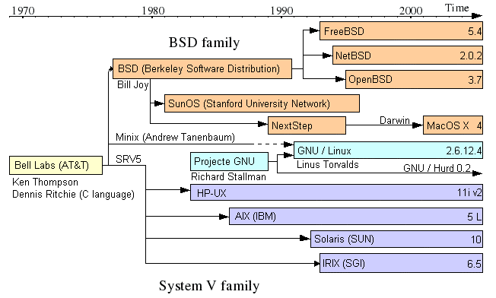
History of UNIX

Slide 4
Unix/Linux features
Multiuser / multitasking
Composition of tools (filters) at user level
Designed by programmers for programmers
“Everything is a file”
Monolithic kernel
Modularity (eg, file system)
Written almost entirely in C (like Unix)

Slide 5
General design principles
Main design principles:
speed, efficiency and standardization
Relationships with other UNIXes
"compliant" with POSIX specifications
API heavily based on UNIX SVR4
many tools and libraries derived from BSD
Integration with GNU
System
Management
Programs
User
Processes
User
Utilities
System Shared Libraries
Linux Kernel
Loadable Kernel Modules

Slide 6
Linux layers
user interface
Users
standard library interface
utility programs
(shells, editors, compilers, ...)
system calls interface
standard libraries
(fprintf, fopen, malloc, ...)
interface of
architecture
Linux kernel
(process and memory management, filesystem, I/O driver, IPC, ...)
Hardware
(CPU, RAM, disks, multimedia, serial, LAN, ...)

Slide 7
The Kernel
The kernel supports the use of dynamic modules (Loadable Kernel Module - LKM)
Modules are sections of kernel code that can be compiled, loaded, and unloaded independently of the rest of the kernel
A kernel module can typically implement a device driver, a file system, or a networking protocol
The modules interface allows third parties to write or distribute, under their own terms, device drivers or other code that cannot be distributed under the GPL

Slide 8
Login
The login procedure is used to:
authenticate the user
configure an environment for the user
start the shell
If the username and password are correct, the user gets the prompt (message that the system is ready) of the shell
Fedora Core release 3 (Heidelberg)
Kernel 2.6.9-1.667 on an i386
antarctic login: penguin
Password:
Last login: Thu Aug 18 17:13:26 on :0
[penguin@antarctic ~ ]$ echo $SHELL
/bin/bash
[penguin@antarctic ~ ]$

Slide 9
Logout
The logout procedure is used to:
release the resources allocated to the user
kill processes belonging to the user
end the user's work session
As an alternative to the logout command , you can also use exit or Ctrl-d
[penguin@antarctic ~ ]$ logout
Fedora Core release 3 (Heidelberg)
Kernel 2.6.9-1.667 on an i386
antarctic login:

Slide 10
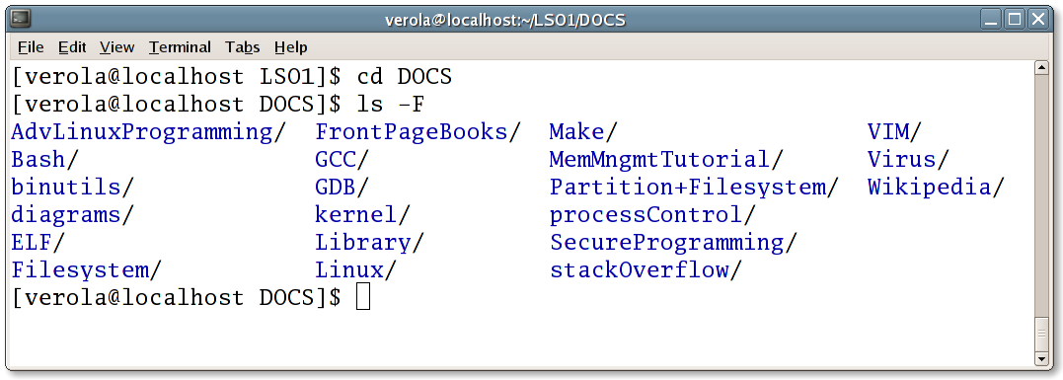
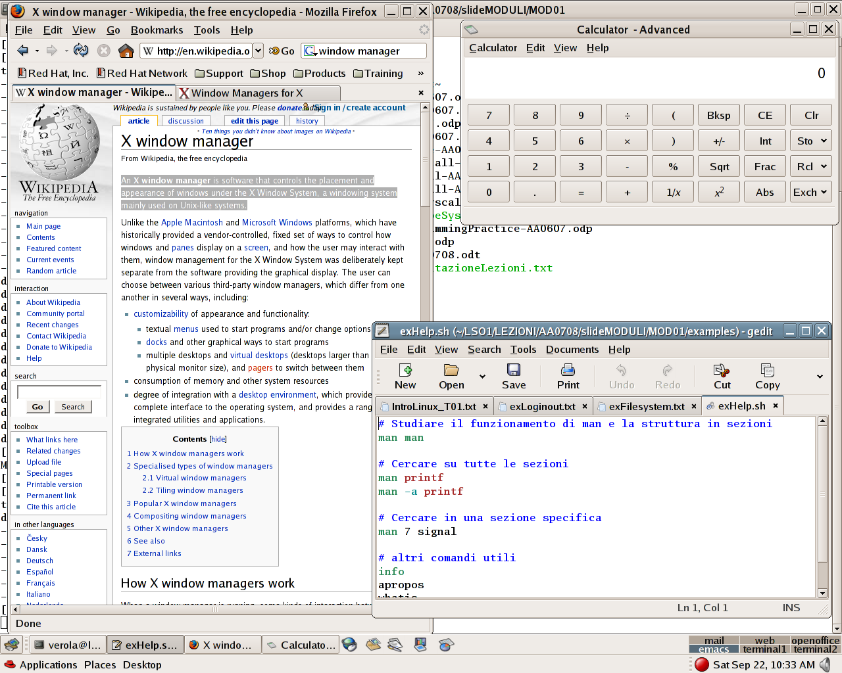
User interface
Two different ways of interacting with the user:
command interface (managed by the shell)
graphical interface (managed by the X Windows server)

Slide 11
Command interface
The user interacts with the system by sending commands to it
Each command consists of a sequence of alphanumeric characters terminated by the <ENTER> key ( <Enter> or <Return> or ↵ )
The commands follow a well-defined syntax, which is parsed by a command interpreter (in Linux it is the Shell and also the OS utility invoked by the Shell on behalf of the user)
The command interpreter verifies the correctness of the string on the command line and performs the required actions, possibly generating results or output messages on the video
[penguin@antarctic ~]$ du -sh /home/penguin
507M /home/penguin
[penguin@antarctic ~]$ by -sh /home/penguin
bash: di: command not found
[penguin@antarctic ~]$ du -sh (/home/verola
bash: syntax error near unexpected token `('

Slide 12
Graphic interface
Is based on the use of icons and graphic panels for inserting input data or selecting topics from predefined menus
Responds to the need for greater ease of use and learning of the OS, requires a graphic terminal and a mouse, in addition to the usual keyboard
The graphical interface in the Linux environment is based on the X Window System ( X11 or even just X ), which is a client/server application dedicated to providing the primitives to create GUIs:
X server: manages mouse and keyboard, draws within the graphic windows reserved for X Clients (processes that communicate with the X Server) the output data that those clients sent to the server
X client: waits for input data from the server to process it and sends the processing results to the server
GUIs under the X Window System are denoted as X window managers, i.e. those software that control the positioning, functionality and graphic style of windows
The user can choose between various X window managers, which may differ in various factors including level of customization and integration with the desktop environment

Slide 13
Main commands
The basic commands and main utilities of Linux (derived from Unix) are:
Creation of directories and files and movements in the filesystem: ls cd pwd mkdir rmdir tree touch cp rm find
Viewing and editing files: more ed vi emacs ex
Text processing: echo cat grep sort uniq sed awk tail tee head cut tr split printf
File comparison: comm cmp diff patch
Miscellaneous utility programs: test xargs find
System Administration: chmod chown ps on who
Network communication: mail telnet ftp finger ssh
Shell launch: sh bash csh ksh tcsh

Slide 14
Exercises
After obtaining a username on the PC and a password, log in, change the password and log out in various ways:
closing the entire graphics session
closing the terminal window
Open a new terminal window, familiarize yourself with the window manager functions ( minimize, maximize, resize, move, close ), if you are not familiar with them!
Analyze the mechanism of the text interface:
the prompt
entering a command
the output of the command
Run the man man command and explain its meaning

Slide 15
Filesystems - I
The filesystem is an OS module dedicated to storing information on mass memories
There are different types of file systems (ntfs, fat, ext2, ext3, jfs, ...)
Several file systems can be used simultaneously
The main functions are:
simplify access to mass storage: to read and write data you do not need to specify physical addresses using head, sector, cylinder, but simply refer to file and directory names
offer the user a structured and efficient way to organize their data
manage the various disks connected to the system, assigning or releasing secondary memory areas based on the requests of the programs that use the filesystem

Slide 16
Filesystems - II
More important filesystem functions:
Implement data protection schemes (access rights to files and directories) and policies to limit the use of disk space (quotas)
Support direct access to peripheral devices ( /dev )
Allow access to system information ( /proc )
Allow access to remote data (samba, NFS)
Allow access to data from other operating systems (NTFS, FAT)

Slide 17
Linux files
“On a UNIX/Linux system, everything is a file; if something is not a file, it is a process”
In fact, in addition to "regular" files (programs, text, images, ...), there are "special" files that can represent I/O devices, communication channels such as pipes and sockets, kernel memory areas, ...
A regular file is a sequence of bytes (there is no record structure)
The OS does not interpret the structure and contents of a file; this is delegated to the various applications
A directory is a file containing a list of names of other files and/or other directories (called subdirectories) contained in it
The Linux file system is organized hierarchically as a tree:
the root directory (indicated with “ / ”) constitutes the root of the tree
directories constitute the nodes of the tree
the files make up the leaves

Slide 18
File Types (I)
A Linux file can be of the following types (the first character is the one used by the ls command to indicate the file type):
- regular file: data in text or binary format, executables, source programs, images, ...
d directory: file that contains a list of other files
L symbolic link: file that points to another file
c character device: I/O device organized into single bytes
b block device: I/O device organized in blocks of fixed length (buffered)
p Named Pipes: Mechanism for IPC within the kernel
s socket: channel for network communications

Slide 19
File Types (II)
-l option of the ls command displays the file type, using the first character of each line of output:
[penguin@antarctic ~]$ ls -l
total 160
drwxr-xr-x 2 penguin birds 4096 Aug 13 11.07pm Desktop
drwxrwxr-x 9 penguin birds 4096 Aug 17 11.11pm LSO1
-rwxrwxr-x 1 penguin birds 6240 Aug 31 09:35 main
-rw-rw-r-- 1 penguin birds 337 Aug 31 09:35 main.c
lrwxrwxrwx 1 penguin birds 6 Aug 31 00:04 prog.c -> main.c
prw-rw-r-- 1 penguin birds 0 Aug 31 17:40 myfifo

Slide 20
Filenames (I)
A file name can be any length and can use any printable character, except the forward slash '/'
File names must be unique within the same directory
A file name starting with '.' denotes a hidden file/directory ( hidden ) and is not shown by the ls command (unless you use the -a option )
A file name should never begin with hyphen '-', as many commands treat a string starting with '-' as indicating an option
A file/directory name does not have a defined structure: any extensions (.c, .h, .txt, ...) have only a conventional and not intrinsic value

Slide 21
Filenames (II)
If a file name contains special characters such as &, *, \, $, ?, <space> , and must be used on the shell command line, precautions must be taken by escaping the characters '\' and quoting ' ' to prevent the shell from interpreting and expanding special characters
[penguin@antarctic DUMMY]$ ls -l
total 24
-rw-rw-r-- 1 verola verola 337 Sep 1 11:14 filename with spaces
-rw-rw-r-- 1 verola verola 4 Sep 1 11:18 fileWith$Dollar
-rw-rw-r-- 1 verola verola 38 Sep 1 11:17 fileWithWildcard*.c
[ penguin@antarctic DUMMY ]$ file filename with spaces
filename: ERROR: cannot open `filename' (No such file or directory)
with: ERROR: cannot open `with' (No such file or directory)
spaces: ERROR: cannot open `spaces' (No such file or directory)
[ penguin@antarctic DUMMY ]$ file 'filename with spaces'
filename with spaces: ASCII C program text
[verola@localhost DUMMY]$ file fileWith$Dollar
fileWith: ERROR: cannot open `fileWith' (No such file or directory)
[verola@localhost DUMMY]$ file fileWith\$Dollar
fileWith$Dollar: ASCII text
[verola@localhost DUMMY]$

Slide 22
Pathname
To identify a file or directory, a pathname composed of directory names separated by the ' / ' character is used; the last name is that of the directory or file in question
The pathname can be:
absolute : starts with '/' and therefore refers to the root of the filesystem
relative : starts with a directory name or is composed only of the name of the file to be addressed and the search starts from the active or working directory of the running process
The symbol '.' indicates the active directory, while '..' indicates the directory containing the active directory ( parent directory )

Slide 23
Linux filesystem example
/
bin
boot
dev
etc
home
lib
proc
sbin
sys
tmp
usr
var
user1
user2
user3
user4
bin
etc
includes
lib
local
sbin
share
src
tmp
X11R6
Absolute pathname:
/usr/src/linux
Pathname relative to /usr/bin :
../src/linux
linux

Slide 24
Root directories under Linux
/bin Basic commands ( utilities ) for users
/boot Kernel image file
/dev Device file to access peripherals or storage systems
/etc System configuration file
/home "Home directory" of users
/lib Libraries shared by programs and useful for their operation
/proc Virtual file system with no real disk allocation. It is used to provide system information, especially related to the kernel
/sbin Commands for system management, intended for the system administrator
/sys Files relating to system HW information
/tmp Temporary files directory
/usr Directory containing most of the programs existing on the system
/var Variable data, print queues

Slide 25
Filesystem related commands
pwd
Print Working Directory
cd directory
Change working Directory (“go to” directory)
mkdir directory
Make to directory
rmdir directory
ReMove directory
ls directory
LiSt directory contents
-a all files
-l long listing
-g group information
tree directory
display directory tree

Slide 26
File management
rm
ReMove (delete) files
cp
Copy files
mv
MoVe (or rename) file
ln
LiNk creation (symbolic or not)
blackberries, less
page through a text file
df [options] [directory]
shows free space on disks
> df -Tm
du [options] [directory]
> du
> two directories
> du -s directory
> du -k directories

Slide 27
Exercises
Change your working directory, verify that the command took effect, and then return to your home directory.
Check the files in your working directory and /etc.
ls command options for:
view hidden files
recursive output (list contents of all subdirectories)
list files in reverse alphabetical order
print the inode of the files
test directory in your home directory .
cp option to recursively copy a directory tree.
rm option that requires confirmation of file deletion.
Remove a file starting with '-' (e.g. -file ).
Find mkdir option that allows you to create the directory and any parent directories, if not existing.

Slide 28
The filesystem in reality
Even though files and directories are organized according to an ordered tree structure for the user, the computer does not actually know the meaning of this representation
The disk is divided into partitions and each partition has its own filesystem; the set of filesystems forms the tree structure with which the user interacts
File names are useful to the user, but the OS identifies files by their inode numbers
An inode number is a unique identifier associated with a data structure ( inode ) containing information on the properties of the file and the physical location of the data that constitute the file itself
Each partition has its own set of inodes: space for them is usually created during the system installation process

Slide 29
The inode
Each file created is assigned an inode with the following information:
file length in bytes
ID of the device containing the file
user ID of the file owner and group ID of the file
inode number
file mode, which determines the type and access and execution permissions of the file
date of last modification ( mtime ), last access ( atime ) and last modification of the inode ( ctime )
link number , which indicates the number of hard-links connected to the inode

Slide 30
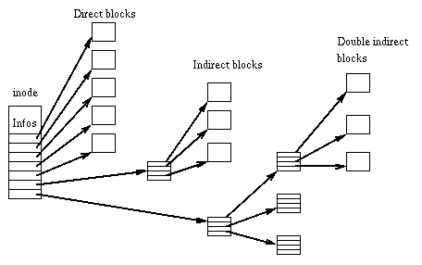
inodes and blocks on disk
inode structure ( ext2 filesystem)

Slide 31
File attributes
To get complete information about a file:
% ls –lis test.txt
72670 8 -rwxr--r-- 1 penguin birds 213 Oct 2 00:12 test.txt
Description of fields:
Index of the file's inode
Number of blocks used by the file (1 block = 1024 bytes)
File type and permissions
The hard-link count
Username and groupname of the file owner
Size in bytes
Last modification date
File name
Note that this is much of the data contained in an inode

Slide 32
Owner and group concept
Each file is associated with:
a user who owns the file
a group (ie, set of users) with special rights to the file
How to identify users and groups:
user id (integer value, Unix internals); username (string)
group id (integer value, Unix internals); groupname (string)
How to associate a user with a file:
when you create a file, it is associated with your user id
you can change the owner via chown newUserId file(s)
normally not available in a system where system quotas are managed

Slide 33
Group management
How to get the list of groups you belong to
groups [ username ]
invoked without arguments, lists the groups you belong to;
indicating username , returns the groups associated with username
How to associate a group with a file
when you create a file, it is associated with your current group
Your initial current group is chosen by the administrator
you can change your current group (by opening a new shell) via newgrp <groupname>
you can change the group associated with a file using the
chgrp command <groupname> <file(s)>

Slide 34
File permissions (I)
Each file is associated with 9 flags called “Permission bits”
Read :
regular files: ability to read the contents
directory: ability to read the list of files contained in a directory
Write :
regular files: ability to edit content
directory: ability to add, remove, rename files
Execute :
regular files: ability to execute the file (if it makes sense)
directory: possibility to cd to the directory or access it via path
User
Group
Others
R
W
X
R
W
X
R
W
X

Slide 35
File Permissions (II)
Actually:
Permission management is slightly more complex than presented
When a process is running, it has:
A real user ID / group ID (used for accounting)
An effective user ID / group ID (used for login)
What permissions are used?
If the actual user ID matches that of the file owner, User permissions apply
Otherwise, if the actual group ID matches that of the file, Group permissions apply
Otherwise, Others permissions apply

Slide 36
How to change permissions (I)
Related: chmod [ugoa][+-=][rwxXstugo] file(s)
Examples:
chmod u+x script.sh
Adds execute right for the owner to the script.sh file
chmod –R ug+rwX src/*
Adds write, read rights for the owner and group for files and contents in src/ , recursively. It also adds execute right for directories
chmod –R o-rwx $HOME
Removes all rights from all users who are not the owner and do not belong to the group, recursively
Note:
See chmod info for more details

Slide 37
How to change permissions (II)
Absolute: chmod octal-number file(s)
Examples:
chmod 755 public_html
Assign write, read and execute rights to the user, read and execute rights to the group and users
chmod 644 .procmailrc
Assign write rights, read rights to the user, read rights to the group and others
User
Group
Others
R
4
W
2
X
1
R
4
W
2
X
1
R
4
W
2
X
1

Slide 38
Links
ln file hlink
It is a hard-link, that is, it creates an entry (in the current directory) called hlink with the same inode number as the file
The link number of the file inode is incremented by 1
ln -s file slink
It is a symbolic link, that is, it creates a special file (in the current directory) called slink which "points" to the entry in the directory with the file name
The link number of the file inode is not increased
If I cancel files :
hard-link : The inode link number is decremented, but the file data is not removed from disk, until the link number becomes 0.
symbolic link : the link becomes " stale ", i.e. it points to a non-existent file.

Slide 39
Example - Initial situation
file 1
Directories:
name inode no.
inode 1
links: 1
file
There is a file named file with inode number =1 and link number =1
(i.e. only one entry in the directory refers to the inode of the file)

Slide 40
Example - Creating a hard-link
Directories:
name inode no.
data
of the
file
inode 1
links: 2
file
hlink
hard link named hlink is created which refers to inode 1, so the link number of the inode becomes 2 (i.e. 2 entries in the directory refer to the inode of the file)

Slide 41
Example - Creating a symbolic link
data
of the
file
Directories:
name inode no.
inode 1
links: 2
file
hlink
slink
inode 2
links: 1
./file
symbolic link named slink is created that points to the file with inode 1, then slink refers to a new inode 2 with link number =1;
the contents of the slink file is the pathname of the pointed file

Slide 42
Example - Removing the original file
data
of the
file
Directories:
name inode no.
inode 1
links: 1
hlink
slink
inode 2
links: 1
./file
?
file is removed from the directory, the slink symbolic link, while remaining an existing file, becomes stale

Slide 43
Exercises
Use ls to view file attributes, including inode.
What is the octal representation of the -rwxr----- permission mask? And the symbolic representation of the octal permission masks 755?
Make a directory non-executable, but readable, and cd into the dir. What do you get? And with ls dir?
Make a directory unreadable, but executable, and cd into the dir. What do you get? And with ls dir?
How can you list files in chronological order? What do the -u and -c options in ls do?
Analyze the information provided by the stat command.
Create a symlink1 symbolic link that points to a symlink2 symbolic link which in turn points to symlink1 (circular dependency). What happens if you try to read the contents of one of the 2 files?
Create a bin subdirectory within your home directory to put executables and scripts. Make a hard-link to the compress command file and a symbolic link to the date command file.

Slide 44
Process attributes
pid : process identifier
ppid : parent pid (parent process identifier)
nice number : static priority of the process; can be changed (decreased) with the nice command
TTY : terminal device associated with the process
real, effective user id
real, effective group id
Process owner and group owner identifiers
other: memory used, cpu used, etc.

Slide 45
Process monitoring
The command ps reports the status of active processes in the system (see man ps for the
meaning of the various columns)
$ ps
PID TTY TIME CMD
648 pts/2 00:00:00 bash
$ ps alx
F UID PID PPID PRI NI VSZ RSS WCHAN STAT TTY TIME COMMAND
0 0 1 0 15 0 500 244 1207b7 Y ? 0:05 init
0 0 2 1 15 0 0 0 124a05 SW ? 0:00 [keventd]
0 0 3 1 34 19 0 0 11d0be SWN ? 0:00 [ksoftirqd_CPU0]
0 0 4 1 25 0 0 0 135409 SW ? 0:00 [kswapd]
0 0 5 1 25 0 0 0 140f23 SW ? 0:00 [bdflush]
0 0 6 1 15 0 0 0 1207b7 SW ? 0:00 [kupdated]
0 0 7 1 25 0 0 0 15115f SW ? 0:00 [kinoded]
0 0 9 1 19 0 0 0 23469f SW ? 0:00 [mdrecoveryd]
0 0 12 1 15 0 0 0 1207b7 SW ? 0:00 [kreiserfsd]
0 0 150 1 0 -20 0 0 107713 SW< ? 0:00 [lvm-mpd]

Slide 46
Process priority and termination
nice command
executes a command with a static priority different from the default one (in the range from -20=maximum priority to 19=minimum priority, 0=default, for details see nice info )
nice -n 19 command
Renice command
changes the priority of a process while it is running
renice [+-] value -p pid
Command kill
sends a signal to a process; some signals can cause the process to terminate
kill -9 pid

Slide 47
Launch and control of processes
Foreground processes
Processes that "control" the terminal from which they were launched
At any given time, only one process is in the foreground
Background processes
They are executed without "checking" the terminal to
which they are "attached"
Job control
It allows you to move processes from background to foreground and vice versa
& Launch a process directly in the background
Example: long_cmd &
Ctrl+z Stop the foreground process
jobs List background processes
%n Refers to the n-th background process
Example: kill %1
fg Switch a process from background to foreground
Example: fg %1
bg Restarts stopped processes in the background
Ctrl+<x> control keys and special characters with their meaning/action will be presented in the Shell module.

Slide 48
Exercises
Review and try the various ps options .
Use the utility for a periodic ps: top .
Test the launch of foreground and background processes.
Check the effect of various Ctrl+c, Crtl+\, Crtl+z interrupts on foreground and background processes.
kill option to list supported signals.
Find a way to launch a process (e.g. sleep 30 ) in the foreground, suspend it, list it in the job list, reactivate it in the background, suspend it again, reactivate it in the foreground.
Find a way to verify the existence of a process whose PID is known, using kill , but without terminating it.
Lower the priority of a process to the lowest possible.

