Slide 1
Course Lab Introduction to IBM Watson Explorer
University of Rome «La Sapienza»
Course of Business Intelligence - 2017
Ing. Vittorio Carullo
IBM Italia
v.carullo@it.ibm.com

Slide 2
Our Target
Familiarize with a «real» software used in large organizations
Accomplish small but significant use cases in BI arena
Introduce advanced topics in BI like the use of “non structured” information

Slide 3
Lab Schedule
Lab sessions on Tuesday from October 17, 2017 , 4 - 6 pm
Presentation of the Watson Explorer tool and its basic features
(1 – 1.5 sessions)
Use of the tool for conducting standard BI use cases
(2 – 2.5 sessions)
Use of the tool for Advanced Content Analytics
(2 sessions)

Slide 4
Reference Materials
IBM Redbook on Watson Content Analytics
http://www.redbooks.ibm.com/abstracts/sg247877.html?Open
Suggested chapters: 1-6. Further chapters are more «technical»
IBM Knowledge Center
https://www.ibm.com/support/knowledgecenter/SS8NLW_11.0.2/com.ibm.discovery.es.nav.doc/explorer_analytics.htm
Use it just as a technical reference for product features

Slide 5
Today’s Contents: Loading, Configuring and Working with Data
Data Sources and Collections
Import and Configure data
Lab 2.1 – Import data
Browse and Analyze data
Lab 2.2 – Browse and Analyze

Slide 6
1. Data Sources
and Collections

Slide 7
What is a Data Source
Data Sources are “silos” where the original information we need is stored
Every BI or CA project may require different types of data that are available in different formats and stored in different containers
Data sources can be internal (-> private data) or external (-> public/ open data or data purchased from third-party vendors)
Each data source has its distinct set of characteristics that need to be managed in order to effectively acquire data

Slide 8
What is a collection?
A Collection is composed by two things
A set of documents that represents the data that will be used and processed for business purposes. Documents can be of several types (Web pages, database records, mails, readable PDF documents, etc.)
A set of configurations that explains all the processing related to these documents:
Options for extracting documents from data sources (->crawling , importing)
Options for reading and analyzing (-> parsing)
Options for storing and mining (-> indexing)
Options for retrieving (-> searching)

Slide 9
From Data Sources to Collection
Crawlers
Import
Watson Explorer Collection

Slide 10
Crawlers
Crawlers are the processes in charge of exploring data sources, get required documents and put them into collections
There are several crawler types for managing particular data source types:
Web sites on the Internet or on your intranet
Computer file systems
Mail databases
Relational Databases (IBM DB2, Oracle, MS SQL Server)
Documental systems
For each crawler, you define the location of the data to be crawled and the frequency with which to crawl it.

Slide 11
Crawling features / 1
Ease of access –No additional module is required on the data source server
Data discovery – Capability of understanding data repository structure. For example, list tables in a relational database
Efficient data retrieval – Detects new data, updated data, and deleted data.

Slide 12
Crawling features / 2
Schedule – It is possible to decide when and how collect new data (this is important for not interfering with regular user activities
Security support – Use Access Control List (ACLs) to crawl documents for secured search
Plugin – Possibility to adapt crawler to virtually any data format (requires use of custom code development)

Slide 13
Crawling vs Importing
Crawling is a dynamic process that can run independently through several days and acquire new information in an independent manner. The number of documents retrieved by a crawler is not known a priori
Importing is a batch process that is run under operator supervision in a controlled fashion and acquires a well known amount of documents
Use cases are different!

Slide 14
Data Format for Import
Usually can be imported data in CSV format
CSV (Comma Separated Values) files contain a set of records (one per row) where different fields are separated by commas. The field sequence has to be fixed
First line is usually field description names (-> Header row), while all other lines are field values
CSVs are easily produced from Excel spreadsheets and database tables

Slide 15
2. Import and
Configure Data

Slide 16
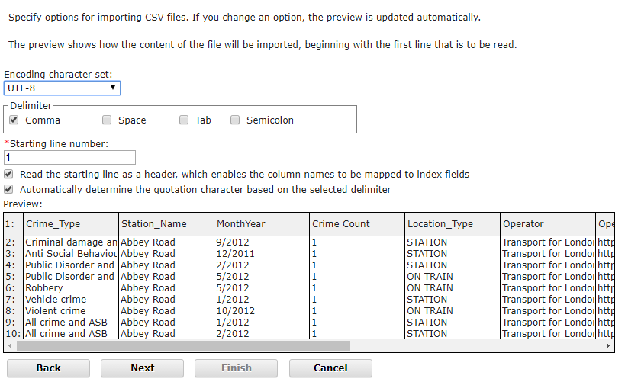
Import: Recognition of CSV structure

Slide 17
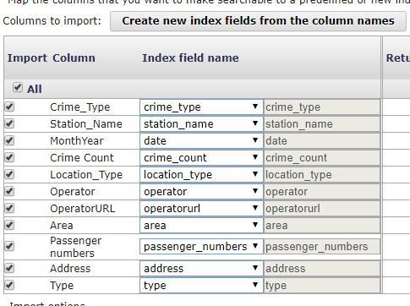
Import: Data Fields
It is important to specify :
which information (columns) to import
what has to be used as index field of the collection
Field features that will enable data search, analysis and organization

Slide 18
Free Text Search
Free Text fields can be searched with a “keyword portion” of a search expression (the classic “Google-like” use case).
For instance a product description or the body of a document
Matches are not exact but can keep into account language variations
Singular vs plural
Different lettercase (capitalized or not)
Verb conjugation
Synonims (if configured)

Slide 19
Fielded Search
It is used when the word to be searched must belong to a precise field
Classic example: Book search by author
Matches can be exact or not

Slide 20
Faceted Search
It is used when the field has a finite number of discrete values that can be enumerated
Not the case of free text fields or numeric continue values
Configuring a field for faceted search determines the creation of a facet, i.e. a grouping of values of the same type
Facets are a crucial mechanism for navigating and analyzing your data

Slide 21
Hands On: Lab 2.1
Use Administration Console
Define a collection
Import some data starting from a CSV file
Review options for data fields
Let WEX parse and index data
Console link:
http://172.31.1.2:8390/ESAdmin
Connect with credentials esadmin/uniroma1

Slide 22
Lab 2.1 instructions
Create a collections called «British Transport Crimes xx»
Collection must be of type «Content Analytics»
Start Import wizard
Use the file BTP-Nov-2012-xx.csv
(xx is a number, one different for each group)
/home/esadmin/labs/2.1/ BTP-Nov-2012-xx.csv
Look at the information and decide which kind of index field has to be assigned to each column

Slide 23
3. Browse and
Analyze Data

Slide 24
Import is complete when….
Parse and Index section is in «waiting» state and the bar is fixed blue
Search and Content Analytics section is in «running» state
Now we can switch to Content Miner interface
http://aaa:8393/ui/analytics

Slide 25
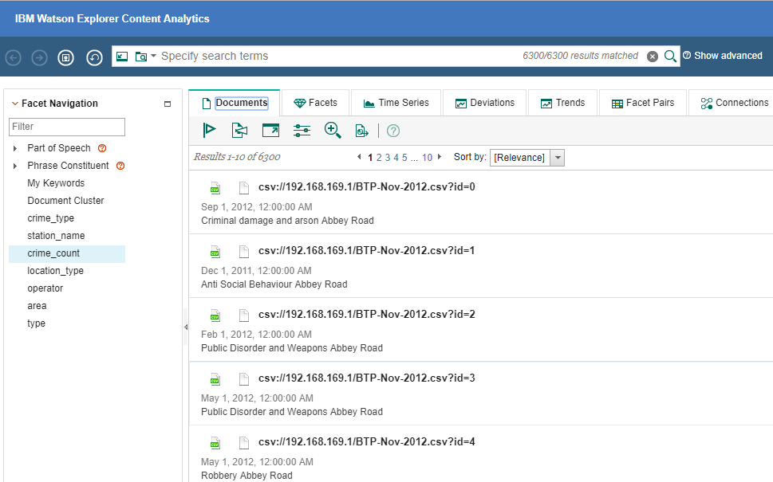
Content Miner
Documents
facets

Slide 26
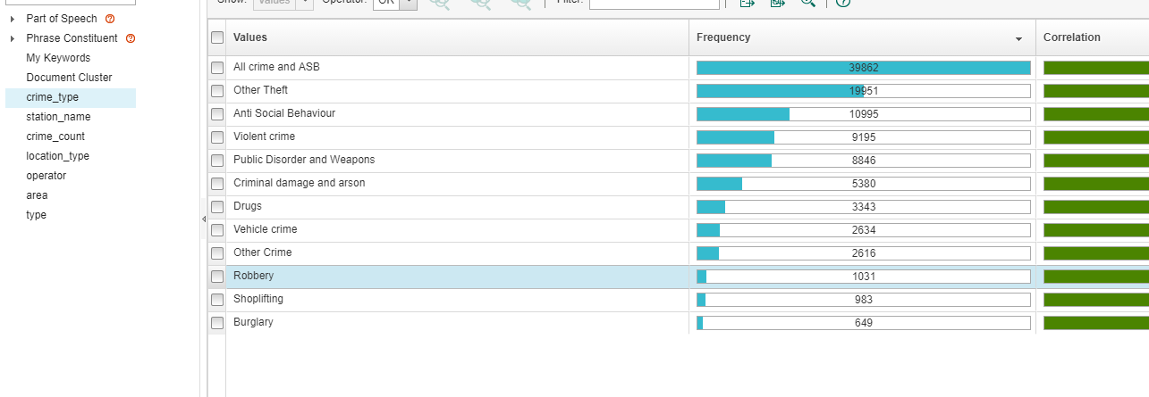
Explore facets
Frequency (Count for each value)
values

Slide 27
Frequency vs Correlation
Frequency count represent the total number of documents that contribute to a particular keyword.
The frequency can change as your query constraints changes.
Keyword are counted once for each document
Correlation is a measure of how strongly a facet value is related (correlated) to the current query or the selection criteria.
It is an index about how much two concepts are tied to each other

Slide 28
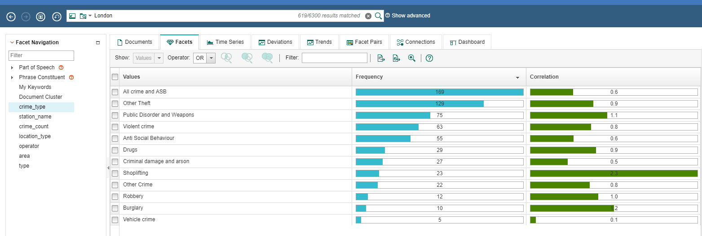
Count vs Correlation
The search create a «scope context»
count
correlation

Slide 29
Correlation between facets: Facet Pairs
Higher correlation pairs

Slide 30
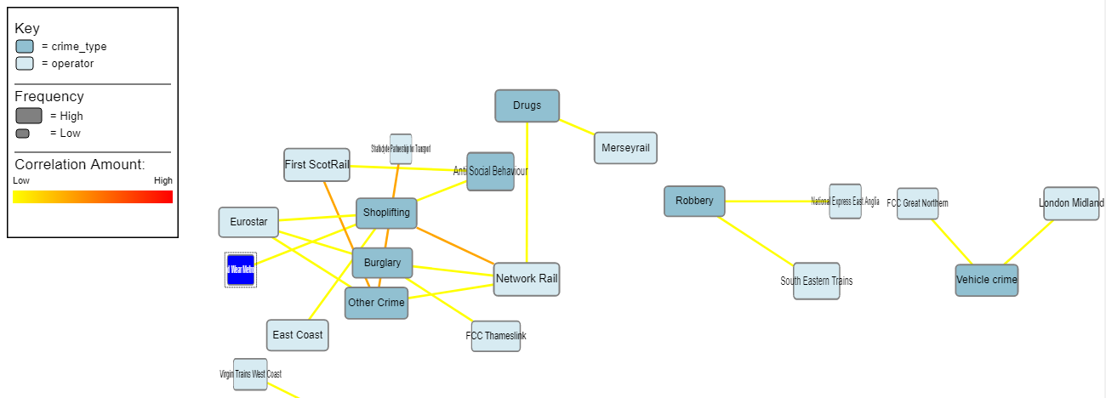
Connections
An alternate view for explore facet correlation

Slide 31
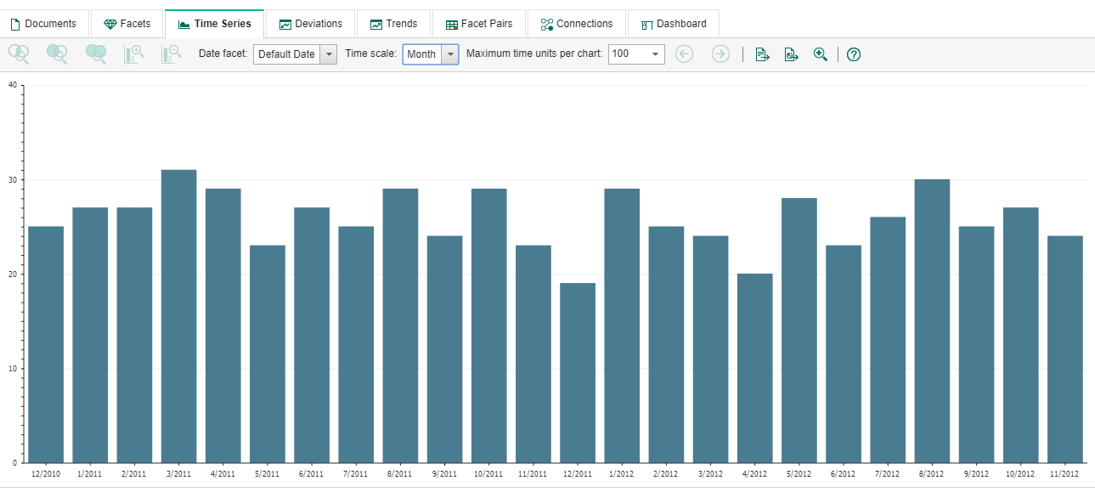
Time Series
Set time unit here
Count for each time unit

Slide 32
Time series - Warning
You can leverage time series view if
Your documents have a significant date
The date field is clearly specified in import configuration
The date format is set during import configuration with the correct syntax
20/02/2016 09:10 -> dd/MM/yyyy hh:mm
2016-02-20 09.10 -> yyyy-MM-dd hh.mm

Slide 33
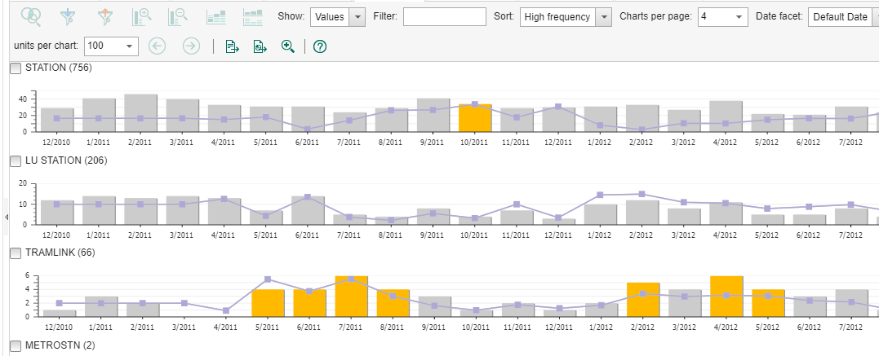
Trends

Slide 34
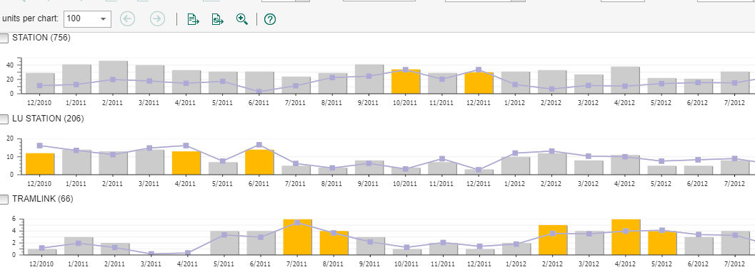
Deviations

Slide 35
Trends vs Deviations
Trends view shows unexpected increases in frequency over time.
Usually a sharp increase warrants further investigation.
Deviations view shows deviation of frequency for a given time period.
This view is focused on how much the frequency of a facet deviates from the expected average for a given time period (not from its past history as in the Trends view).
You use this view to observe cyclic patterns in your data by selecting a cyclic item in “Time scale” such as “Days of the month” or “Days of the week” showing patterns that occur on a monthly or weekly basis

Slide 36
Hands On: Lab 2.2
Use Content Miner
Select the collection you previously created
Examine different data views
Run some simple search queries
Content Miner Link
http://172.31.1.2:8393/ui/analytics
No authentication required

Slide 37
Lab 2.1 instructions
Check Facet View
Examine frequency for various facets
Focus search with a keyword (eg. «London» and view how correlation changes)
Where is «London» string searched?
Check Time Series
Change time scale from year to month
Restrict the scope to few months
Answer questions like this
How many Public Disorder cases at Strattford in 2011?

