Slide 1
Course Lab Introduction to IBM Watson Explorer
University of Rome «La Sapienza»
Course of Business Intelligence - 2017
Ing. Vittorio Carullo
IBM Italia
v.carullo@it.ibm.com

Slide 2
Our Target
Familiarize with a «real» software used in large organizations
Accomplish small but significant use cases in BI arena
Introduce advanced topics in BI like the use of “non structured” information

Slide 3
Lab Schedule
Lab sessions on Tuesday from October 17, 2017 , 4 - 6 pm
Presentation of the Watson Explorer tool and its basic features
(1 – 1.5 sessions)
Use of the tool for conducting standard BI use cases
(2 – 2.5 sessions)
Use of the tool for Advenced Content Analytics
(2 sessions)

Slide 4
Reference Materials
IBM Redbook on Watson Content Analytics
http://www.redbooks.ibm.com/abstracts/sg247877.html?Open
Suggested chapters: 1-6. Further chapters are more «technical»
IBM Knowledge Center
https://www.ibm.com/support/knowledgecenter/SS8NLW_11.0.2/com.ibm.discovery.es.nav.doc/explorer_analytics.htm
Use it just as a technical reference for product features

Slide 5
Today’s Contents: Introduction to WEX
From Data to Knowledge
A Closer Look to Content Analytics
An Even Closer Look to IBM Watson Explorer
Components of a Watson Explorer Project
Data Sources and Collections
Hands On

Slide 6
1. From Data
To Knowledge

Slide 7
2.5 Quintillion bytes of new data created daily
Expertise matters more today than ever, but even top experts can’t keep up
Are you ready for the challenges and opportunities?
Notes:
We are in the information age with a tremendous amount of data being created daily
Every day, we create 2.5 quintillion bytes of data — so much that 90% of the data in the world today has been created in the last two years alone.
This data comes from a wide range of sources and takes many different forms: human-generated documents and social media communications ; transactional data that we use to run our businesses; multimedia accounts for a huge amount of new data; and there’s an ever-increasing proliferation of sensors that produce streams of data.
We don’t have enough experts to harness this data and act on it
We need experts in different domains to sift through, normalize, understand, analyze, manipulate and act on the data. We don’t have enough experts to harness this data and harvest it so that we can utilize it. We need a cognitive solution like Watson to understand, reason and learn across the entire data universe, helping businesses and organizations scale expertise to meet new and evolving challenges.
How do we tap into the challenges and opportunities?
What I’m going to talk to you about today is how you tap into this vast and complex world of data to deliver the information and insights that the individuals in your organization need, when they need it. In the long run, if you can do this better than your competition, you’ll gain a significant edge.

Slide 8
Cognitive systems democratize innovation by scaling knowledge
sensors
data
analytics
information
cognitive
knowledge

Slide 9
Evolution from search through Cognitive Computing
Cognitive Computing
Natural language Q&A - Automated Learning – Natural Language Generation - Simulated Thinking – Factoid Responses
NLP and Contextual Discovery
Entity and Relationship Extraction - Semantic Analysis - Emotion Analysis - Contextual Search – Passage=level Answers
Unified Access
Fusion Across Multiple Sources
Business Value
Keyword Search
Record/Document
Retrieval
Simple UI
Role-specific and immersive UIs
Capabilities
Notes:
There is a natural and cumulative evolution from basic search, through advanced NLP, to cognitive computing … all with the goal of delivering actionable information and scaling expertise.

Slide 10
Objectives can be redefined:
Finding answers from siloed data.
“I know the answer is out there.”
Discovering actionable insights from structured and unstructured content.
“I don’t know the question or I don’t know what I am looking for.”
Making informed decisions from both internal and external content.
“I need to fuse external content with my organization’s content to to get the full picture.”

Slide 11
Well…..but HOW?
Answers from data
Actionable Insight
Informed Decision
Aggregate and Analyze data
Search and Discovery
Visualize analysis, patterns and trend
Content
Analytics!

Slide 12
2. A Closer Look
to Content Analytics

Slide 13
What is Content Analytics?
Content analytics is the act of applying business intelligence (BI) and business analytics (BA) practices to digital content. Companies use content analytics to provide visibility into the amount of content that is being created, the nature of that content and how it is used.
Source: whatis.com

Slide 14
BI + Text Analytics = Content Analytics
Text Analytics (NLP*) is a general term that refers to the automated techniques of converting textual data (which is also known as unstructured data) into structured data.
Content analytics refers to the text analytics process plus the applying statistics to visually identify and explore trends, patterns, and statistically relevant facts found in various types of content spread across internal and external content sources.

Slide 15
The emergence of text mining

Slide 16
Content analytics creates actionable data from unstructured content
Unstructured Content
Structured Data for Analysis
Commander 4.0 Cu. Ft.
26-Cycle King-Size washer - white. I hate this machine. Have had 3 calls on machine. You can't wash large items, Won’t clean in the middle. Leaves dry spots through the clothes, I can only do ½ basket of clothes. Will not clean or mix bleach in with the water.
Product | Commander
Category | 4.0 Cu. Ft.
Size | 26-Cycle King-Size
Model | washer
Color | white
Issue | large items
Issue | leaves dry spots
Issue | ½ basket
Issue | not clean
Issue | mix bleach
Watson Explorer
Deep Natural Language Analysis
Watson Explorer Advanced Edition
Notes:
Deliver information to knowledge workers when they need it with Watson’s advanced content analytics on-premises and on the cloud.
* Unstructured content is brimming with information that can be analyzed easily by humans but not by standard IT systems.
In this example, you see a snippet of unstructured content from a customer review of a washing machine. Typically, you would need a human to read and understand this information and act on it.
* Using deep natural language analysis, Watson Explorer Content Analytics and Watson Discovery Service can create structured data for analysis quickly from unstructured text … and deliver context-ready answers to employees and customers.
* With structured text, it is easy to visualize patterns to identify ‘hidden insights’ and make data-driven decisions

Slide 17
Content analytics uncovers the why behind the what
 | Traditional analytics explains What happened | Content analytics explains Why it happened
Customer Insight | Sales missed targets | Customers expressed negative sentiment when products failed
Healthcare | 20% increase in congestive heart failure patients’ readmission rate | Missed medical facts buried in doctors/patient notes indicate relationship of age to readmission
Insurance | Claims payouts over reserve by 8% | Missed suspicious information in accident descriptions in claims submitted
Crime | Decrease in arrests over the past six months as the crime rate slowly rises | Resources redeployed incorrectly due to unrecognized patterns in crime reports
Watson Explorer Advanced Edition
Notes:
* Structured data can be used to determine “what” happened. Usually, understanding “why” something happened requires analyzing some unstructured content.
The common thread in these examples is finding the “Why” behind “what”.
* Examine examples across different use cases (use appropriate use case for audience)
First example is about sales target being missed due out-of-stock inventory. You’ll see that the obvious reason is because you’re not selling as much but what you might not realize that extra drop in sales is due to bad reviews customers were leaving each time the product was not available.
Another example is around local law enforcement where we see decrease in arrests and increase in crime rate. With content analytics you can now identify that officers were incorrectly deployed due to new crime patterns that emerged recently.
[Note to presenter: details for each use case are provided in the supplemental slides. Insert slides relevant to your audience.]

Slide 18
Content Analytics Use Cases
Customer Insight
Crime
Analytics
Healthcare
Insurance
Finance
Customer experience
Customer satisfaction and survey analysis
Product and service quality
Churn prediction
Marketing campaign development and execution
New revenue opportunities
Product enhancements
Notes:
The area of customer insight is particularly rich and closely related to your bottom line. In today’s digital world, there’s no shortage of data that you might exploit.
You could easily start with customer experience. Customers today are not shy about expressing themselves about their experience, either directly to your organization or in social media and other digital forums. If you have access to those communications they can provide very rich content to mine. Are they happy or dissatisfied? What are the products and issues they mention most often and what terms do they use in reference to those products? What competitors do they mention? That’s just a start
Churn prediction – you can see that there is churn from your structured data. But you need to identify why that is happening. Using content analytics, you can do that by looking at indicators such as comments from customers.

Slide 19
Content Analytics Use Cases
Customer Insight
Crime
Analytics
Healthcare
Insurance
Finance
Community policing
Investigation analytics
Incident management
Anti-gang initiatives
Anti-terrorism initiatives
Cyber crime investigation
Notes:
Crime analytics is an area where content analytics is being used dramatically improve the success rate of investigations. The ability to rapidly analyze data from social media, confiscated devices, and various intercepted communications can greatly magnify the effectiveness of a law enforcement or other investigative organization.

Slide 20
Content Analytics Use Cases
Customer Insight
Crime
Analytics
Healthcare
Insurance
Finance
Diagnostic assistance
Clinical treatment
Critical care intervention
Fraud detection and prevention
Voice of the patient
Claims management
Prevention of readmissions
Patient discharge and follow-up care
Research for improved disease management
Notes:
There are a number of potential use cases in the healthcare field.
Prevention of readmission is a proven use case. For example, manager might be able to see from structured analytics that there is an increase in readmission. However a lot of information that can reveal the actual cause could be stored in notes from doctors and nurses as unstructured data. With WEX Advanced Edition, you can get to that information and look for indicators that can help in addition to existing structured data.
Numerous other opportunities exist in the healthcare field ranging from patient management to fraud detection and prevention.

Slide 21
Content Analytics Use Cases
Customer Insight
Crime
Analytics
Healthcare
Insurance
Finance
Risk assessment
Fraud detection
Policy and underwriting analysis
Claims analysis, payment validation and loss review
Reserve trending and optimization
Notes:
Potential use cases in the insurance field include:
Risk assessment. Leveraging unstructured content to reveal risk factors that are not captured through structured data analysis.
Claims analysis. Sorting and classification of claims based on content, as well as tagging claims as suspicious or low-risk.
Fraud detection. Scanning accident claims for suspicious terms, repeated passages from accident claims and other red flags.
Policy underwriting analysis. Flagging of incorrect or inappropriate terms in policies.
Reserve trending and optimization

Slide 22
Content Analytics Use Cases
Customer Insight
Crime
Analytics
Healthcare
Insurance
Finance
Anti–money laundering
Internet banking fraud
Operational efficiency
Risk management and compliance

Slide 23
3. An Even Closer Look
To IBM Watson Explorer

Slide 24
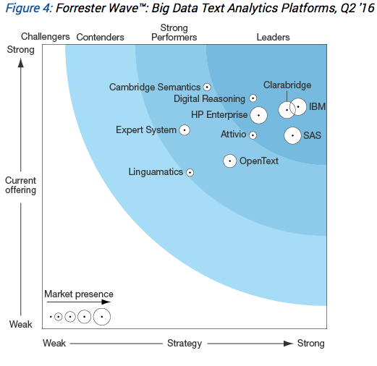
Forrester Ranks IBM Watson Explorer a leader in Content Analytics and Discovery (2016)
“IBM Watson Explorer goes beyond linguistic and statistical rules - it enriches the capabilities with over 12 cognitive APIs. Watson Explorer’s architecture allows it to address a use case not all other vendors can offer. Watson Explorer can seamlessly ingest and process structured and/or unstructured data, and perform search or analytical queries. It is also one of the few platforms evaluated in this Forrester Wave that is continuously moving more components into Hadoop, taking advantage of the low-cost distributed processing.”
The Forrester Wave™: Big Data Text Analytics Platforms, Q2 2016
Source: Forrester Research, 2015
Notes:
Recently, Forrester Research published their report on Big Data Search and Knowledge Discovery markets.
This report is the result of rigorous, transparent research by the Forrester team. I can provide you a copy of the report at no charge to help you understand how we’re different from our competitors
Forrester confirmed IBM’s market leadership in this report rating Watson Explorer as a strong offering with a strong market presence and a solid strategy.
In addition to demonstrating a strong market presence, Watson Explorer received excellent scores in key areas such as core search and knowledge discovery capabilities, administration, application deployment,

Slide 25
Challenges |  | Watson Explorer
Information Access Data, applications and services distributed on-premises and in cloud—employees struggle to get a full view |  | Explore Unified view of information from ALL systems and sources to enable new insights and better decisions
Unstructured Content 80% of data is unstructured but only a small percentage of that data is leveraged for insights |  | Analyze Analyzes both unstructured and structured content to surface actionable insights
Actionable Knowledge from Data Knowledge workers spend 88% of their time looking for hidden answers instead of taking action |  | Discover Pressure to increase performance, innovate faster and stay competitive with limited skilled resources—while doing more with less
Fast Effective Decision-making Pressure to increase performance and innovation—while doing more with less |  | Scale Expertise Integrates Watson’s cognitive APIs, machine learning and natural language processing to scale human expertise faster and enable more effective decision-making
Cloud &
On-premises
Leverage the flexibility of a hybrid architecture to realize the benefits of on-premises and cloud capabilities.
Notes:
Let’s focus now on the specific challenges that we see in organizations when confronted with today’s complex hybrid landscape of information and applications and how Watson Explorer can address these challenges.
* Today’s knowledge workers struggle to get the information they need, when they need it, in the relevant context, efficiently – Watson Explorer can unify information access from all sources in the enterprise and deliver it in context
If you’re like most organizations, it’s a constant struggle to deliver the information and insights that your front-line employees need for top performance. This was true even before the proliferation of data and hybrid environments, and it’s even more true today. The first challenge we see is one of information access. This results both from the sheer volume and variety of data in your organization and from the varied ways in which it is stored and managed. If you’re like most organizations, you have 100s of terabytes of data and it is spread across on-premises, cloud-based and external systems. To address this Watson Explorer provides the ability to explore across many different systems—on-premises and off—and deliver the right information to front-line staff, at the “point of impact” and in the proper context. If done right, this means that it doesn’t matter where the data and analytic services reside.
* 80% of organizational data is unstructured (in free text, documents, web pages, images, etc.) and only a small percentage of it is utilized – Watson Explorer can analyze this data and surface patterns and insights
Another challenge most organizations face is that most of their data—80% according to industry analysts—is “unstructured” in the form of documents, web pages and other forms of human language, mixed it with images and other media. As we’ll see in a few minutes, a tremendous amount of insight could be gained from this data if you only had a scalable way to analyze it all. To address this, Watson Explorer provides very advanced content analytics capabilities.
* Finding data is only part of the challenge; finding answers often takes far more effort – Watson Explorer can uncover hidden patterns with high confidence and accuracy
Often answers to questions are spread across multiple sources. Locating the specific part of the answer needed to help a customer or repair a product can be time-consuming. Watson Explorer uses cognitive technologies like natural language processing and machine learning to deliver relevant content, in context, to enable employees to act with confidence.
* Expertise matters more today than ever, but is scarce and difficult to scale – Watson Explorer’s cognitive computing can help!
And finally, you face the challenge of scaling the expertise in your organization. How many times have you said to yourself that you’d like to “clone” one of your experts or top performers? Now we’re not promising anything along those lines, but in fact a lot of the work that humans do to consume and process information, form hypotheses and make judgments, can be automated to a degree. Here I’m talking about the field of cognitive computing. The Watson Group has taken the key capabilities of the Watson Platform and made them accessible in the cloud. We have provided an integration layer with Watson Explorer with the ability to tap into the cognitive capabilities of the IBM Watson platform and to leverage those immediately.
And of course, Watson Explorer’s hybrid cloud architecture allows you to take advantage of the cloud while ensuring sensitive data remains secure on-premises.
Let’s examine each of these challenges individually and understand how Watson Explorer can help.

Slide 26
What is WEX (Watson EXplorer)?
A platform for rapid insight
Multiple views for visual analysis, exploration and investigation
– Unique views of content, including subdocument views
Dynamically search and explore content for new business insight
– Connections and Dashboard views to easily detect insights
– Add your own custom views
Powerful solution modeling and support for advanced classification tools for
more accurate and deeper insight
– Enhanced analytics configuration tools
Deliver rapid insight to other systems, users and applications for complete
business view

Slide 27
What is WEX (Watson EXplorer)? (cont’d)
Analyze
Aggregates and extracts information from multiple sources
Creates text-based collections from multiple sources and types, including ECM repositories, structured data, social media, and more
Organizes, indexes, analyzes, and allows you to visualize enterprise content and data
Helps identify trends, patterns, correlations, anomalies, and business context from collections
Enables users to search and explore to derive insight from collections
Helps to confirm what is suspected or uncover something new

Slide 28
WEX User Interfaces
The product provides two main user interfaces, both accessible through a Web browser:
Administration Console
http://<nome server>:8390/ESAdmin
Content Miner
http://<nome server>:8393/ui/analytics

Slide 29
WEX Administration Console
The reference view for administrative users. Use WEX Admin Console to:
Create and administer information collections
Start and stop system components
Monitor system activity
Configure system users and security
Customize search and content analytics applications

Slide 30
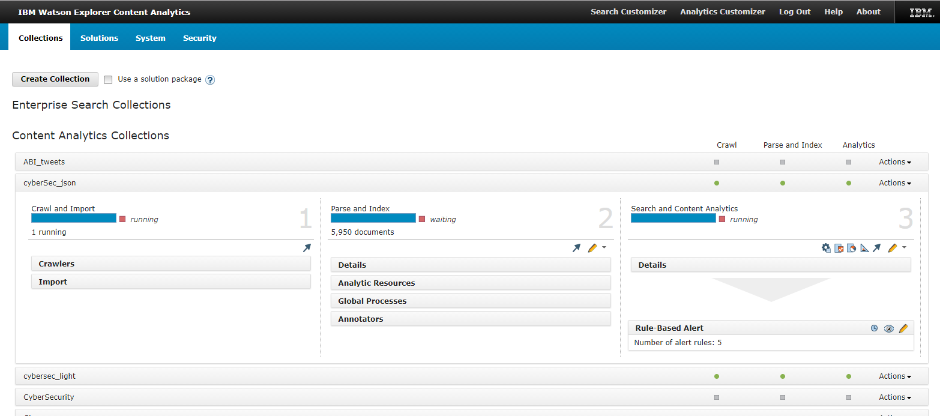
WEX Administration Console

Slide 31
WEX Content Miner
The reference view for business users and data analysts. Use WEX Content Miner to
Explore data crawled or imported into a collection
Execute complex search/queries on data
View relevant information aggregation
Discover correlation between data
Explore time-based patterns, trends and deviations
Analyze non-structured textual content and find relations, sentiment and insights

Slide 32
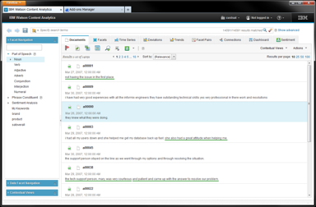
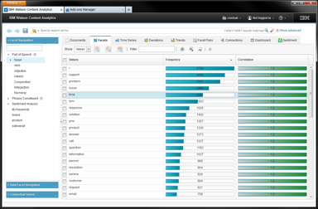
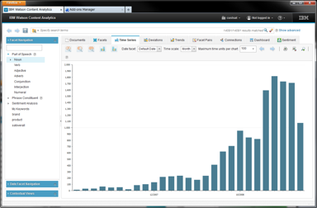
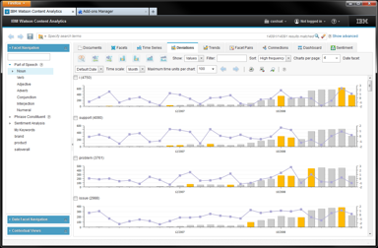
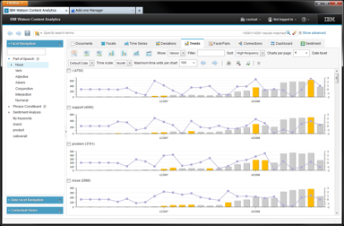
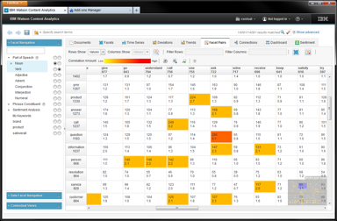
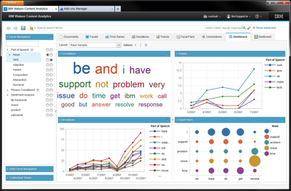
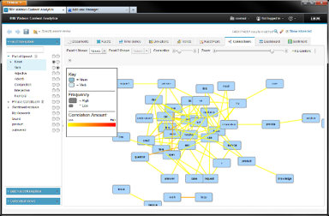
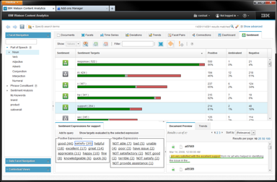
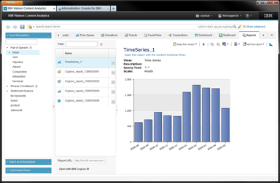
WEX Content Miner
Documents
Facets
Time Series
Deviations
Trends
Facet Pairs
Dashboard
Connections
Sentiment
Reports
Notes:
* Content Miner provides an interactive interface to help business professionals mine large amounts of text for new business insights
* Textual information is analyzed and visualized using a series of views that can show trends, patterns, and anomalies in information
For example, a user might see a rising number of references to a specific component or product in call center logs over time indicating the need to investigate whether the increased references are an early indicator of a problem or of new interest in a product capability.
* Out of the box, we have ten analytic frameworks for detecting patterns in unstructured content.
It works hand in hand with the Watson Explorer Content Analytics Studio it enables your organization to create and use content analytics projects without requiring extensive programming or coding.

Slide 33
4. Components of a
Content Analytics Project

Slide 34
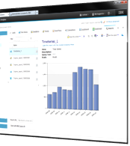
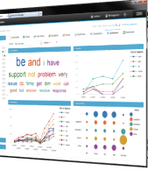
The very basic WEX architecture
Crawlers,
Import
Document
Processor
Indexer
Search &
Advanced Analytics
Collections
Parser
Data
Sources
UIMA
Pipeline
User
Interfaces

Slide 35
Definitions
Data Source – A physical or logical site that hosts data that have to be extracted and put into Content Analytics project
Crawler – Processing that retrieves documents from data sources
and gathers information that can be used to create search indexes.
Collection – A set of data sources and options for crawling,
parsing, indexing, and searching those data sources.

Slide 36
Definitions
Parser – Processing that extracts information from the documents
that are added to the data store and prepares them for indexing,
search, and retrieval.
UIMA Pipeline – A sequence of processing stages that can add or modify
information to build a more detailed analysis of the document.
Indexer – A data structure that references data items to enable a
search to find documents that contain the query terms

Slide 37
5. Data Sources
and Collections

Slide 38
What is a Data Source
Data Sources are “silos” where the original information we need is stored
Every BI or CA project may require different types of data that are available in different formats and stored in different containers
Data sources can be internal (-> private data) or external (-> public/ open data or data purchased from third-party vendors)
Each data source has its distinct set of characteristics that need to be managed in order to effectively acquire data

Slide 39
What is a collection?
A Collection is composed by two things
A set of documents that represents the data that will be used and processed for business purposes. Documents can be of several types (Web pages, database records, mails, readable PDF documents, etc.)
A set of configurations that explains all the processing related to these documents:
Options for extracting documents from data sources (->crawling , importing)
Options for reading and analyzing (-> parsing)
Options for storing and mining (-> indexing)
Options for retrieving (-> searching)

Slide 40
From Data Sources to Collection
Crawlers
Import
Watson Explorer Collection

Slide 41
Crawlers
Crawlers are the processes in charge of exploring data sources, get required documents and put them into collections
There are several crawler types for managing particular data source types:
Web sites on the Internet or on your intranet
Computer file systems
Mail databases
Relational Databases (IBM DB2, Oracle, MS SQL Server)
Documental systems
For each crawler, you define the location of the data to be crawled and the frequency with which to crawl it.

Slide 42
Crawling features / 1
Ease of access –No additional module is required on the data source server
Data discovery – Capability of understanding data repository structure. For example, list tables in a relational database
Efficient data retrieval – Detects new data, updated data, and deleted data.

Slide 43
Crawling features / 2
Schedule – It is possible to decide when and how collect new data (this is important for not interfering with regular user activities
Security support – Use Access Control List (ACLs) to crawl documents for secured search
Plugin – Possibility to adapt crawler to virtually any data format (requires use of custom code development)

Slide 44
Crawling vs Importing
Crawling is a dynamic process that can run independently through several days and acquire new information in an independent manner. The number of documents retrieved by a crawler is not known a priori
Importing is a batch process that is run under operator supervision in a controlled fashion and acquires a well known amount of documents
Use cases are different!

Slide 45
Data Format for Import
Usually can be imported data in CSV format
CSV (Comma Separated Values) files contain a set of records (one per row) where different fields are separated by commas. The field sequence has to be fixed
First line is usually field description names (-> Header row), while all other lines are field values
CSVs are easily produced from Excel spreadsheets and database tables

Slide 46
Hands On
Use Administration Console
Define a collection
Import some data starting from a CSV file
Let WEX parse and index data
Use Content Miner
View imported data
Examine different data views
Run some simple search queries

