Slide 1
Social Analytics for BI

Slide 2
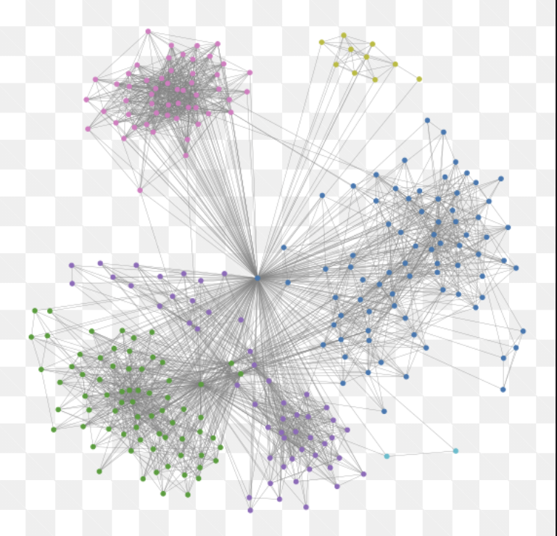
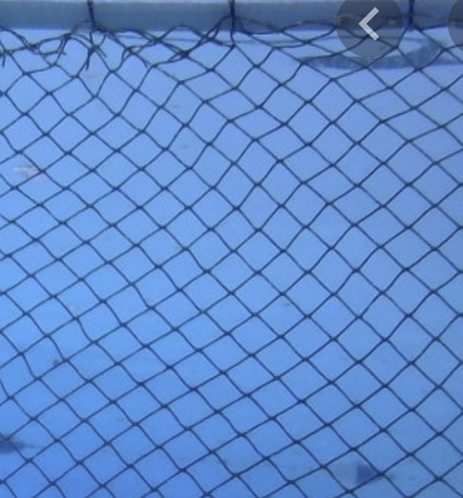
«Regular» networks and social networks

Slide 3
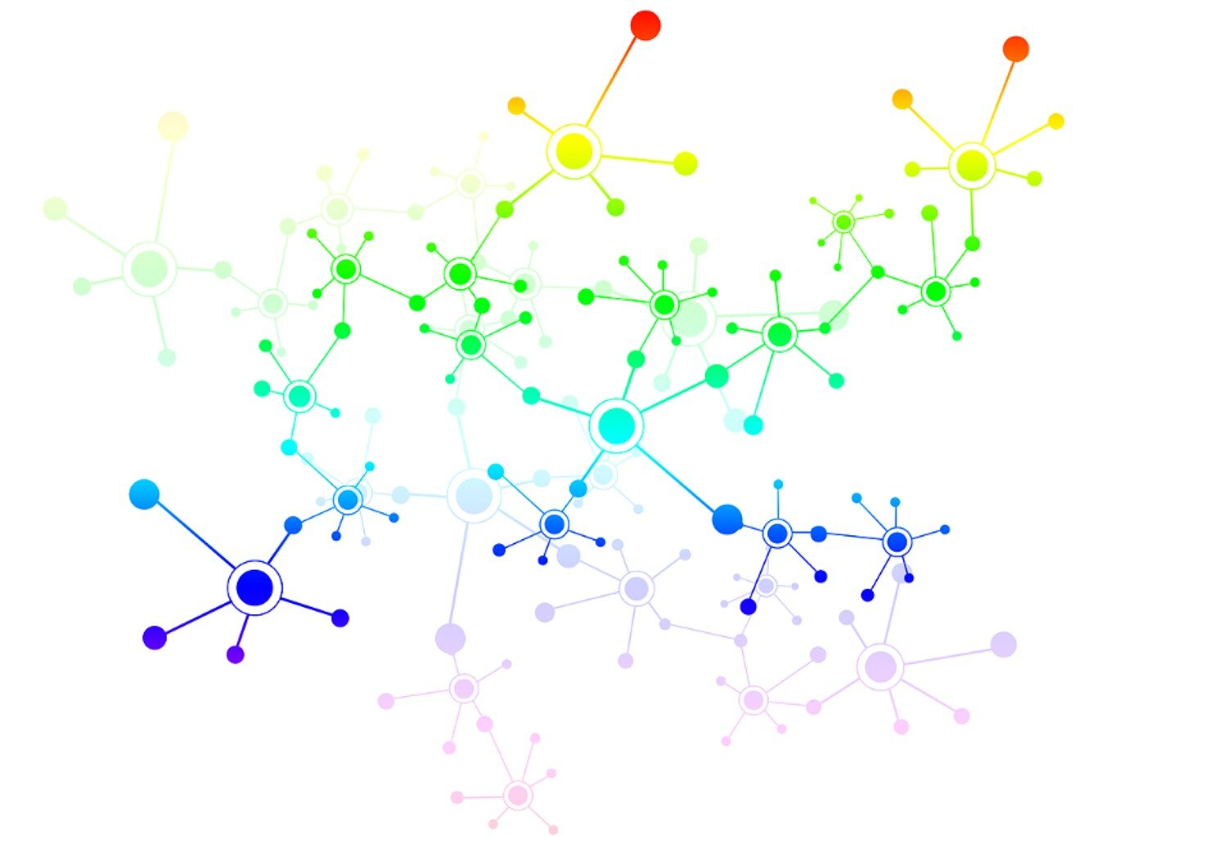
The information lies in this irregularity
Center
Bridges
Communities (small worlds)

Slide 4
Centers, bridges and communities
Centers: those who have influence on others
Bridges: those who connect different groups and facilitate the flow of information
Communities: groups of similar ones

Slide 5
Centers, bridges and communities: what for?
Centers: influencers that may promote a product
Bridges: people that facilitate spread of influence (word of the mouth)
Communities: "birds of a feather flock together.“ Exploit the homophily principle e.g., to create dedicated marketing campaign

Slide 6
Finding relevant players in SN: centers and bridges
To identify centers and bridges in a social network we need a
A better formalization: social networks as graphs

Slide 7
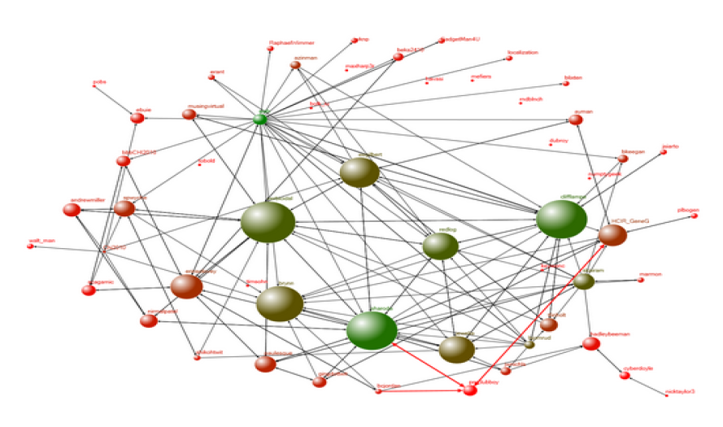
NODE= “actor, vertices, points” i.e. the social entity who participates in a certain network EDGE= “connection, edges, arcs, lines, ties” is defined by some type of relationship between these actors (e.g. friendship, reply/re-tweet, partnership between connected companies..)
Modeling a Social Network as a graph

Slide 8
SN = graph
A network can then be represented as a graph data structure
We can apply a variety of measures and analyses to the graph representing a given SN
Edges in a SN can be directed or undirected (e.g. friendship, co-authorship are usually undirected, emails are directed)

Slide 9
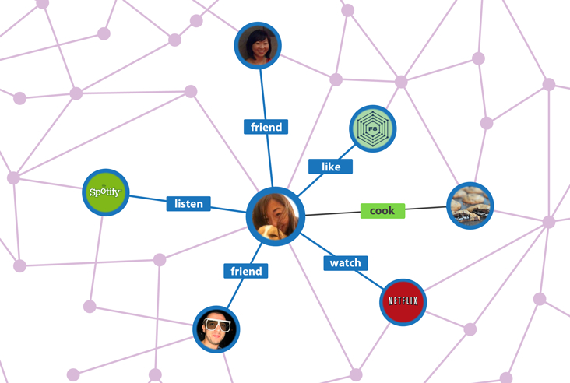
What is the meaning of edges?

Slide 10
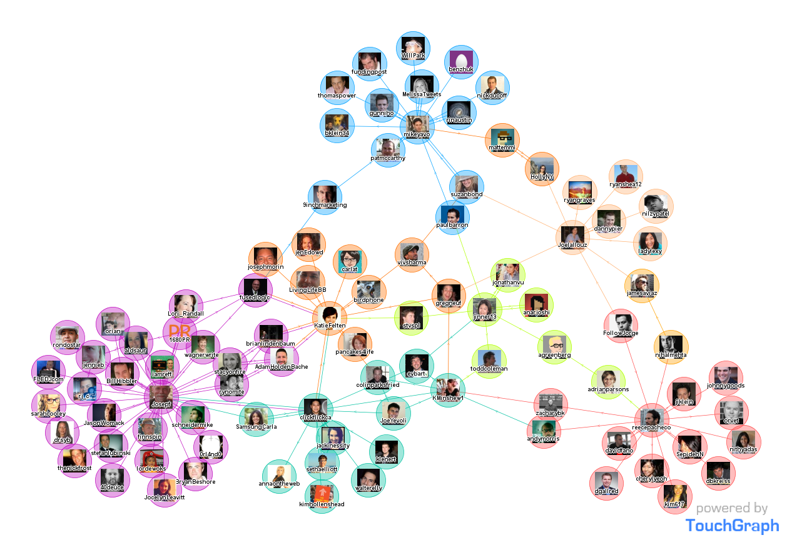
Facebook is undirected (friendship is mutual)

Slide 11
Twitter is a directed graph (friendship is not necessarily bidirectional)

Slide 12
SN as a graph
b
d
a
c
e
Directed, binary
In general, a relation can be: Binary or Valued Directed or Undirected
b
d
a
c
e
Undirected, binary
b
d
a
c
e
Directed, Valued
b
d
1
3
1
2
a
c
4
e
Undirected, Valued

Slide 13
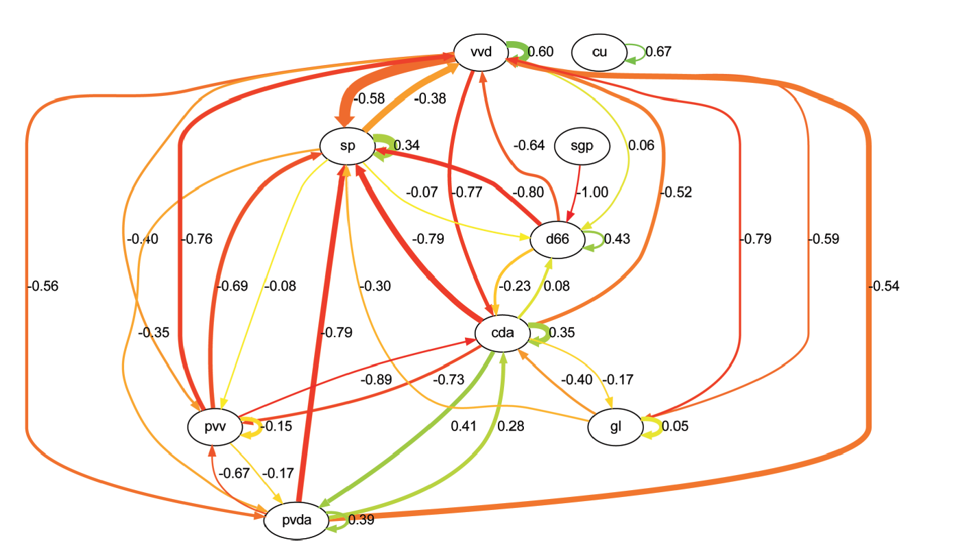
Example of directed, valued:
Sentiment relations among
parties during a political campaign.
Color: positive (green) negative (red).
Intensity (thikness of edges): related to number of mutual
references

Slide 14
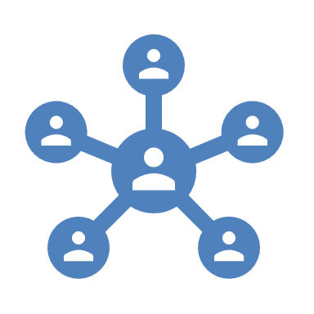
Graph-based measures of social influence
Use graph-based methods/algorithms to identify “relevant players” in the network
Relevant players = more influential, according to some criterion. (center, bridges)
Use graph-based methods to analyze the “spread” of information. (predictive)
Use graph-based methods to identify global network properties and communities (community detection, a.k.o. clustering, descriprive/prescriptive)

Slide 15
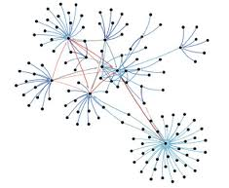
Graph-based measures of social influence: key players
Using graph theory, we can identify key players in a social network
Key players are nodes (or actors, or vertexes) with some measurable connectivity property
Two important concepts in a network are the ideas of centrality and prestige of an actor.
Centrality more suited for undirected, prestige for directed
Another important notion is that of bridgeness, or brokerage (people connecting other people)

Slide 16
Centrality degree calculation examples
Degree is the number of ties, and the actor with the most ties is the most important:

Slide 17
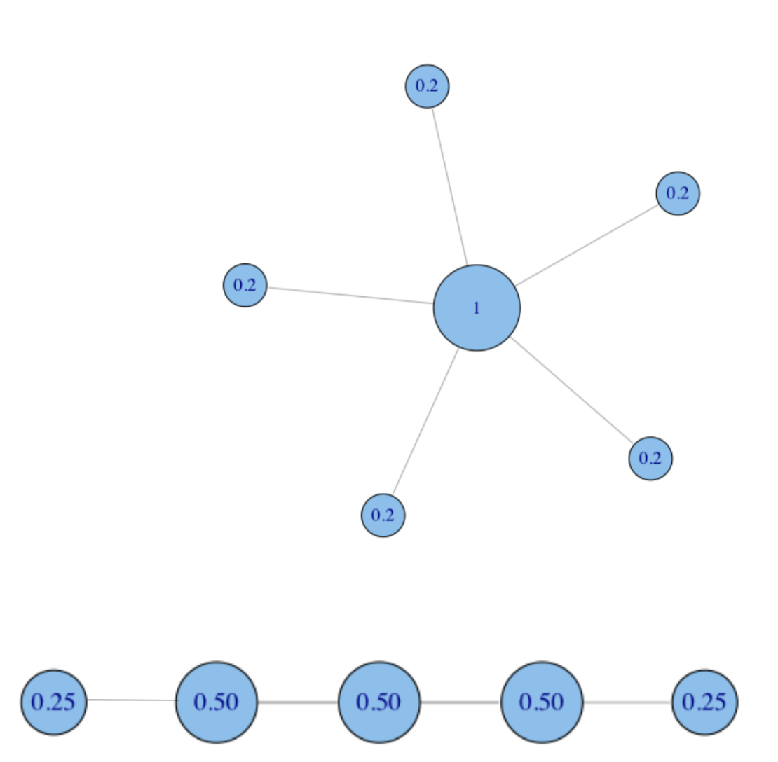
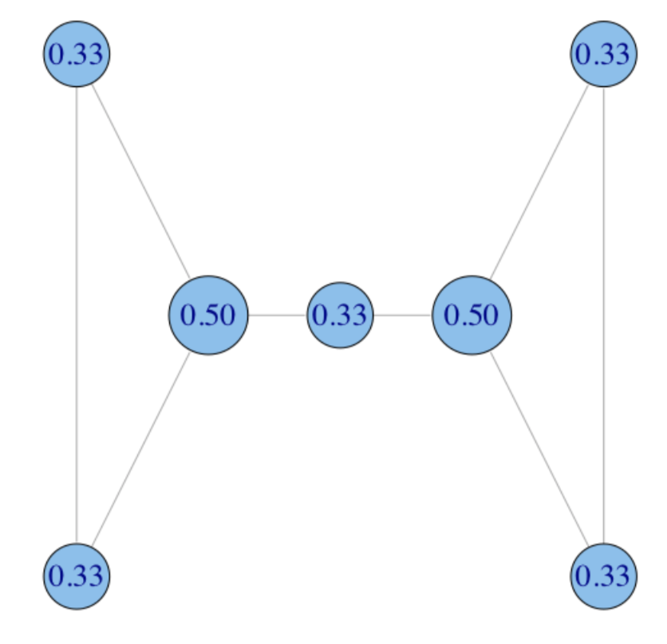
Centrality degree: normalization
Divide for the max possible value of C_{D}, i.e. N-1 for N nodes.
Another possible normalization is dividing by the max C_{D} observed value

Slide 18
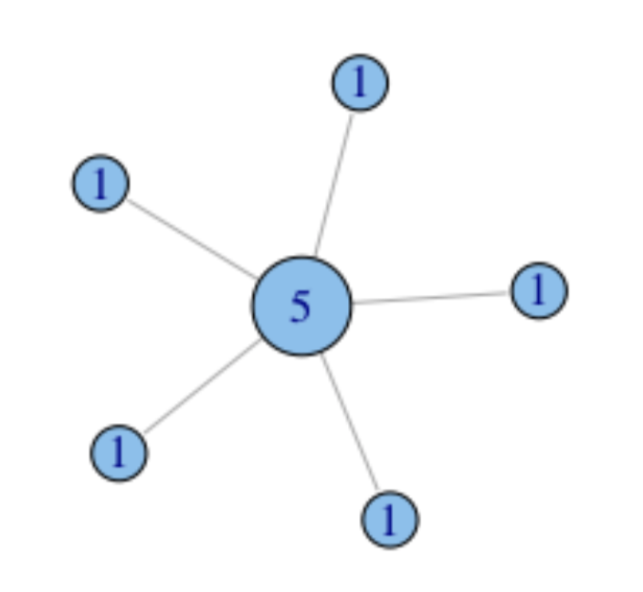
Centrality Degree = number of connections
Very simple measure, not always the best:
You are “central” if you have many friends, but perhaps you are only very “social”
Centrality degree does not account for the “importance” of your friends

Slide 19
Centrality degree for directed networks (prestige)
For directed networks (e.g., Twitter) direction is an important property of the relation.
In this case we can define two different types of centrality (also called prestige for directed networks):
one for outgoing arcs (measures of influence),
one for incoming arcs (measures of support).
Examples:
An actor has high influence, if he/she gives hints to several other actors (e.g. on Istagram).
An actor has high support, if a lot of people vote for him/her (many “likes”)
An actor can be both an influencer and highly supported

Slide 20
Problem with degree centrality
Degree Centrality depends on having many connections: but what if these connections are pretty isolated?
A truly “central” node should be one connected to many other «powerful» nodes
E.g. in a citation network: it is better to have fewer citations by very cited scientists than many citations by poorly cited scientists (being supported by other influencers)
E.g. Mario Draghi being supported by Angela Merkel is better than Mario Draghi being supported by John Doe

Slide 21
Example
If Mrs. Green is the boss, employees referring directly to her are more important

Slide 22
Measuring prestige: Page Rank
Page Rank is one of the main algorithms used by Google to rank web pages when you make a search (graph-based methods apply to any problem that can be modeled with a graph!)
A complex method but basically the idea is that the rank (prestige) of a node depends on the rank of the other nodes pointing at that node

Slide 23
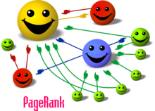
The basic principle of Page Rank

Slide 24
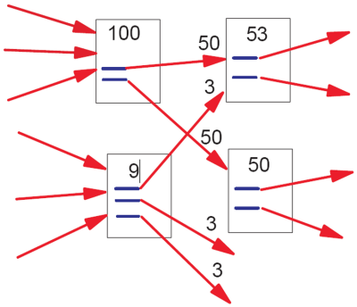
How does it works
Note this is a SIMPLIFIED formulation
Node u
A
Example: Node u is pointed by 2 nodes,
A and B with PR 100 and 9
B
A has 2 outlinks, B has 3. Some of these outlinks are connected to other nodes not shown here.
PR(u )=100/2 + 9/3=53

Slide 25
How is it calculated?
The rank of a node u depends on the rank of its pointing nodes v.
So it seems a “circular” problem: how can we compute it for all nodes?
Start with a random guess of page rank values, and keep on adjusting values until values don’t change (steady state)
In computer science, this is called RECURSION

Slide 26
0
0
1
0
Parto da pesi casuali

Slide 27
0
0
0
0
0
0
0
0,5
1
0,5

Slide 28
0,5
0
0,5
0

Slide 29
0
0,25
0
0,75

Slide 30
After several iterations..
0,22
0,11
0,22
0,44
Why stops here?

Slide 31
More on finding “key players” : bridgeness
Centrality degree, PageRank and other centrality measures tells us how a node (an individual in a social network) is “authoritative”
There are other qualities we may want to compute, for example, the “bridgeness” (also called betweenness, brokerage, key separators..)
People that link other people, acting as bridges
Model based on communication flow: A person who lies on communication paths can control communication flow, and is thus important to ensure connections (flow of information) among groups

Slide 32
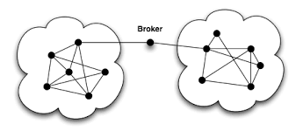
Example of bridge
Algorithms to identify bridges (also called brockers) are all based on some measure of the graph connectivity.

Slide 33
Betweenness: intuition
Intuition: how many pairs of individuals would have to go through you in order to reach one another in the minimum number of steps?
Who has higher betweenness, X or Y in these 3 examples?
Y
X

Slide 34
Formally: Betweenness Centrality
Betweenness centrality counts the number of geodesic paths between i and k that actor j resides on. Geodesics are defined as the shortest path between points
b
b MUST go through a to reach
any of c,d,e,f,g,h (and viceversa)
a
c d e f g h
Any among b,c,d,e,f,g,h must go through a to reach any other

Slide 35
Betweenness Centrality
Where g_{jk} = the number of geodesics (shortest) connecting jk, and g_{jk} (ni)= the number of such paths that node i is on (count also in the start-end nodes of the path).
Can also compute edge betweenness in the very same way

Slide 36
Example of betweenness computation
A lies between no two other vertices (betweenness is 0)
B lies between A and 3 other vertices: C, D, and E (so any information from A to C,D,E or viceversa must flow trough B: betweenness is 3)
C lies between 4 pairs of vertices (A,D),(A,E), (B,D),(B,E): betweenness is 4

Slide 37
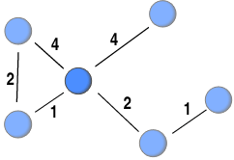
Example of computation (bridgeness of the red node)

Slide 38
Many other measures of bridgeness
Betweeness centrality, like centrality degree, is a local measure (based only on path counts)
More sophisticated algorithms are available, based on the notion of graph connectivity
The intuition is: what if we remove a node from the network? The highest the “damage” in term of connectivity, the highest the bridgeness value of the node

Slide 39
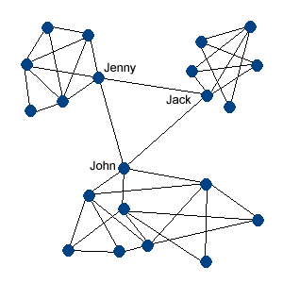
Finding Bridgeness /brokerage
Good bridges = actors that are indispensable for the flow of communication within the network
As for graph representation, good bridge sare actors that, if removed from the graph, reduces graph connectivity. For example, it causes the creation of disconnected components (Jenny, Jack and John in the graph)
This is why bridges are also called brokers or key separators

Slide 40
Other graph-based social measures
Besides identifying key players (centrality, bridgeness) other types of information are relevant, and they require a global analysis of the network, not just single nodes
E.g., If we wish to measure the likelyhood that an information originated anywhere in the network will reach you (spread of influence)
Or, if we want to identify sub-groups (communities) within a network

Slide 41
Graph-based measures of social influence
Use graph-based methods/algorithms to identify “relevant players” in the network
Relevant players = more influential, according to some criterion
Use graph-based methods to analyze the “spread” of information
Use graph-based methods to identify global network properties and communities (community detection)

Slide 42
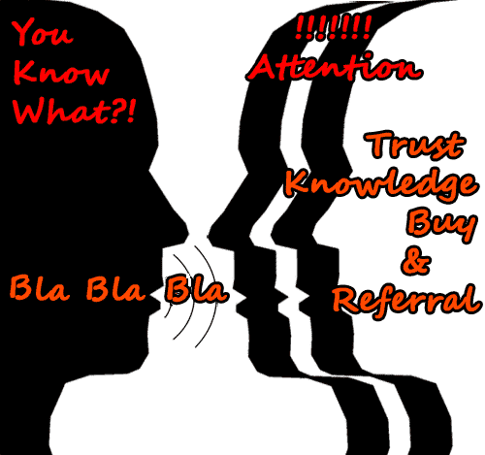
Influence Spread
We live in communities and interact with our friends, family and even strangers.
In the process, we influence each other.
Notes:
We live in communities and interact with our friends, family and even strangers. We share ideas and knowledge with them. In the process, we influence each other. This social influence, if modeled properly, can be leveraged in various applications like Viral Marketing, Recommender Systems, Feed Ranking etc.

Slide 43
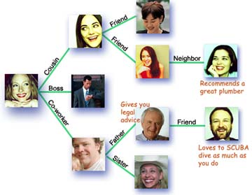
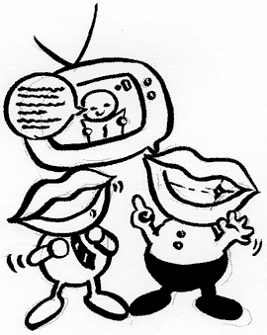
Social Network and Spread of Influence
Social network plays a fundamental role as a medium for the spread of INFLUENCE among its members
Opinions, ideas, information, innovation…
Direct Marketing takes the “word-of-mouth” effects to significantly increase profits (Gmail, Tupperware popularization, Microsoft Origami …)

Slide 44
Social Network and Spread of Influence
Examples:
Hotmail grew from zero users to 12 million users in 18 months on a small advertising budget.
A company selects a small number of customers and ask them to try a new product. The company wants to choose a small group with largest influence.
Obesity grows as fat people stay with fat people (homofily relations)
Viral Marketing..

Slide 45
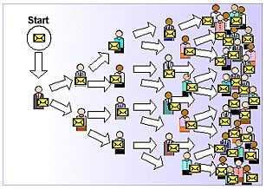
Viral Marketing
Identify influential customers
Convince them to adopt the product – Offer discount/free samples
These customers endorse the product among their friends
Notes:
One of the fundamental problems is identification of influential customers in social networks. If you convince them to adopt a product – say by offering discounts or free samples, then these customers, if they like the product will endorse it among their friends, and it will lead to large number of adoptions, driven by word-of-mouth effect.

Slide 46
Spread of Influence analysis: Problem Setting
Given
a limited budget B for initial advertising (e.g. give away free samples of product)
estimates for influence between individuals
Goal
trigger a large cascade of influence (e.g. further adoptions of a product)
Question
Which set of individuals should B target at?
Application besides product marketing
spread an innovation
detect stories in blogs (gossips)
Epidemiological analysis
Notes:
if we can try to convince a subset of individuals to adopt a new
product or innovation
But how should we choose the few key individuals to use for seeding this process?
Which blogs should one read to be most up to date?

Slide 47
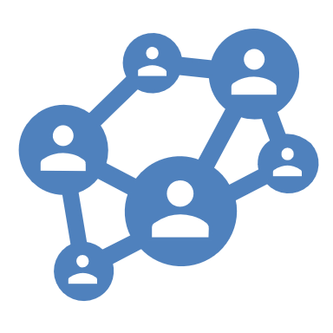
What we need
Models of influence in social networks.
Obtain data about particular network (to estimate inter-personal influence).
Algorithms to maximize spread of influence.

Slide 48
A simple algorithm
Linear Threshold Model (only the intuition..)
The basic model implies that each actor is influenced by those he/she is linked to
The influence depends on the strength of the relation between two actors (contagiousness)
It also depends on the personal tendency of an actor to be influenced by others (resistance)

Slide 49
Linear Threshold Model
A node v has some threshold θ_{v} ~ U[0,1] (this models the “tendency to be influenced”: the higher the threshold (resistance), the lower is the influence of others on an person’s opinion)
A node v is influenced by each neighbor w according to a weight b_{vw} such that
b_{v,w} models the “strength of the relation” of actor v on actor w
A node v becomes active when at least (weighted) θ_{v} fraction of its neighbors are active
We assume a cumulative effect of neighbours’influence on an actor!
Notes:
Given a random choice of thresholds, and an initial set of
active nodes A0 (with all other nodes inactive), the diffusion process
unfolds deterministically in discrete steps: in step t, all nodes
that were active in step t-1 remain active, and we activate any
node v for which the total weight of its active neighbors is at least
Theta(v)

Slide 50
Example (weights on edges are the b_{u,v})
Inactive Node
0.6
Active Node
0.3
0.2
0.2
Threshold
X
Active neighbors
0.1
0.4
U
0.5
0.3
Stop!
0.2
w
0.5
v

Slide 51
Influence Maximization Problem
Problem:
Given a parameter k (budget), find a k-node set S to maximize f(S)
In simpler terms: find the minimum number of influencer to “reward”, given the budget, which maximizes the number of individuals that can be “influenced” (through a cascade process of influence propagation”
Several algorithms (you don’t need to learn..)
Notes:
the influence of a set of nodes A: the expected number of active nodes at the end of the process.

Slide 52
Graph-based measures of social influence
Use graph-based methods/algorithms to identify “relevant players” in the network
Relevant players = more influential, according to some criterion
Use graph-based methods to analyze the “spread” of information
Use graph-based methods to identify global network properties and communities (community detection)

Slide 53
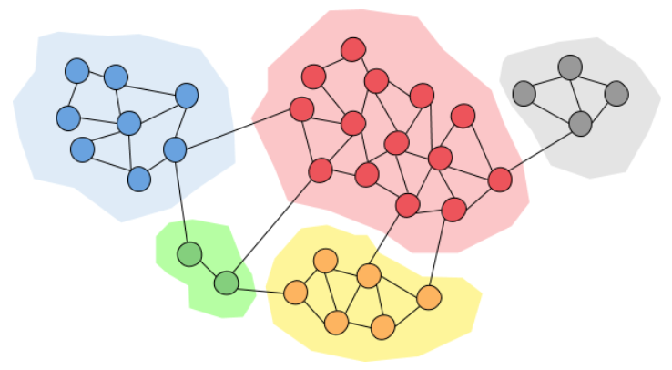
Community detection
Community: It is formed by individuals such that those within a group interact with each other more frequently than with those outside the group a.k.a. group, cluster, cohesive subgroup, module in different contexts
Community detection: discovering groups in a network where individuals’ group memberships are not explicitly given
2
Notes:
The categorization are not necessarily disjoint
; social media is becoming an aspect of the physical world
53

Slide 54
Community detection
Why communities in social media?
Human beings are social
Easy-to-use social media allows people to extend their social life in unprecedented ways
Difficult to meet friends in the physical world, but much easier to find friend online with similar interests
Interactions between nodes can help determine communities

Slide 55
Communities in Social Media
Two types of groups in social media
Explicit Groups: formed by user subscriptions (e.g. Google groups, Twitter lists)
Implicit Groups: implicitly formed by social interactions
Some social media sites allow people to join groups, however it is still necessary to extract groups based on network topology
Not all sites provide community platform
Not all people want to make effort to join groups
Groups can change dynamically
Network interaction provides rich information about the relationship between users
Can complement other kinds of information, e.g. user profile
Help network visualization and navigation
Provide basic information for other tasks, e.g. recommendation
55
Notes:
Groups are not active: the group members seldom talk to each other
Explicitly vs. implicitly formed groups
55

Slide 56
Subjectivity of Community Definition
Each component is a community
A densely-knit community
Definition of a community
can be subjective.
56
Notes:
No objective definition for a community
Visualization might help, but only for small networks
Real-world networks tend to be noisy
Need a proper criteria
56

Slide 57
Community detection = clustering
The two problems are very similar
And share the same complexity

Slide 58
A very simple method
K-means
Input is the number of communities you wish to identify, K
Algorithm:
Select K random nodes, each of these node represent the “cluster center”
Assign every other node to the cluster it is more close to
Compute the new cluster center
Iterate until clusters become stable (no more nodes are moved from one cluster to the other)

Slide 59
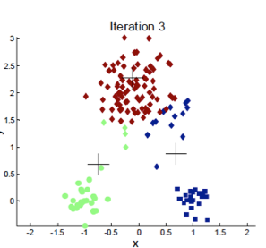
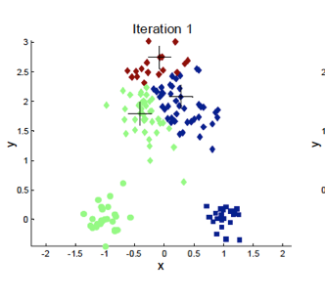
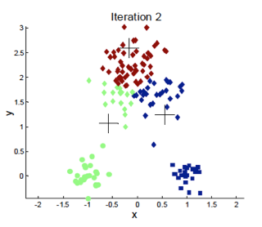
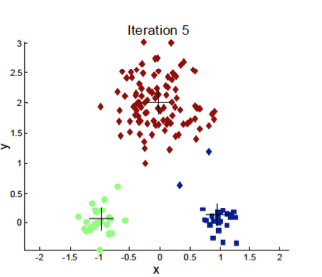
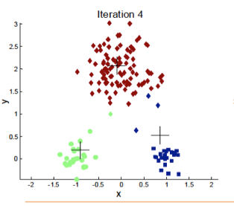
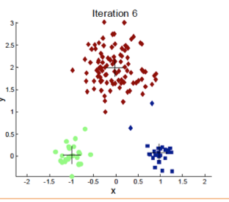
Example with K=3

Slide 60
https://www.youtube.com/watch?v=5I3Ei69I40s&ab_channel=bitLectures

Slide 61
A step-by step example (customer clustering based on purchasing behaviours)
User ID | Item 1 | Item 2
1 | 1 | 1
2 | 1 | 3
3 | 3 | 1
4 | 3 | 3
5 | 4 | 12
6 | 6 | 14
7 | 14 | 9
8 | 16 | 7
9 | 16 | 11
10 | 18 | 9
The table shows a list of users and their purchases (# of purchases for item)

Slide 62
Item 2
1 2 3 4 5 6 7 8 9 10 11 12 13 14
1 2 3 4 5 6 7 8 9 10 11 12 13 14 15 16 17 18
Item 1
Each user is represented as a point in a bi-dimensional space. In step
1, we randomly pick up 3 users who are the initial cluster seeds.

Slide 63
Item 2
1 2 3 4 5 6 7 8 9 10 11 12 13 14 15 16 17 18
Item 1
Each of the other users is assigned to the cluster whose center is
the closest among the three initial seeds

Slide 64
Item 2
1 2 3 4 5 6 7 8 9 10 11 12 13 14 15 16 17 18
Item 1
For each cluster, we compute a centroid (centroid are an “average”
of the users of each cluster – indicated by squares)

Slide 65
Item 2
1 2 3 4 5 6 7 8 9 10 11 12 13 14 15 16 17 18
Item 1
Using the new centroids, we re-assign all users to a centroid and
re-compute clusters

Slide 66
Item 2
1 2 3 4 5 6 7 8 9 10 11 12 13 14 15 16 17 18
Item 1
Based on new clusters, we re-compute centroids

Slide 67
Item 2
1 2 3 4 5 6 7 8 9 10 11 12 13 14 15 16 17 18
Item 1
..and re-assign users to clusters, based on closest centroid

Slide 68
Item 2
1 2 3 4 5 6 7 8 9 10 11 12 13 14 15 16 17 18
Item 1
We re-adjust centroids, but now re-assignment of users to clusters
produce NO changes. So we are done!

