Slide 1
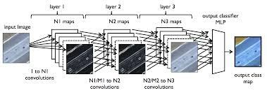
Deep Learning
a.k.a. Neural Network

Slide 2
Deep learning:
NNs with multiple internal layers
Wikipedia (October 2013) provides the following definition:
“Deep learning is set of algorithms in machine learning that attempt to learn layered models of inputs, commonly neural networks. The layers in such models correspond to distinct levels of concepts, where higher-level concepts are defined from lower-level ones, and the same lower-level concepts can help to define many higher-level concepts.”
Notes:
aggiunta data

Slide 3
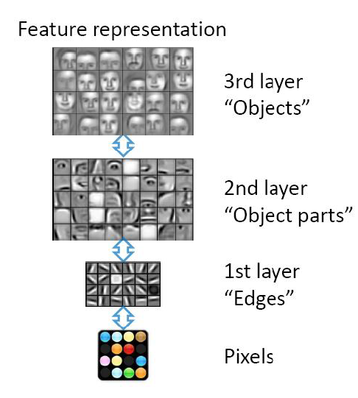
Example:
Image Processing
1
Hierarchical Learning:
The natural progression from a low level to a higher level features as seen in many real problems
Easier to monitor what is being learned in each level and guide subsequent layers
Notes:
cambiato titolo

Slide 4
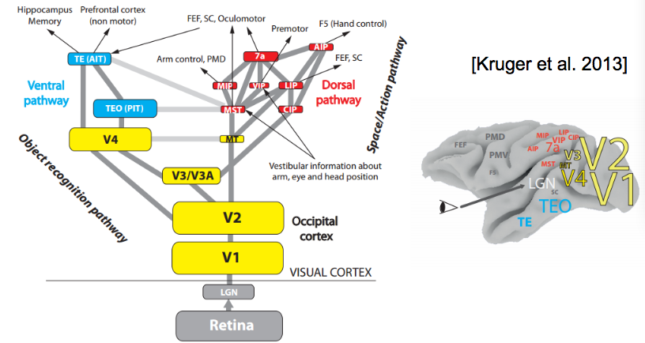
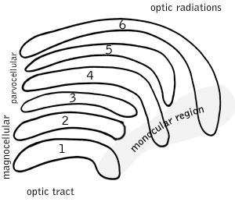
Example:
Image Processing
2
Neural Networks including many hidden layers (usually, 7-50 hidden layers) which are organized in hierarchies
The hierarchical organization allows to share and re-use information, selecting in each layer useful information and filtering useless details
Our perceptual system works on a deep hierarchy of levels
Notes:
cambiato titolo

Slide 5
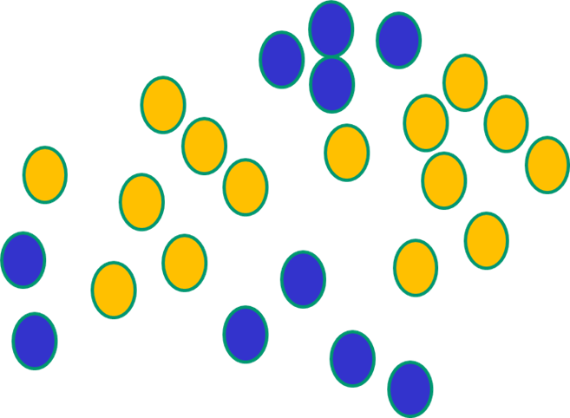
Deep learning
But, until very recently, available weight-updating algorithms (e.g., backpropagation) simply did not work on multi-layer architectures

Slide 6
Backpropagation Drawbacks
Based on iterative weight-updating
NN work by making thousands and thousands of tiny adjustments to edge weights, each making the network do better at the most recent pattern, but perhaps a little worse on many others
Gets stuck in local minima, especially since it starts with random initialization
It needs labeled data (it is a trained method) but in many important problems (especially speech recognition, image understanding) data are unlabeled

Slide 7
Complexity in NNs
The number of levels (depth) is only one of the sources of complexity. Others are the number of neurons, connections, and weights
These impact both on the cost of forwarding and backpropagation
The main problem is the vanishing/exploding gradient
What is this?

Slide 8
The Vanishing Gradient Problem
As more layers using certain activation functions (e.g. sigmoid) are added to neural networks, the gradients of the loss function approaches zero, making the network hard to train.
In short, it is related to the fact that weights updating at each layer depends on the gradient (the delta function)
Using the backpropagation, the gradient at the earlier layers is the product of terms from all the subsequent layers.
When there are many layers, there is an intrinsically unstable situation (it turns out that earlier weights gets updates much slower than the later weights).
The mathematical motivation for instability lies in the used activation functions, like the sigmoid function, that squishes a large input space into a small input space between 0 and 1. For example, the sigmoid function, whose derivative has the shape of a gaussian distribution. (link, link)

Slide 9
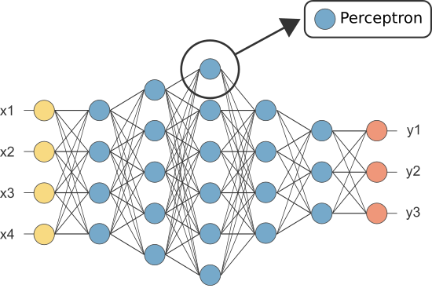
Vanishing gradient 1
$$δ_{j}^{1}=o_{j}^{1}\left(1−o_{j}^{1}\right)\sum_{j→k}{δ_{k}^{2}}w_{jk}=o_{j}^{1}\left(1−o_{j}^{1}\right)\sum_{j→k}{{\left(o\right.}_{k}^{2}\left(1−o_{k}^{2}\right)\sum_{k→i}{δ_{i}^{3}}w_{ki}}{\left) w\right.}_{jk}=o_{j}^{1}\left(1−o_{j}^{1}\right)\sum_{j→k}{{\left(o\right.}_{k}^{2}\left(1−o_{k}^{2}\right)\sum_{k→i}{\left.{\left(o\right.}_{i}^{3}\left(1−o_{i}^{3}\right)\sum_{i→n}{δ_{n}^{4}}w_{in}\right)}w_{ki}}{\left) w\right.}_{jk}=$$
$$δ_{j}^{1}=o_{j}^{1}\left(1−o_{j}^{1}\right)\sum_{j→k}{δ_{k}^{2}}w_{jk}=o_{j}^{1}\left(1−o_{j}^{1}\right)\sum_{j→k}{{\left(o\right.}_{k}^{2}\left(1−o_{k}^{2}\right)\sum_{k→i}{δ_{i}^{3}}w_{ki}}{\left) w\right.}_{jk}$$
$$δ_{j}^{1}=o_{j}^{1}\left(1−o_{j}^{1}\right)\sum_{j→k}{δ_{k}^{2}}w_{jk}$$
Where σ(x) is the sigmoid function
So, deltas at the initial layers are the results of repetitive multiplications of derivatives of the sigmoid function and synaptic weights, which are all -1<w<1
δj¹
δi³
δk²

Slide 10
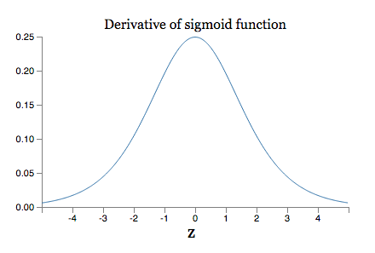
Vanishing Gradient:
Example
2
Since weights are usually -1<w<1, and the derivative of a sigmoid σ’(x) has the following shape:
Then, the “deltas” at the initial levels become quickly very small as the number of layers increase (the product of many derivatives all much lower than one) – causing very slow convergence on stable values

Slide 11
How to avoid:
The vanishing gradient problem
Solutions:
Simplest method: use other activation functions which doesn’t cause a small derivative (e.g. ReLU).
Residual networks: they provide residual connections straight to earlier layers. This residual connection doesn’t go through activation functions that “squashes” the derivatives, resulting in a higher overall derivative of the block. (link, link)
Batch Normalization layers.

Slide 12
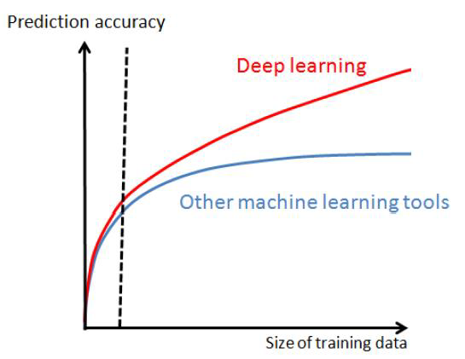
Deep Neural Network Advantages
1
Big data: e.g. ImageNet, millions of categorized images. DNNs show a clear advantage only with very large data sets (easier to find regularities)
Notes:
cambiato titolo

Slide 13
Deep Neural Network Advantages
2
High-performance computing (such as GPU, graphics processing units): we can train models with many layers, nodes and connections thanks to HPC like Hadoop, NoSQL, Spark, etc.
Vanishing Gradient: This is greatly simplified by the use of ReLU function (rectifier linear unit, see later)
Versatile method: Deep Neural Network approaches can be used for supervised, semi-supervised, unsupervised problems and reinforcement learning.

Slide 14
Many Deep Learning algorithms
1. Feedforward “discriminative” models (semi-supervised training, used for image processing):
CNN Convolutional Neural Networks
FC DNN- Fully Connected DNN
HTM – Hierarchical Temporal memory
2. Unsupervised training (“generative” models to re-build the input, select salient features, etc)
Stacked Denoising Auto-Encoders
RBM –Restricted Boltzmann Machine
DBN Deep Belief networks
3. Recurrent models (used for sequences, such as speech, natural language, patients trajectories..)
RNN Recurrent neural Networks
LSTM Long Short-Term memory
GRU gated recurrent units
4. Reinforcement learning (to learn behaviors)
Deep Q-Learning
And everything augmented with Attention mechanisms, that compute a mask which is used to multiply features link

Slide 15
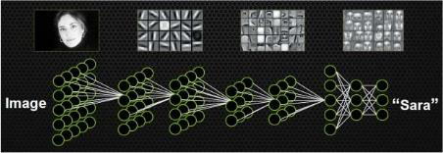
CNN
Explicitly designed for image processing (although used also in speech processing and many other tasks)
Architecture: a hierarchy of “loosely” connected layers, except for the last layers which are usually fully connected
The first layer is directly connected to pixels

Slide 16
Convolution
Important concepts in CNN
Volumes of convoluvolutors
Strides
Padding
Activation
function
Pooling
Softmax

Slide 17
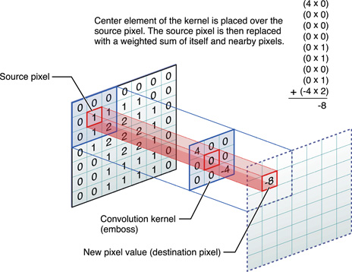
Convolution: what is ?
A digital filter (a small 2D weight mask, also called kernel) of slides over the different input positions;
For each position, an output value is generated by replacing the source pixel with a weighted sum of itself and it nearby pixels.
So here each neuron performs a convolution on a subset of input signals

