Slide 1
Convolution
Volumes of convoluvolutors
Strides
Padding
Activation
function
Pooling
Softmax

Slide 2
Strides:
Kernel slide on input with a 1-unit step (moves 1 neuron to the left). We can use higher increment, or stride. This further reduces the number of connections to be learned.
A stride of 2 or 4 may imply a high-efficiency gain on first layers

Slide 3
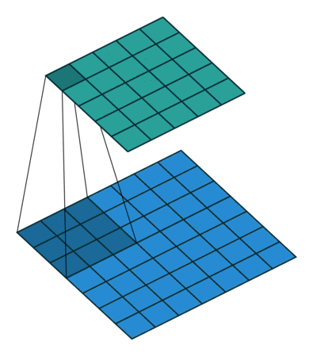
Example of Stride=1
1

Slide 4
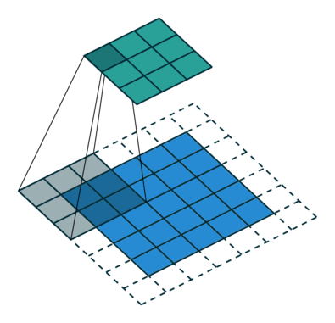
Example of Stride=2
2

Slide 5
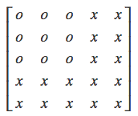
Why strides?
1
They reduce the size (width, length) of the next layer, and lets you decide how much overlap you want between two output values in a layer.
Let’s say you have a 5x5 input to a layer, and the kernel is 3x3. This is the first thing it sees:

Slide 6
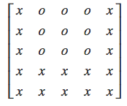
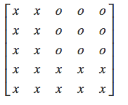
Why strides?
2
With a stride of 1, this will be the second thing:
With a stride of two, instead:

Slide 7
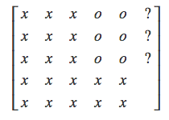
Why strides?
3
With a stride of 3:
We exceed the boundary of the input. So, how can we avoid this problem?

Slide 8
Convolution
Volumes of convoluvolutors
Strides
Padding
Activation
function
Pooling
Softmax

Slide 9
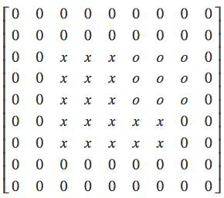
Padding
To solve the problem of extremes edges (filters that either don’t reach an edge or exceed the boundaries) we use 0-valued borders to the input volume. This is called padding
Around the entire input, we add padding data with a width equal to the kernel/filter width minus one (or height equal to kernel height minus one) P=F-1 (larger paddings can be used)
The (hyper)parameter “padding” P defines the thickness of such borders.

Slide 10
Computing output volume with strides and padding
Let W_{out} be the (horizontal) size of the output and W_{in} the corresponding input dimension. Also, let 𝐹 be the horizontal size of the kernel/filter. The following relationship applies:
𝑊_{𝑜𝑢𝑡} = ((𝑊_{𝑖𝑛}-𝐹 + 2 ∙ 𝑃𝑎𝑑𝑑𝑖𝑛𝑔)/Stride) + 1
A similar relationship links the vertical parameters.
In previous example, padding=2, F=3, W_{in}=5; stride=3, 𝑊_{𝑜𝑢𝑡} =((5-3+2x2)/3)+1)= 3
Large strides, large compression

Slide 11
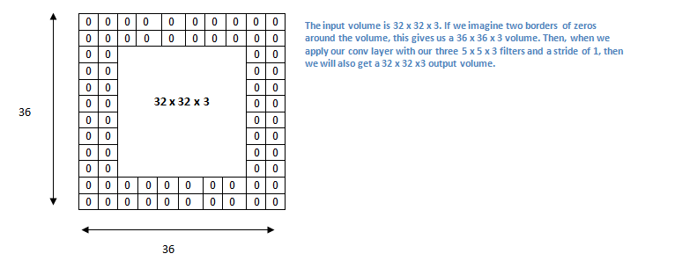
Another example
Let’s consider the case in which we have an input volume of 32x32x3 and we apply a filter of 5x5x3 with stride 1. Now, let’s apply a padding of size 2 to the input volume
Padding= 2, 𝑊_{𝑖𝑛} = 32, Stride= 1, 𝐹 = 5 →𝑊_{𝑜𝑢𝑡} = 32.

Slide 12
Convolution
Volumes of convoluvolutors
Strides
Padding
Activation
function
Pooling
Softmax

Slide 13
ReLU
1
In the Multilayer Perceptron (MLP) networks the most used (historically) activation function is the sigmoid function.
In deep networks, the use of sigmoid is problematic for the vanishing gradient problem, as we have seen.
Notes:
cambiare titolo

Slide 14
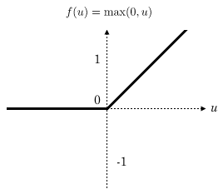
ReLU
2
To solve this problem the Rectified Linear (ReLU) activation function is used
The derivative is 0 for negative or null values of the net(x)
No saturation for positive values
It causes sparse activation of
neurons which are shown to add robustness

Slide 15
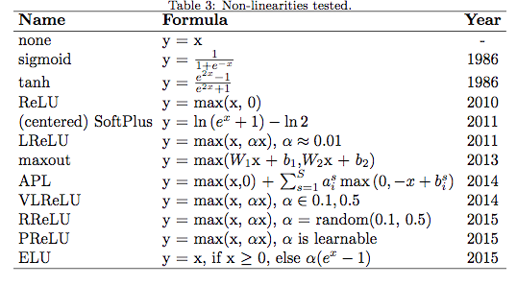
Types of Activation Functions (many are used in Deep Learning)
To learn more on CNN hyper-parameters: link

Slide 16
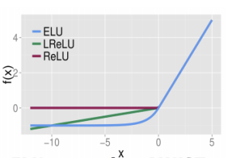
ELU, ReLU, LReLU

Slide 17
Convolution
Volumes of convoluvolutors
Strides
Padding
Activation
function
Pooling
Softmax

Slide 18
Pooling Layer
Pooling is to aggregate data in input volume, to generate lower dimension feature maps (it is another method to compress data)
A Pooling layer is frequently used in convolutional neural networks, with the purpose to progressively reduce the spatial size of the representation, to reduce the number of features and the computational complexity of the network.
The main reason for the pooling layer is to prevent the model from overfitting. The idea is to reduce the number of unnecessary details, keeping the “invariants”.
“Reasonably” invariant for small translations are the average and max pooling
Pooling is performed (usually) within single feature maps (slices), so the number of features is not reduced
It makes sense for images (not always reasonable for other types of input)

Slide 19
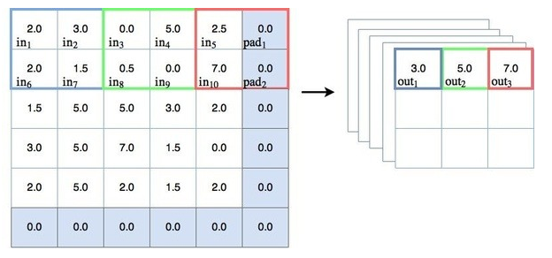
Max pooling

Slide 20
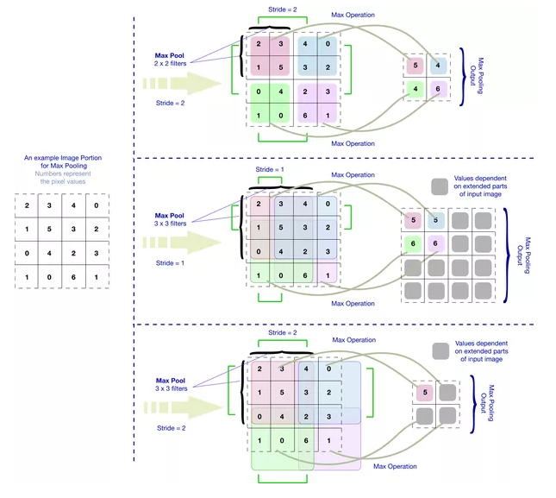
Pooling with strides

Slide 21
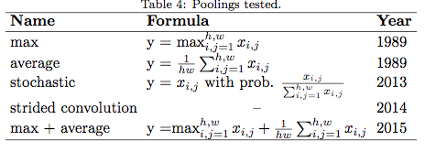
Pooling methods
More on: link

Slide 22
Advantages of pooling
1
The idea is that pooling creates "summaries" of each sub-region.
Dimension Reduction: In deep learning when we train a model, because of excessive data size the model can take a huge amount of time for training. Now consider the use of max-pooling of size 5x5 with 1 stride. It reduces the successive region of size 5x5 of the given image to a 1x1 region with a max value of the 5x5 region. Here pooling reduces the 25 (5x5) pixel to a single pixel (1x1) (less weights to learn in subsequent layers).

Slide 23
Advantages of pooling
2
Rotational/Position Invariance Feature Extraction: Pooling can also be used for extracting rotational and position invariant feature.
Consider the same example of using pooling of size 5x5. Pooling extracts the max value from the given 5x5 region. Extract the dominant feature value (max value) from the given region, irrespective of the position of the feature value.
The max value would be the same from any position inside the region. Pooling thus provides rotational/positional invariant feature extraction.

Slide 24
Pooling Caveat
It is important to be careful in the use of the pooling layer since you are actually reducing the “context” of elements within a given input (e.g., pixels surrounding a pixel; words to the left and right of a word; etc)
While it would help significantly reduce the complexity of the model, it might cause to lose the location sensitivity in the model.
This is particularly problematic e.g., for text processing tasks, where context might be very important, but also in images (see next example)
Notes:
Cambiato titolo

Slide 25
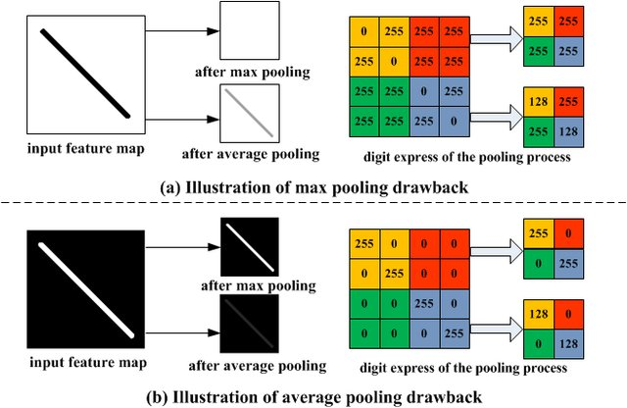
Pooling Drawbacks
example
Notes:
cambiato titolo

Slide 26
Convolution
Volumes of convoluvolutors
Strides
Padding
Activation
function
Pooling
Softmax

Slide 27
Softmax Function
As anticipated, the final level of a CNN is a fully connected network
It consists of 𝑠 neurons (one for each class) fully-connected to neurons of the previous level. The activation level 𝑛𝑒𝑡_{𝑘} of individual neurons is calculated in the usual way, but the activation function for the 𝑘 -th neuron is (instead of Sigmoid or ReLU):
where the y_{k} can be interpreted as probabilities since they are in the [0,1] range
$y_{k}$=f(${net}_{k}$)=$\frac{e^{{net}_{k}^{}}}{\sum_{j}{e^{{net}_{j}}}}$
Notes:
Titolo cambiato

Slide 28
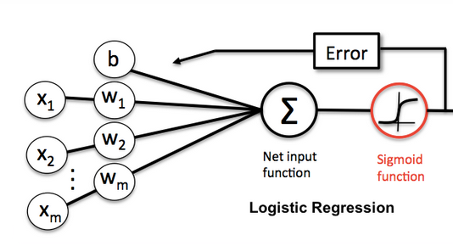
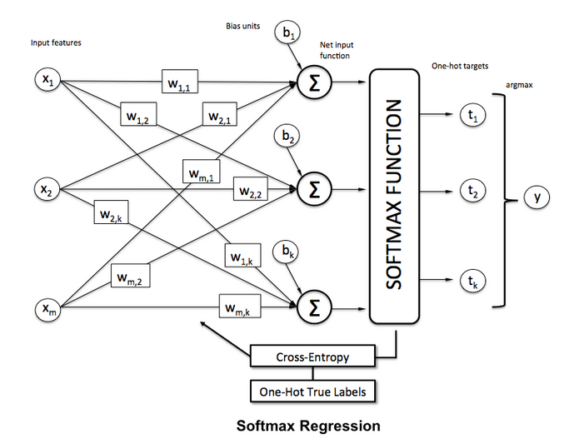
Softmax VS Sigmoid
Note: b here is the bias/threshold, as usual
Fully connected
NN layer with softmax

Slide 29
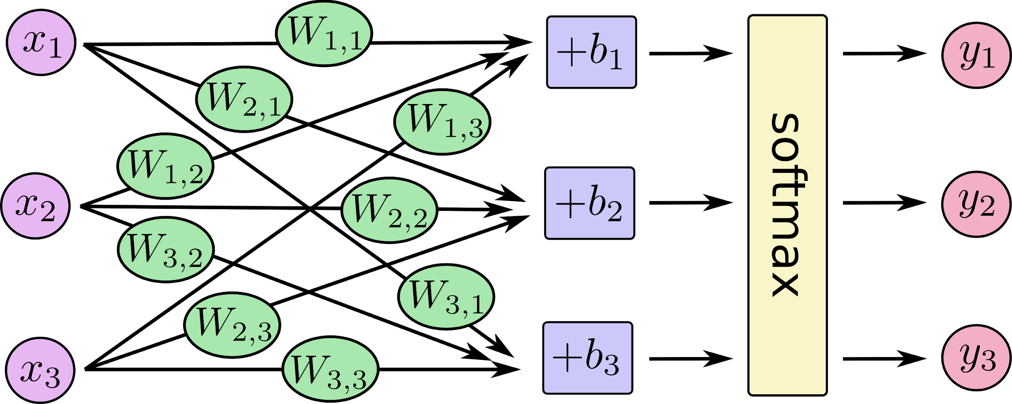
Example
1

Slide 30
Example
2

Slide 31
Example
in matrix form
3

Slide 32
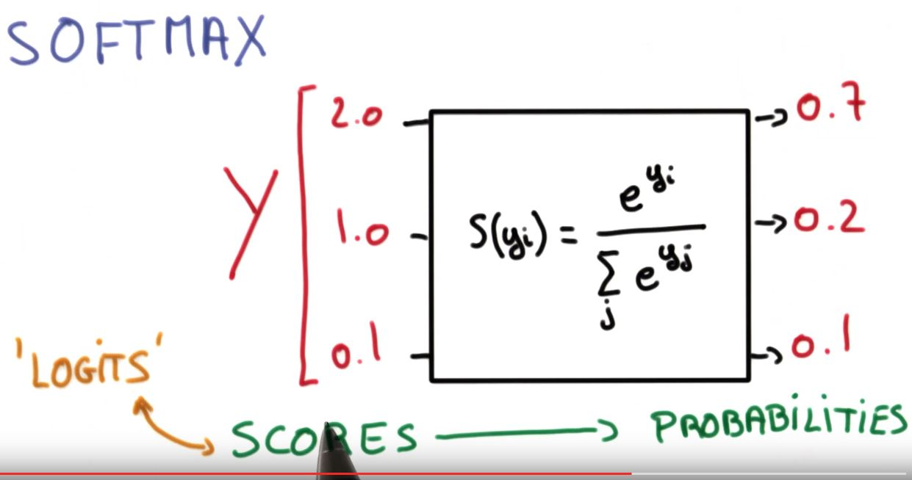
The effect of the Softmax function
From scores to probabilities. Highest probabilities are
assigned to highest values

Slide 33
Computing the error
1
Gradient descent of a loss function, as for NN:
However:
The loss function is the MSE (mean squared error) in internal convolutional layers, like for Multilayer Perceptron
It is instead Cross-Entropy in the final layer of a convolutional net
The cross-entropy between two discrete distributions 𝑝 and 𝑞 (measuring how far 𝑞 differs from 𝑝 for fixed 𝑝) is defined by:

Slide 34
Computing the error
2
Let T^{i}=[0,0..1,0..0] be the ground truth multi-class classification (n classes) for input instance in_{i} (a 1 value in position k of T^{i} indicates that the correct classification for in_{i} is the k-th class label), le Y^{i} be the output (softmax) vector
The cross-entropy H(T^{i}, Y^{i}) is given by:
Weights are updated using gradient descent on the total cross-entropy
$H(T^{i}$,$Y^{i}$)=$\sum_{j=1..n }{t_{j}^{i}}log⁡(y_{j}^{i}$)
$∆w_{kj}$=$η\frac{\sum_{j=1..n }{(t_{j}^{i}}−y_{j}^{i}\text{)}x_{k}}{n}$
Where ($t_{j}^{i}$- $y_{j}^{i}$) is the derivative of the loss function (cross entropy) on output node j. See details in link

Slide 35
Putting all together
The network is a sequence of convolution and pooling layers with a final fully connected layer with Softmax
Hyper-Parameters are: pooling and strides, padding, the number and type of features (filters and the filter dimension);
To be estimated: all weights (filters and final MLP connection weights)
Method to estimate weights: backpropagation using Softmax + Cross-Entropy in final MLP layer, backpropagation + Mean Squared Error with ReLu (or other activation functions) on convolution layers

Slide 36
More mathematical details
Backpropagation in convolutional layers: link
Softmax: link

Slide 37
Example
An age/gender classifier
Notes:
titolo cambiato

Slide 38
Examples of CNNs
ALEXNET:
8 levels; 650K neurons; 60M parameters
VGG-16:
16 levels, 15M neurons, 140M par.
CAFFE: link
You can use Tensor-Flow: link

Slide 39
STACKED DENOISING AUTOENCODERS

Slide 40
Stacked Denoising Auto-encoders
They are basically a minimally trained generalization of Backpropagation, but they allow multiple layers
More details on Stacked Denoising Autoencoders: “Learning Useful Representations in a Deep Network with a Local Denoising Criterion (Journ. of Machine Learning Research, 2010)”

Slide 41
Auto-Encoders
Encoder: The deterministic (= non-stochastic) mapping f_{θ} that transforms an input vector x into a «hidden» representation y=f_{θ}(x)
θ= (W,b) are the parameters of the encoder
Decoder: The resulting hidden representation y=f(x) is then mapped back to a reconstructed d dimensional vector z
Notes:
Spezzata in due

Slide 42
Auto-Encoders
In general, z is not to be interpreted as an exact reconstruction of x, but rather in probabilistic terms as the parameters (typically the mean) of a distribution p(X=x|Z = z) that «may generate x with high probability».
Autoencoder training consists of minimizing the reconstruction error (the difference between x and g_{θ’}(y))
Intuitively, if a representation allows a good reconstruction of its input, it means that it has retained much of the information that was present in that input (=identifying the relevant features).

Slide 43
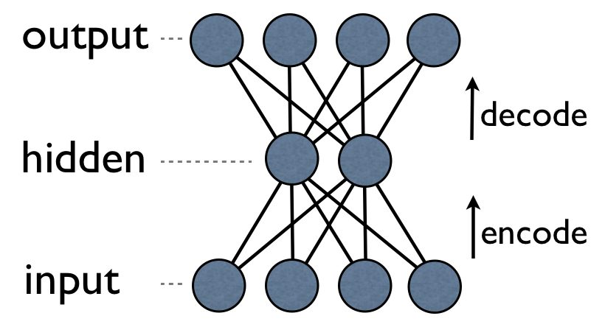
Auto-encoders Implementation
NN with backpropagation
They can be implemented as a neural network with one hidden layer and an equal number of nodes in input and output
Can be trained without supervision, since we don’t need to know the class of an instance: the task is simply to learn the weights in order for the output to be similar to the input (or better: to learn the “essential” features of the input instances)
It can be also used an as anomaly detector: if an instance is very different from “normality”, the network is unable to reconstruct it.
Notes:
Cambiato titolo

Slide 44
Denoising Auto-encoders
a better method
The reconstruction criterion alone is unable to guarantee the extraction of useful features as it can lead to the obvious solution “simply copy the input”
Denoising criterion:
“A good representation is one that can be obtained robustly from a corrupted input and that will be useful for recovering the corresponding clean input”

Slide 45
Denoising Auto-encoders Architecture
Denoising autoencoders can still be learned using backpropagation with gradient descent. What is the advantage? As in the figure, y is a “compact” representation of x, one that only retains only its essential features.

Slide 46
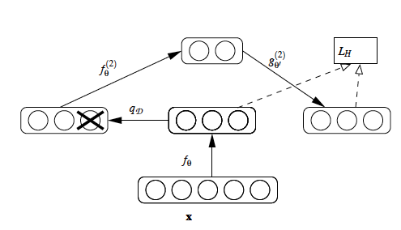
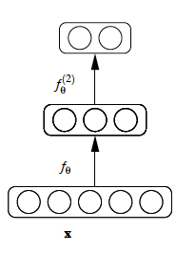
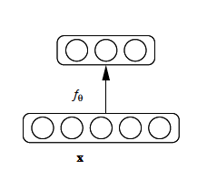
Stacking Denoising Auto-encoder Architecture
After training a first level denoising autoencoder, its learned encoding function f_{θ} is used on “clean” input (no noise)
The resulting representation is used to train a second level denoising autoencoder (middle) to learn a second level encoding function f.
From there, the procedure can be repeated (right).

Slide 47
Deep autoencoders

Slide 48
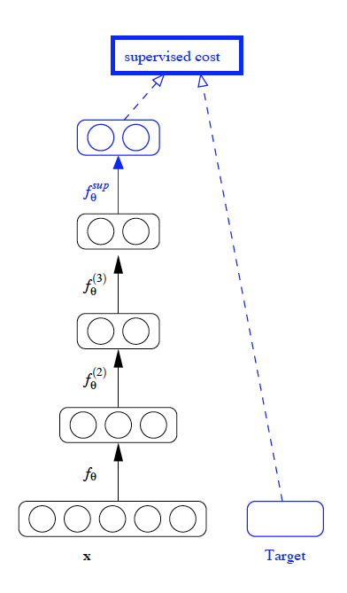
Final layer training is supervised
After training a stack of encoders , an output layer is added on top of the stack (with softmax, as for convnets).
The parameters of the whole system are fine-tuned to minimize the error in predicting the supervised target (e.g., class), by performing gradient descent.
Everything here just like convnets

Slide 49
Image Understanding
Example
Original Corrupted Reconstructed
Notes:
Titolo cambiato

Slide 50
Deep Learning Applications
Images, Video, sound, text, DNA
Time-series (stock markets, economic tables, the weather)
Relevant players:
Deep Mind (acquired by Google in 2014): learn playing videogames
Deep Brain (always by Google) (used by photo search and to build recommenders)
May be Siri? (Apple’s Speech Interpretation and Recognition Interface)
Microsoft’s Cortana (Intelligent Assistant)

Slide 51
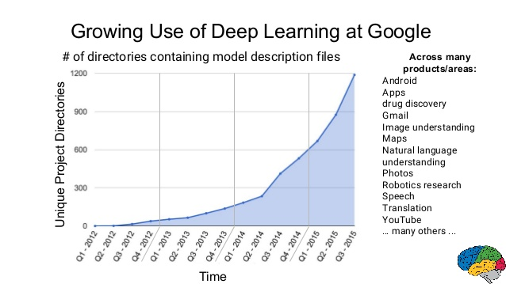
Google goes deep

Slide 52
Advantages of deep methods over «traditional» ML algorithms
Traditionally input features to a machine learning algorithm have to be hand-crafted, and the result often depends on practitioners’ expertise and domain knowledge to determine patterns of prior interest.
Conversely, Deep Learning techniques learn optimal features directly from the data without any guidance, allowing for the automatic discovery of latent relationships that might otherwise be not found
The most essential idea of Deep Learning is that of representation. Algorithms rely on complex data representations that are often expressed as compositions of other, simpler representations

Slide 53
Deep Learning Caveat
1
Highly parametric: like (and perhaps more than) for “surface” learners, parameter and feature tuning is a complex task (can easily have more than 100 million parameters!!)
Poor interpretability: machine learning algorithms like decision trees (or itemset mining) give us crisp rules as to why it chose what it chose, while deep learners produce scores and not reveal why they have given that score. In many industrial applications, this is an issue.
Recently, three scientists suggest that the answer lies in the regime of physics rather than mathematics. Suggested reading: link Why does deep and cheap learning work so well? Henry W. Lin (Harvard), Max Tegmark (MIT) David Rolnick (MIT) (Submitted on 29 Aug 2016 (v1), last revised 3 Aug 2017 (this version, v4))

Slide 54
Deep Learning Caveat
2
3. Needs big datasets
In general, with so many parameters to learn, it may perform poorly with small datasets
However, in some case, it is possible to “expand” the representation of instances with data extracted from larger datasets
This is the case, for example, of text processing: words representing the context of a small corpus can be replaced by word embeddings* extracted, e.g., from large corpora such as Wikipedia
*Word embeddings are words or phrases from the vocabulary mapped to vectors of real numbers

Slide 55
How to select the right
Loss and Final Activation Functions
Usually, the selection of the Loss and Activation function depends on the problem type (LINK):

Slide 56
Recommended Reading
NNs and Deep Learning
NN Architectures LINK, LINK, LINK
How to choose the right activation and loss functions: LINK
About the optimizers: LINK
Overfitting: Dropout and Regularization LINK, LINK, LINK
NN weight initialization LINK, LINK
Curse of dimensionality LINK
Interpretability LINK, LINK, LINK
Attention Mechanism LINK
Useful ML sheets LINK , LINK

Slide 57
Open Source
Several open-source frameworks and libraries exist for Deep Learning algorithms in a variety of programming languages, such as: TensorFlow, Theano, Keras, Torch, PyTorch, Caffe, CNTK and Deeplearning4j

