Slide 1
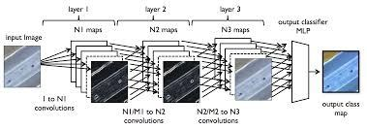
Deep Learning
a.k.o. Neural Network

Slide 2
Deep learning: neural networks with multiple internal layers
Wikipedia provides the following definition:
“Deep learning is set of algorithms in machine learning that attempt to learn layered models of inputs, commonly neural networks. The layers in such models correspond to distinct levels of concepts, where higher-level concepts are defined from lower-level ones, and the same lower-level concepts can help to define many higher-level concepts.”

Slide 3
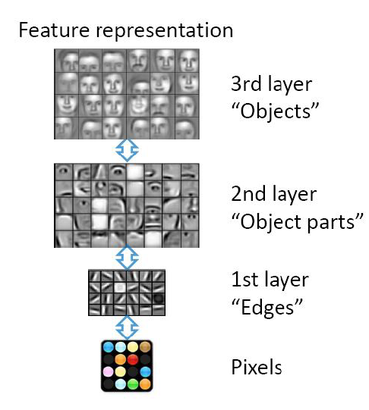
An example: image processing
Hierarchical learning
Natural progression from low level to higher level features as seen in many real problems
Easier to monitor what is being lernt in each level and guide subsequent layers

Slide 4
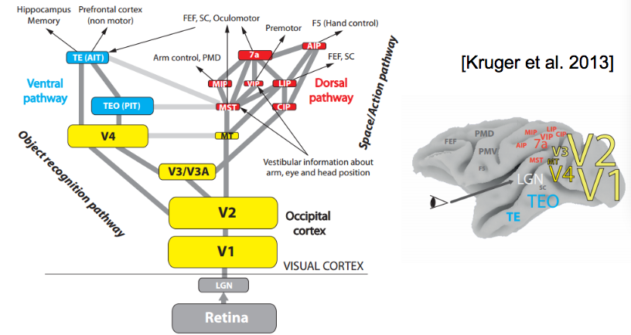
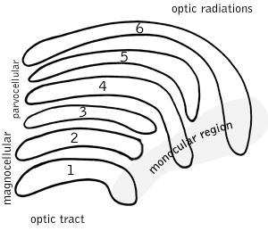
Deep Neural Networks
Neural Networks including many hidden layers (usually, 7-50 hidden layers) which are organized in hierarchies
The hierarchical organization allows to share and re-use information, selecting in each layer useful information and filtering useless details
Our perceptual system works on a deep hierarchy of levels

Slide 5
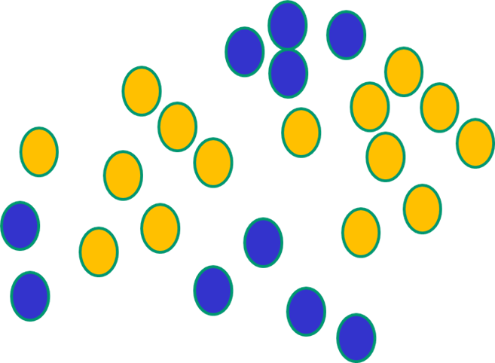
But, until very recently, available weight-learning algorithms (e.g., backpropagation) simply did not work on multi-layer architectures

Slide 6
Shortcomings of Neural networks with backpropagation
Based on iterative weight-learning
NN work by making thousands and thousands of tiny adjustments to edge weights, each making the network do better at the most recent pattern, but perhaps a little worse on many others
Gets stuck in local minima, especially since it starts with random initialization
It needs labelled data (it is a trained method) but in many important problems (especially speech recognition, image understanding) data are unlabeled

Slide 7
Sources of complexity in NN
The number of levels (depth) is only one of the sources of complexity. Others are the number of neurons, connections and weights
These impact both on cost of forward and back propagation
Main problem is the vanishing/exploding gradient
What is this?

Slide 8
What is the vanishing/exploding gradient problem?
To learn the mathematical details, read http://neuralnetworksanddeeplearning.com/chap5.html
In short, it is related with the fact that weights updating at each layer depends on the gradient (the delta function)
Because of back-propagation, the gradient at the earlier layers is the product of terms from all the later layers.
When there are many layers, that is an intrinsically unstable situation (it turns out that either the earlier weights gets updates much slower that later weight – vanishing gradient- or the viceversa – exploding gradient-).
The mathematical motivation for instability lies in the sigmoid function, whose derivative has the shape of a gaussian.

Slide 9
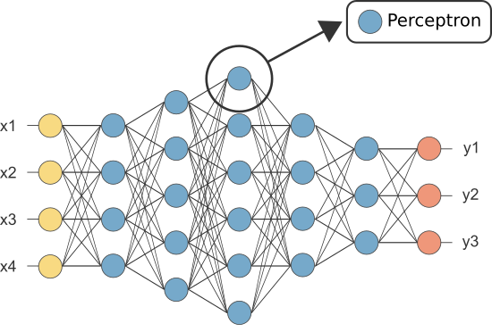
Example (vanishing gradient)
δj¹
δi³
δk²
Where σ(x) is the sigmoid function
So, deltas at the initial layers are the results of repetitive multiplications of
derivatives of the sigmoid function
and synaptic weights, which are all -1<w<1

Slide 10
More on the vanishing gradient: remember from NN
Let’s consider a simple case:

Slide 11
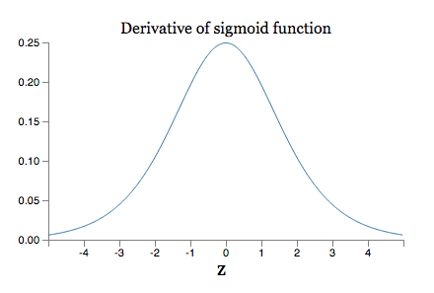
Example (vanishing gradient)
Since weights are usually -1<w<1, and the derivative of a sigmoid σ’(x)
has the following shape:
Then, the “deltas” at the initial levels become quickly very small as the number
of layers increase – causing very very slow convergence on stable values

Slide 12
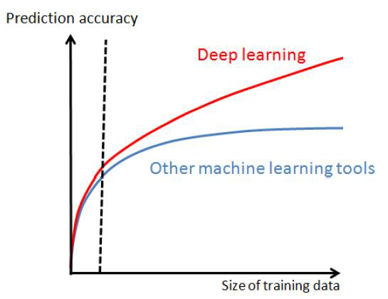
Why DeepNN is now possible (1)
Big data: e.g. ImageNet, millions of categorized images.
DNN show a clear advantage only with very large data sets (easier to find regularities)

Slide 13
Why DNN is now possible (2)
High-performance computing (such as GPU, graphic processing units): we can train models with many layers, nodes and connections thanks to HPC like Hadoop, NoSQL, Spark etc.
Vanishing (or exploding) gradient: the backpropagation complexity is due (as we have seen) to the sigmoid activation function. This is greatly simplified by the use of ReLU function (rectifier linear unit, see later)
Unsupervised methods: most DeepL approaches are unsupervised except for the last layer

Slide 14
Many Deep Learning algorithms
1. Feedforward “discriminative” models (semi-supervised training, used for image processing):
CNN Convolutional Neural Networks
FC DNN- Fully Connected DNN
HTM – Hierarchical Temporal memory
2. Unsupervised training (“generative” models to re-build the input, select salient features, etc)
Stacked Denoising Auto-Encoders
RBM –Restricted Boltzmann Machine
DBN Deep Belief networks
3. Recurrent models (used for sequences, such as speech, natural language, patients trajectories..)
RNN Recurrent neural Networks
LSTM Long Short-Term memory
GRU gated recurrent units
4. Reinforcement learning (to learn behaviors)
Deep Q-Learning
And everything augmented with Attention mechanisms, that compute a mask which is used to multiply features http://akosiorek.github.io/ml/2017/10/14/visual-attention.html

Slide 15
CONVOLUTIONAL NEURAL NETWORKS

Slide 16
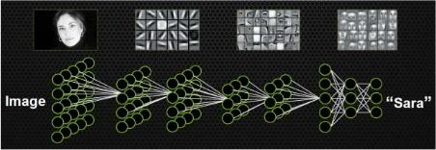
CNN (1)
Explicitly designed for image processing (although used also in speech processing and many other tasks)
Architecture: a hirarchy of “loosely” connected layers, except for the last layers which are usually fully connected
First layer is directly connected to pixels

Slide 17
convolution
Volumes of convoluvolutors
Important concepts in CNN
strides
padding
Activation function
Pooling
Softmax

Slide 18
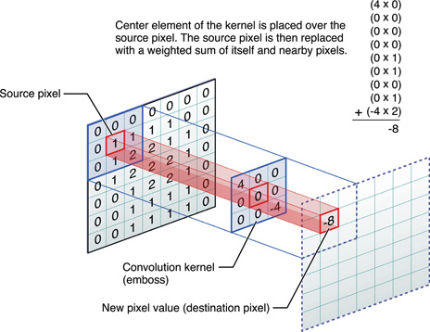
Convolution: what is ?
A digital filter (a small 2D weight mask, also called kernel) slides over the different input positions;
For each position an output value is generated by replacing the source pixel with a weighted sum of itself and it nearby pixels.
So here each neuron performs a convolution on a subset of input signals

Slide 19
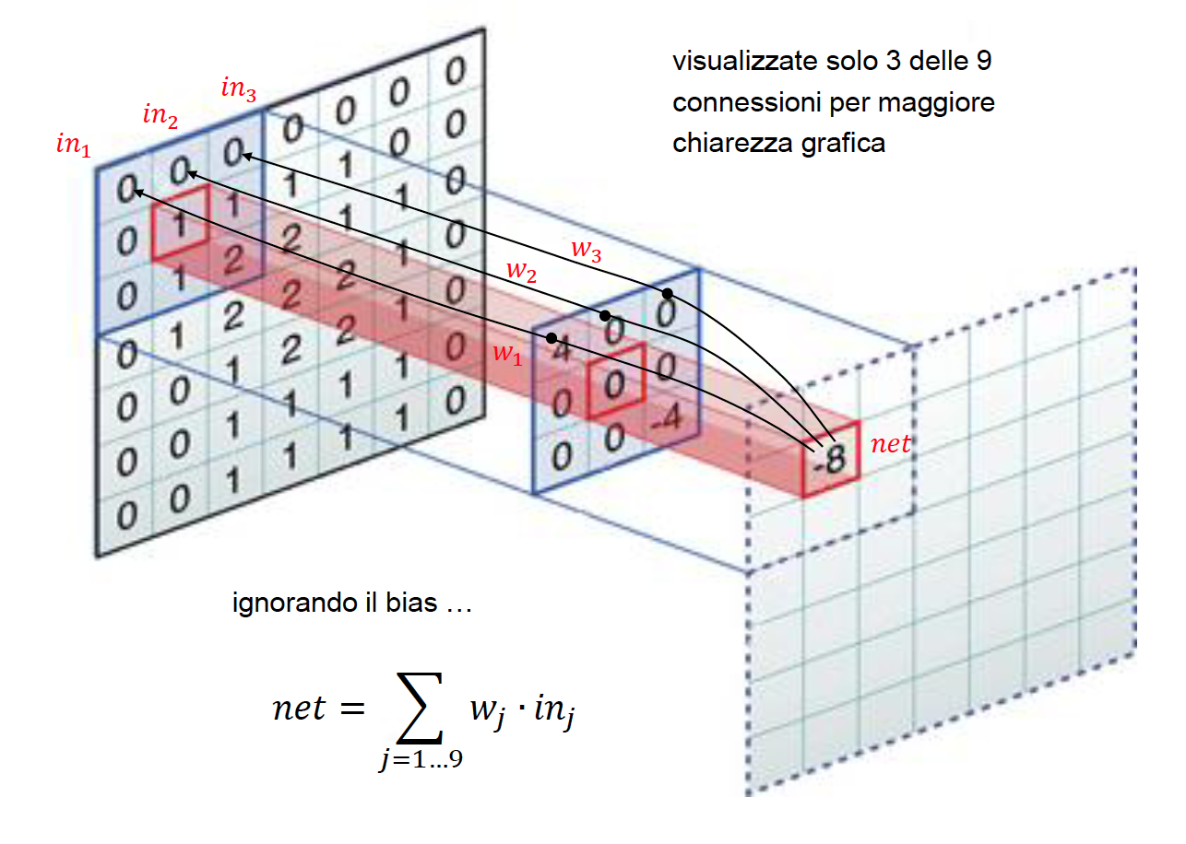
Neurons like convolutors
Given a nxn filter (kernel), if we connect the n² inputs that it "covers" at the previous level, and we use filter weights as connection weights, we notice that a convolution actually computes a weighted sum of input (net=Σw_{j}in_{j}) like a “classic” neuron.
However, neurons here are less connected, each only takes a subset of inputs
Only 3 connections are shown for clarity
We ignore the bias w₀

Slide 20
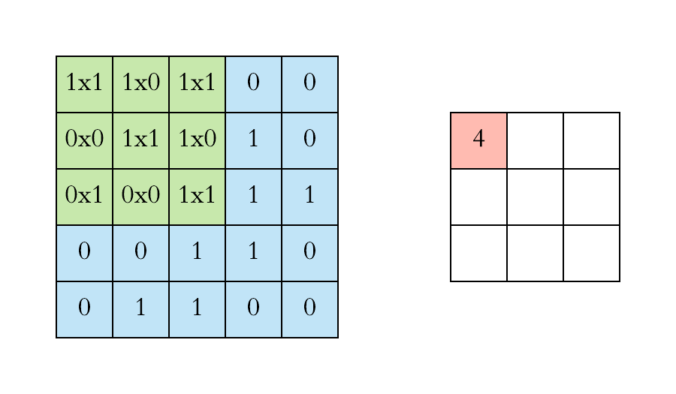
2-D convolution (3x3 kernel)
input
output

Slide 21
convolution
Volumes of convoluvolutors
strides
padding
Activation function
Pooling
Softmax

Slide 22
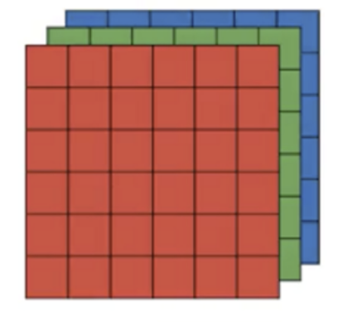
3D Volumes
Often input data are 3-dimensional, e.g., RGB images
In general, we can have multiple slices, or channels, in input, each slice is a different representation (e.g. rotations of an image) of the input

Slide 23
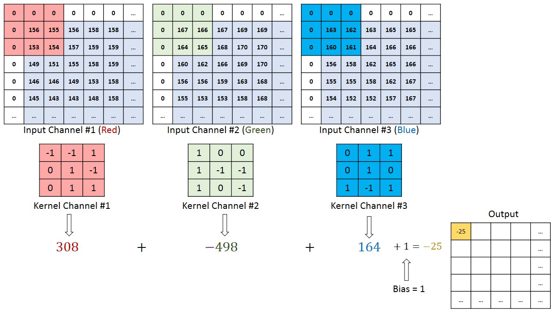
Example of convolution on 3-D input volumes
There is a different kernel sliding on each slice of the input volume

Slide 24
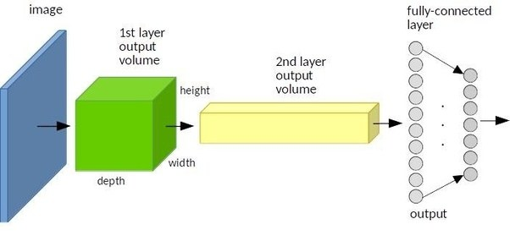
The network is now a sequence of “3D-Volumes” layers
Each layer of the NN is organized in 3D volumes
Width and height surfaces preserve the spatial organization of the image, the depth identifies the “salient features” captured from the image, arranged in slices (every slice is associated with a filter). Note that # of slices may vary in any layer

Slide 25
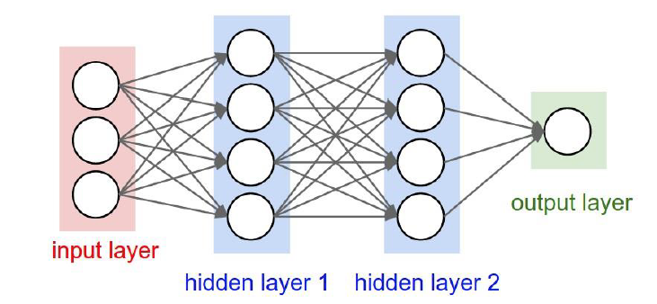
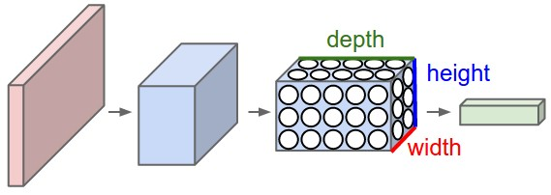
MLP vrs 3D volumes

Slide 26
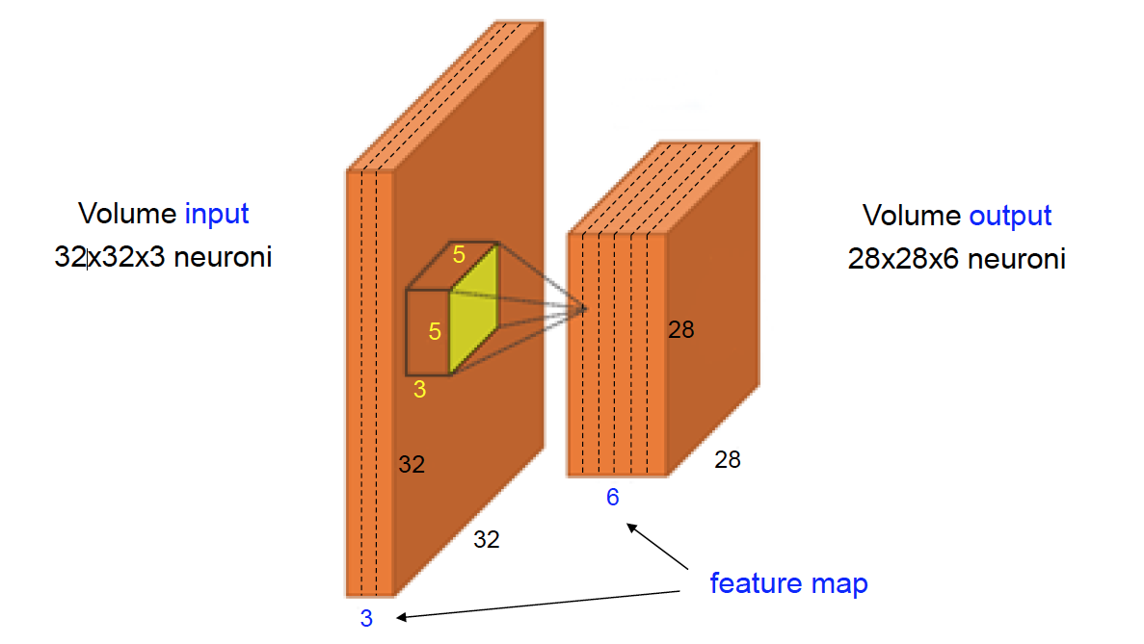
Convolution on 3D volumes
Example of two-layers 3D-volumes
kernel (5x5x3)
Input volume:
32x32x3 neurons
Output volume:
28x28x6 neurons

Slide 27
Convolution on 3D Volumes (2)
Each slice of neurons in a 3D-layer denotes a feature map.
Each feature map can be seen as the result of a specific filtering (with fixed filter) of the input or of previous map.
In the previous example (2 layers of 3D volumes) we find: 3 feature maps (32x32 size) in the input volume and 6 feature maps (28x28 size) in the output volume.
Neurons of the same feature map process different portions of the input volume in the same way.
In the previous example, the number of connections between the two levels is (28x28x6) x (5x5x3) = 352800, but the total number of weights is 6 x (5x5x3 + 1) = 456 (1 is the bias). To compare, how many weights there would be on a fully connected MLP of the same input size?

Slide 28
Ok but..
Q1: What exactly are these kernels/filters?
Q2: How do we compute the kernel/filters weight?
Q3: How do we select the size of a kernel/filter?

Slide 29
Question 1: What exactly are these kernels (or filters) and what are features?
Each filter/kernel can be thought of as feature identifier.
Features in the first layer can be (for images) straight edges, simple colors, and curves. The simplest characteristics that all images have in common with each other.
In the subsequent layers, features can be more complex (e.g.,eyes, nose, if a face classifier)

Slide 30
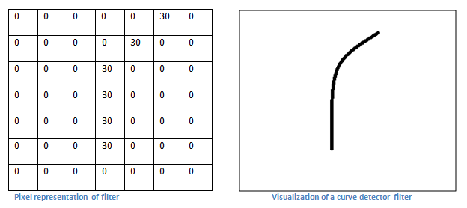
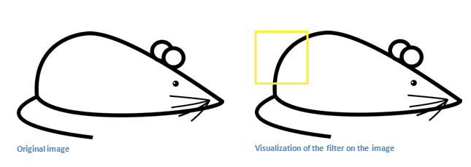
Example of line detector
kernel

Slide 31
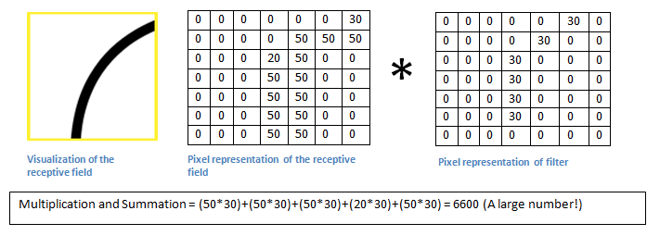
Application of a filter to a region (pixel map)
Visualization of an image detail
Pixel representation of filer
Pixel representation
Examples from: https://adeshpande3.github.io/adeshpande3.github.io/A-Beginner's-Guide-To-Understanding-Convolutional-Neural-Networks/

Slide 32
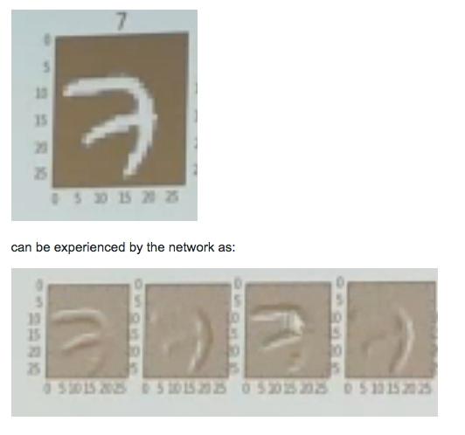
Example 2: effect of different edge filters
The upper image is the initial one. The subsequent 3 images are the result of applying 3 filters (in 3 slices).
Note that each filter is capturing a different edge of the original image
In this example: filters are edge detectors, each slice applies a filter to extract a specific type of edge

Slide 33
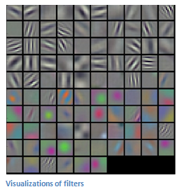
..In the reality..
Filters are much more complex than the simple example of the mouse
The filters on the first layer convolve around the input image and “activate” (like neurons) when the specific feature they are looking for (a line, a texture) is found in the input.

Slide 34
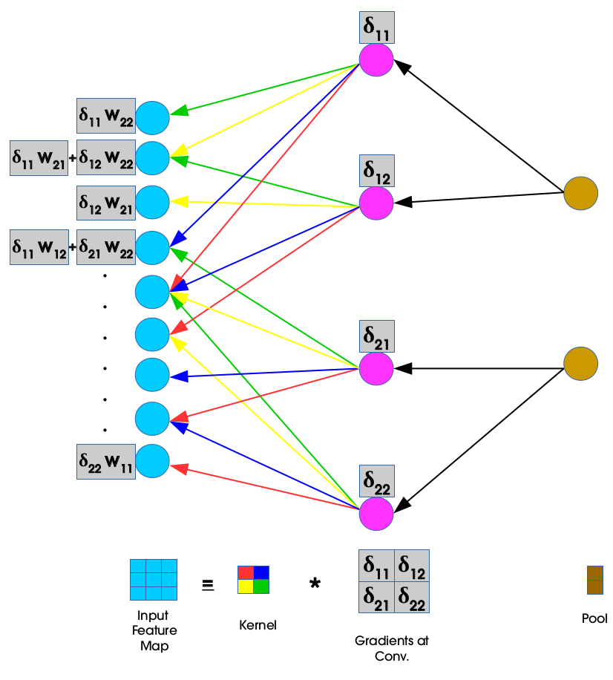
Question 2: how do we compute kernel values (=connection weights)?
This is easy: start with random selection and use backpropagation with gradient descent on Mean Squared Error function, like for multi-layer perceptron
The only difference is with the neuron activation function (ReLu, see later)
In the final layer a different approach is used (Softmax, see later)
Since neurons are only locally connected, a lower number of weights must be computed in each slice.

Slide 35
Question 3: how do we establish the size of kernels?
Size of the filters/kernels plays an important role in finding the key features.
A larger size kernel can overlook at the features and could skip the essential details in the input
a smaller size kernel could provide more information leading to more confusion. Thus there is a need to determine the most suitable size of the kernel/filter.
In one extreme case where we have 1x1 kernels, we are essentially saying low level features are per-pixel, and they don't affect neighbouring pixels at all, and that we should apply the same operation to all pixels.
In the other extreme, we have kernels the size of the entire image. In this case the CNN essentially becomes fully connected, and stops being a CNN, and we are no longer making any assumption on low level feature locality.

Slide 36
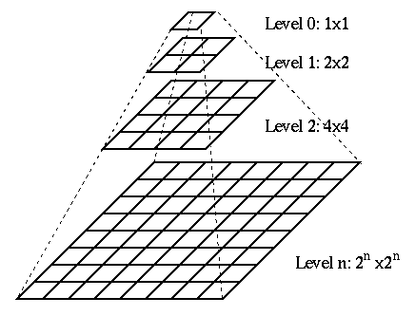
Gaussian Pyramid
Approaches like gaussian pyramids (set of different sized kernels) are generally used to test the efficiency of the feature extraction and appropriate size of kernel is determined.

Slide 37
Summary so far
CNN are multi-layered networks
At each layer a (2)3D convolution operation is applied on the current layer using a (2)3D kernel (third dimension are sliced feature maps)
Key elements of the convolution are the kernel values and size
Values (connection weights) are learned using backpropagation
Size is an (hyper) parameter to be tuned

Slide 38
convolution
Volumes of convoluvolutors
strides
padding
Activation function
Pooling
Softmax

Slide 39
Convolution on 3D Volumes (3): Strides
Kernel/filtres slide on input with a 1-unit step (moves 1 neuron to the left). To simplify, we can use higher increment, or stride. This further reduces the number of connections
A stride of 2 or 4 may imply a high efficiency gain on first layers

Slide 40
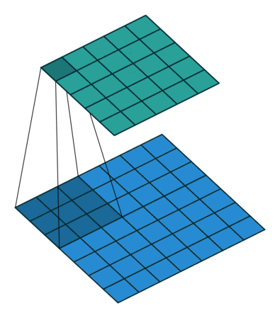
Stride 1

Slide 41
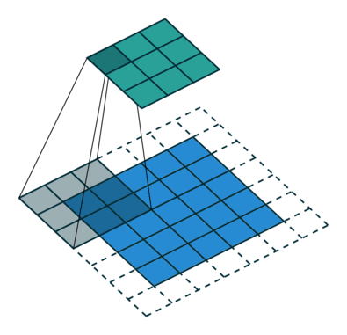
Stride 2

Slide 42
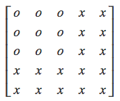
Why strides?
They reduce the size (width, length) of the next layer, and lets you decide how much overlap you want between two output values in a layer.
Let’s say you have a 5x5 input to a layer, and the kernel is 3x3. This is the first thing it sees :

Slide 43
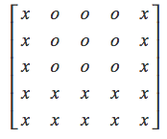
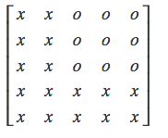
Why strides? (2)
With a stride of 1, this will be the second thing:
With a stride of two, instead:

Slide 44
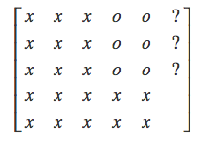
Why strides? (3)
With a stride of 3:
We exceed the boundary of the input. So, how can we avoid this problem?

Slide 45
convolution
Volumes of convoluvolutors
strides
padding
Activation function
Pooling
Softmax

Slide 46
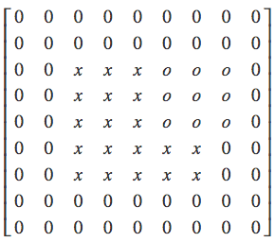
Convolution on 3D Volumes (4): Padding
To solve the problem of extremes edges (filters that either don’t reach an edge or exceed the boundaries) we use 0-valued borders to the input volume. This is called padding
Around the entire input, we add padding data with a width equal to the kernel/filter width minus one (or height equal to kernel height minus one) P=F-1 (larger paddings can be used)
The (hyper)parameter “padding” P defines the thickness of such borders.

Slide 47
Computing output volume with strides and padding
Let W_{out} be the (horizontal) size of the output and W_{in} the corresponding input dimension. Also let 𝐹 be the horizontal size of the kernel/filter. The following relationship applies:
𝑊_{𝑜𝑢𝑡} = ((𝑊_{𝑖𝑛}-𝐹 + 2 ∙ 𝑃𝑎𝑑𝑑𝑖𝑛𝑔)/Stride) + 1
An similar relationship links the vertical parameters.
In previous example, padding=2, F=3, W_{in}=5; stride=3, 𝑊_{𝑜𝑢𝑡} =((5-3+2x2)/3)+1)= 3
Large strides, large compression

Slide 48
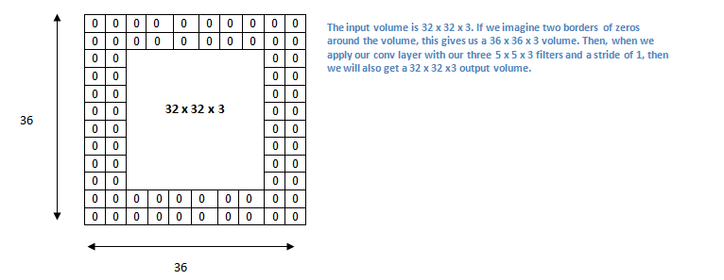
Example 2
Let’s consider the case in which we have an input volume of 32x32x3 and we apply a filter of 5x5x3 with stride 1. Now, let’s apply to input volume a padding of size 2
Padding= 2, 𝑊_{𝑖𝑛} = 32, Stride= 1, 𝐹 = 5  𝑊_{𝑜𝑢𝑡} = 32.

Slide 49
convolution
Volumes of convoluvolutors
strides
padding
Activation function
Pooling
Softmax

Slide 50
Convolution on 3D Volumes (5): ReLU
In the MultilayerPerceptron (MLP) networks the most used (historically) activation function is the sigmoid.
In deep networks, the use of sigmoid is problematic for the vanishing gradient problem, as we have seen.

Slide 51
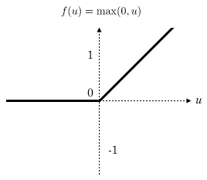
Convolution on 3D Volumes : ReLU
To solve this problem the Rectified Linear (ReLU) activation function is used
The derivative is 0 for negative
or null values of net(x)
No saturation for positive values
It causes sparse activation of
neurons which are shown to add
robustness

Slide 52
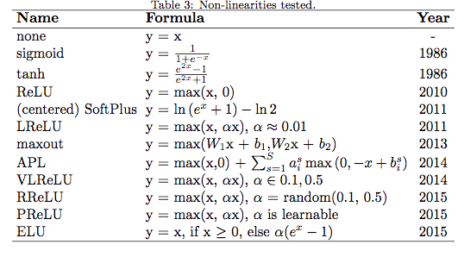
Types of activation functions (many are used in Deep L)
To learn more on CNN hyper-parameters: https://arxiv.org/pdf/1606.02228v2.pdf

Slide 53
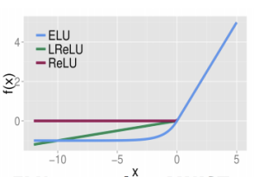
ELU, ReLU, LReLU

Slide 54
convolution
Volumes of convoluvolutors
strides
padding
Activation function
Pooling
Softmax

Slide 55
Convolution on 3D Volumes (7): Pooling
Pooling is to aggregate data in input volume, to generate lower dimension feature maps
Pooling layer is frequently used in convulational neural networks, with the purpose to progressively reduce the spatial size of the representation, to reduce the amount of features and the computational complexity of the network.
The main reason for the pooling layer is to prevent the model from overfitting. The idea is to reduce the number of unnecessary details, keeping the “invariants”.
“Reasonably” invariant for small translations are the average and max pooling
Pooling is performed (usually) within single feature maps (slices), so the number of features is not reduced

Slide 56
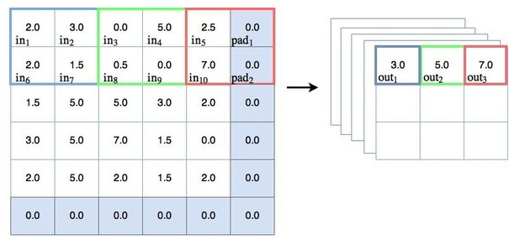
Max pooling

Slide 57
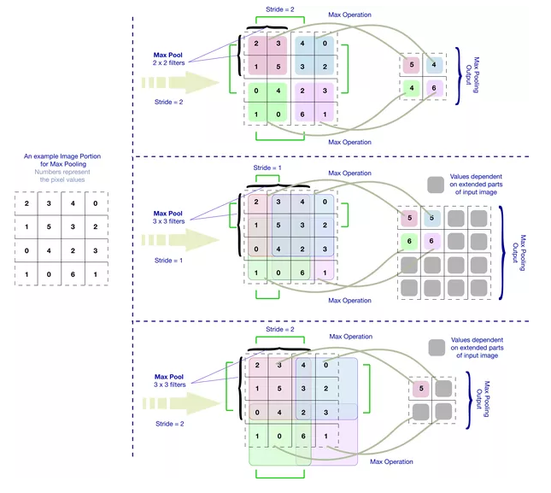
Pooling with strides

Slide 58
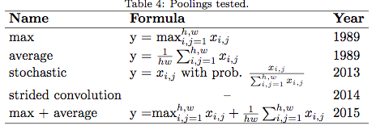
Pooling methods
More on: https://arxiv.org/pdf/1606.02228v2.pdf

Slide 59
Why pooling is useful
The idea is that pooling creates "summaries" of each sub-region.
Dimension Reduction: In deep learning when we train a model, because of excessive data size the model can take huge amount of time for training. Now consider the use of max pooling of size 5x5 with 1 stride. It reduces the successive region of size 5x5 of the given image to a 1x1 region with max value of the 5x5 region. Here pooling reduces the 25 (5x5) pixel to a single pixel (1x1) (less weights to learn in subsequent layers).
Rotational/Position Invariance Feature Extraction : Pooling can also be used for extracting rotational and position invariant feature. Consider the same example of using pooling of size 5x5. Pooling extracts the max value from the given 5x5 region. Basically extract the dominant feature value (max value) from the given region, irrespective of the position of the feature value. The max value would be the same from any position inside the region. Pooling thus provides rotational/positional invariant feature extraction.

Slide 60
Caveat with pooling
It is important to be careful in the use of the pooling layer, since you are actually reducing the “context” of elements within a given input (e.g., pixels surrounding a pixel; words to the left and right of a word; etc)
While it would help significantly reduce the complexity of the model, it might cause to loose the location sensitivity in the model.
This is particularly important for image and text processing tasks, where context might be very important (e.g., text).

Slide 61
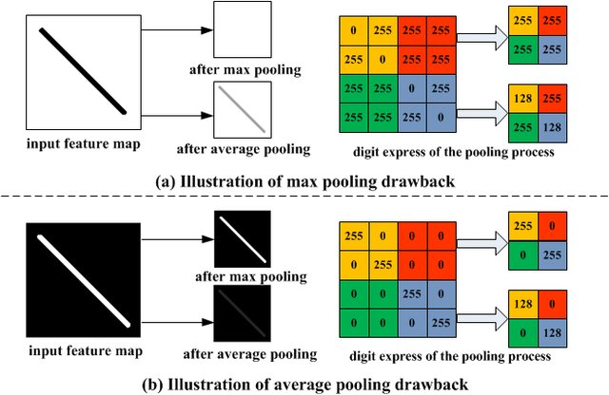
Example of problems with pooling

Slide 62
convolution
Volumes of convoluvolutors
strides
padding
Activation function
Pooling
Softmax

Slide 63
The final step: SoftMax (8)
As anticipated, the final level is a fully connected network
It consists of 𝑠 neurons (one for each class) fully-connected to neurons of the previous level. The activation level 𝑛𝑒𝑡_{𝑘} of individual neurons is calculated in the usual way, but the activation function for the 𝑘 -th neuron is (instead of Sigmoid or ReLU):
where the z_{k} can be interpreted as probabilities since they are in the [0,1] range

Slide 64
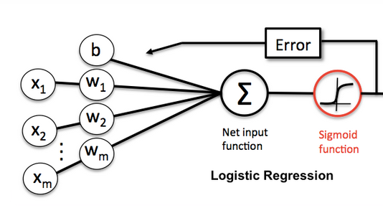
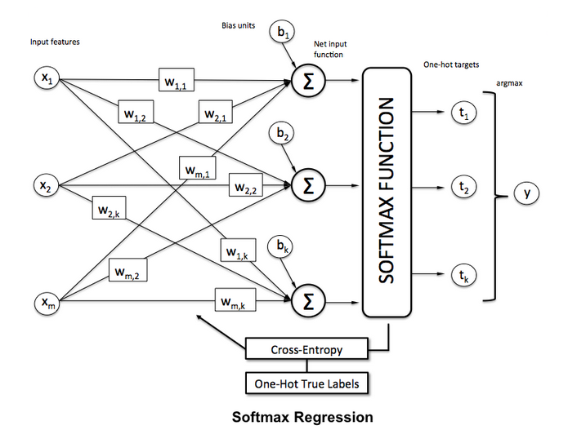
Softmax vrs sigmoid
Note: b here is the threshold or bias
Fully connected
NN layer with softmax

Slide 65
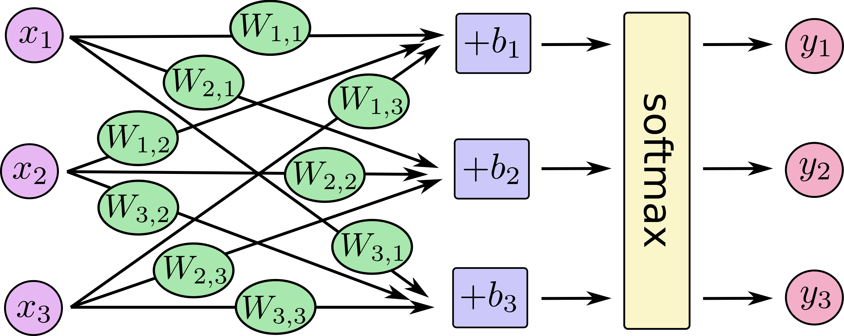
Example (1)

Slide 66
Example (2)

Slide 67
Example in matrix form (3)

Slide 68
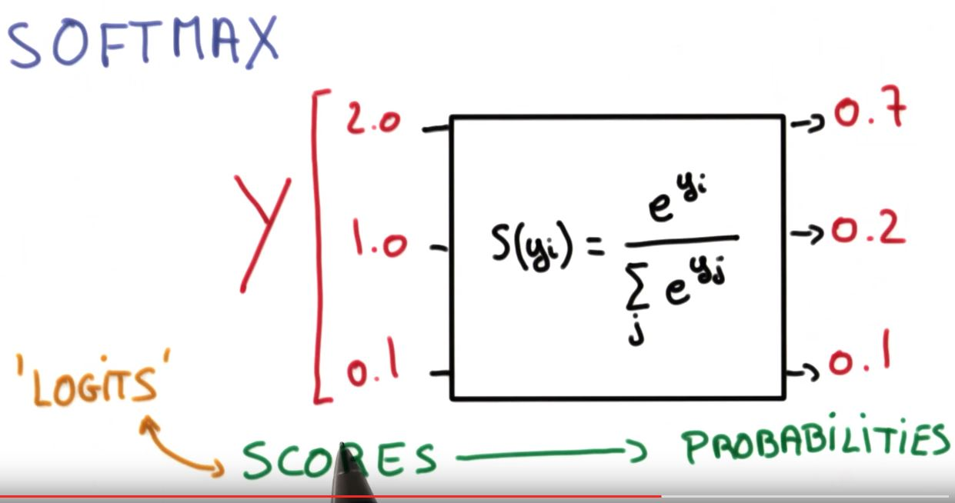
The effect of Softmax(x)
From scores to probabilities. Highest probabilities are
assigned to highest values

Slide 69
The final step: computing the error
Gradient descent of a loss function, as for NN
However:
Loss function is Sum of Squared Errors in internal convolutional layers, like for Multilayer Perceptron
It is instead Cross-Entropy in the final layer of a convolutional net
The cross-entropy between two discrete distributions 𝑝 and 𝑞 (measuring how far 𝑞 differs from 𝑝 for fixed 𝑝) is defined by:

Slide 70
The final step: computing the error (2)
Let T_{i}=[0,0..1,0..0] be the ground truth multi-class classification (n classes) for input instance in_{i} (a 1 value in position k of T_{i} indicates that the correct classification for in_{i} is the k-th class label), le Yi be the output (softmax) vector
The cross-entropy H(T_{i}, Y_{i}) is given by:
Weights are updated using gradient descent on the total cross entropy
Where (Tij-Yij) is the derivative of the loss function (cross entropy) on output node j.
See details on https://deepnotes.io/softmax-crossentropy

Slide 71
Putting all together
The network is a sequence of convolution and pooling layers with a final fully connected layer with SoftMax
Hyper-Parameters are: pooling and strides, padding, the number and type of features (filters and the filter dimension);
To be estimated: all weights (filters and final MLP connection weights)
Method to estimate weights: backpropagation using Softmax + Cross Entropy in final MLP layer, backpropagation + Mean Squared Error with ReLu (or other activation functions) on convolution layers

Slide 72
More mathematical details
Backpropagation on convolutional layers: http://www.jefkine.com/general/2016/09/05/backpropagation-in-convolutional-neural-networks/
Softmax: http://ufldl.stanford.edu/tutorial/supervised/SoftmaxRegression/

Slide 73
An example (age/gender classifier)

Slide 74
Examples of CNNs
ALEXNET: 8 LEVELS, 650K NEURONS AND 60M PARAMETERS
VGG-16: 16 LEVELS, 15M NEURONS, 140M PAR.
CAFFE: http://caffe.berkeleyvision.org/
You can use Tensor Flow https://pythonprogramming.net/cnn-tensorflow-convolutional-nerual-network-machine-learning-tutorial/

Slide 75
Stacked denoising autoencoders

Slide 76
Stacked denoising Autoencoders
They are basically a minimally trained generalization of Backpropagation, but they allow multiple layers
More details on: Stacked Denoising Autoencoders: Learning Useful Representations in a Deep Network with a Local Denoising Criterion (Journ. of Machine Learning Research, 2010)

Slide 77
Auto-encoders
Encoder: The deterministic (= non stocastic) mapping f_{θ} that transforms an input vector x into hidden representation y=f_{θ}(x)
θ=(W,b) are the parameters of the encoder
Decoder: The resulting hidden representation y=f(x) is then mapped back to a reconstructed d dimensional vector z
In general z is not to be interpreted as an exact reconstruction of x, but rather in probabilistic terms as the parameters (typically the mean) of a distribution p(X=x|Z = z) that may generate x with high probability.
Autoencoder training consists in minimizing the reconstruction error (the difference between x and g_{θ’}(y))
Intuitively, if a representation allows a good reconstruction of its input, it means that it has retained much of the information that was present in that input (=identifying the relevant features).

Slide 78
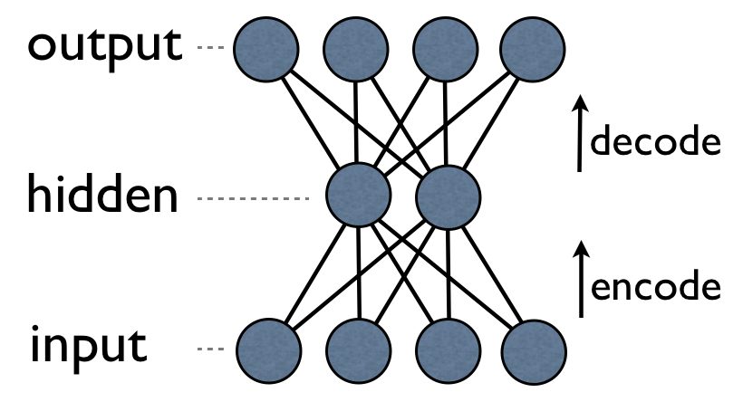
Autoencoders can be implemented with a NN with backpropagation
They can be implemented as a neural network with one hidden layer and equal number of nodes in input and output
Can be trained WITHOUT supervision, since we don’t need to know the class of an instance: the task is simply to learn the weights in order for the output to be similar to the input (or better: to learn the “essential” features of the input instances)
It can be also used an as anomaly detector: if an instance is very different from “normality”, the network is unable to reconstruct it.

Slide 79
Denoising Autoencoders (a better method)
The reconstruction criterion alone is unable to guarantee the extraction of useful features as it can lead to the obvious solution “simply copy the input”
Denoising criterion: “a good representation is one that can be obtained robustly from a corrupted input and that will be useful for recovering the corresponding clean input”

Slide 80
Denoising Autoencoders Architecture
Denoising autoencoders can still be learned using backpropagation with gradient descent
What is the advantage? As in the figure, y is a “compact” representation of x, one that
only retains only its essential features.

Slide 81
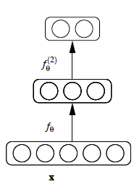
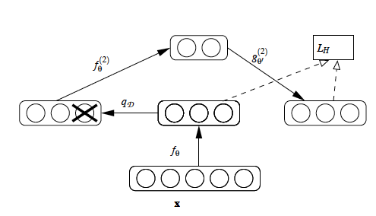
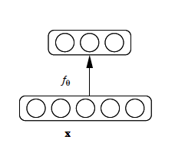
Stacking Denoising Autoencoder Architecture
After training a first level denoising autoencoder, its learnt encoding function f_{θ} is used on “clean” input (no noise)
The resulting representation is used to train a second level denoising autoencoder (middle) to learn a second level encoding function f.
From there, the procedure can be repeated (right).

Slide 82
Intermediate layers are each trained to be auto encoders

Slide 83
Final layer trained to predict class based on outputs from previous layers

Slide 84
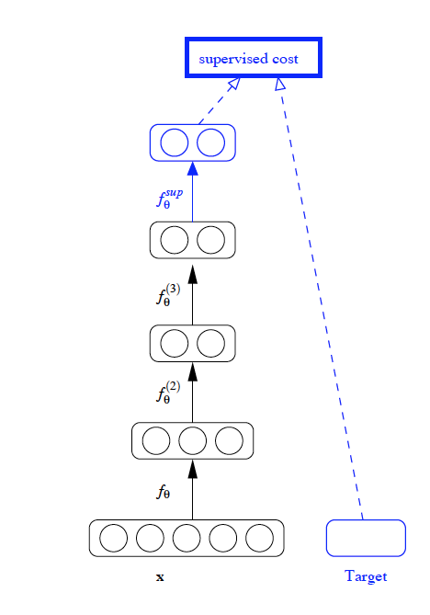
Final layer training is supervised
After training a stack of encoders as explained in the previous figure, an output layer is added on top of the stack (with softmax, as for convnets).
The parameters of the whole system are fine-tuned to minimize the error in predicting the supervised target (e.g., class), by performing gradient descent.
Everything here just like convnets

Slide 85
Example (image understanding)
Original Corrupted Reconstructed

Slide 86
Applications/systems for Deep Learning
Images, Video, sound, text
DNA
time series (stock markets, economic tables, the weather)
Relevant players:
Deep Mind (acquired by Google in 2014) →learn playing videogames
Deep Brain (always by Google) (used by photosearch and to build recommenders)
May be Siri? (Apple’s Speech Interpretation and Recognition Interface)
Microsoft’s Cortana (Intelligent Assistent)

Slide 87
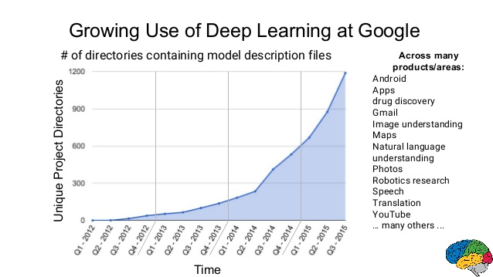
Google goes deep

Slide 88
Caveat with Deep Learning
Highly parametric: like (and perhaps more than) for “surface” learners, parameter and feature tuning is a complex task (can easily have more than 100 million parameters!!)
Poor interpretability : machine learning algorithms like decision trees (or itemset mining) give us crisp rules as to why it chose what it chose, while deep learners produce scores and not reveal why they have given that score. In many industrial applications, this is an issue.
Recently, three scientists suggest that the answer lies in the regime of physics rather than mathematics
Suggested reading: https://arxiv.org/abs/1608.08225
Why does deep and cheap learning work so well?
Henry W. Lin (Harvard), Max Tegmark (MIT), David Rolnick (MIT)
(Submitted on 29 Aug 2016 (v1), last revised 3 Aug 2017 (this version, v4))

Slide 89
Caveat with Deep learning
3. Needs big datasets
In general, with so many parameters to learn, it may perform poorly with small datasets
However, in some case it is possible to “expand” the representation of instances with data extracted from larger datasets
This is the case, for example, of text processing: words representing the context of a small corpus can be replaced by word embeddings* extracted, e.g., from large corpora such as Wikipedia
*Word embeddings are words or phrases from the vocabulary mapped to vectors of real numbers

