Slide 1
Completeness of natural deduction: proof 6
And so on for the other connectives
ϕ is ϕ₁∧ ϕ₂
only one true case
ϕ₁ ∧ ¬ϕ₂ |- ¬(ϕ₁∧ ϕ₂)
¬ϕ₁ ∧ ϕ₂ |- ¬(ϕ₁∧ ϕ₂)
¬ϕ₁ ∧ ¬ ϕ₂ |- ¬(ϕ₁∧ ϕ₂)
ϕ is ϕ₁∨ ϕ₂
¬ ϕ₁ ∧ ¬ϕ₂ |- ¬(ϕ₁∨ ϕ₂) the only false case
ϕ₁∧ ¬ϕ₂ |- ϕ₁∨ ϕ₂
¬ϕ₁ ∧ ϕ₂ |- ϕ₁∨ ϕ₂
ϕ₁∧ ϕ₂ |- ϕ₁∨ ϕ₂

Slide 2
Completeness of natural deduction: proof 7
If we apply the above proposition to
⏐== (ϕ₁→ (ϕ₂→ ( ϕ₃→ ….. → ψ)))
We have 2^{n} proofs
p₁, p₂ , ….p_{n} |-(ϕ₁→ (ϕ₂→ ( ϕ₃→ ….. → ψ)))
Let us eliminate all the premises, because they are pairwise complementary, by using tertium non datur LEM as in the scheme

Slide 3
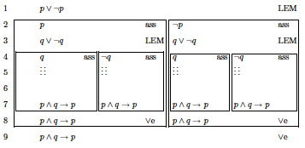
Example: let us take the tautology p∧ q → p, we have
p, q |- p∧ q → p
p, ¬q |- p∧ q → p
¬p, q |- p∧ q → p
¬p, ¬q |- p∧ q → p

Slide 4
Completeness of natural deduction: proof 8
Third step:
|⎯ (ϕ₁→ (ϕ₂→ ( ϕ₃→ ….. → ψ)))
ϕ₁, ϕ₂, ϕ₃, ….. |⎯ ψ
But we know that this is true
⬆

Slide 5
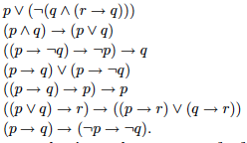
Truth tables exercises

Slide 6
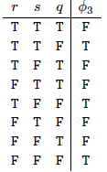
Truth tables exercises
Who ϕ₃ is?

Slide 7
Validity and satisfiability: CNF
A formula is valid when it is true for any assignment
It is satisfiable when it is true for at least one assignment

Slide 8
Validity and satisfiability: CNF
In a CNF looking for validity
means to check validity of every conjunct;
this means that every conjunct must contain
a pair of opposite literals
This is often an efficient way of checking validity

Slide 9
CNF

Slide 10
CNF
In the case we are given with a truth table, we can compute
the CNF directly

Slide 11
CNF
Let us take all the false cases, namely lines 1, 3, 4, 6 and 7
None of them can happen if the formula has to be true
¬((r∧s∧q)∨(r∧¬s∧q)∨(¬r∧s∧q)∨(¬r∧s∧¬q)∨(¬r∧¬s∧q) )
i.e. via De Morgan
¬(r∧s∧q)∧¬(r∧¬s∧q)∧¬(¬r∧s∧q)∧¬(¬r∧s∧¬q)∧¬(¬r∧¬s∧q)
i.e. via De Morgan
(¬r∨¬s∨¬q)∧(¬r∨s∨¬q)∧(r∨¬s∨¬q)∧(r∨¬s∨q)∧(r∨s∨¬q)

Slide 12
CNF
If we are given with the synctactical expression,
we define an algorithm CNF such that
Neither efficiency nor unicity is secured
e.g. p and p ∧(p∨q)

Slide 13
CNF: the algorithm
IMPL_FREE eliminate implications
NNF pull inside negations
DISTR Uses distributivity

Slide 14
CNF: the algorithm
IMPL_FREE to eliminate implications
p → q is equivalent to ¬p∨q
NNF to pull inside negations
¬(p∨q) is equivalent to ¬p∧¬q
¬(p∧q) is equivalent to ¬p∨¬q
DISTR uses distributivity to extract ∧
r ∨(p∧q) is equivalent to (r∨p) ∧ (r∨q)

Slide 15
CNF: exercises

Slide 16
CNF
Validity is easy
Satisfiability is difficult

Slide 17
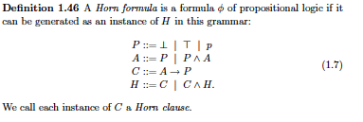
Particular sentences: Horn clauses

Slide 18
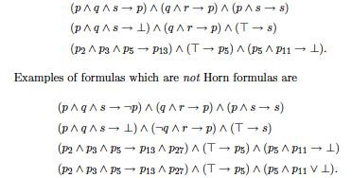
Particular sentences: Horn clauses

Slide 19
Horn clauses: satisfiability
The algorithm

Slide 20
Horn clauses: satisfiability
Exercises

Slide 21
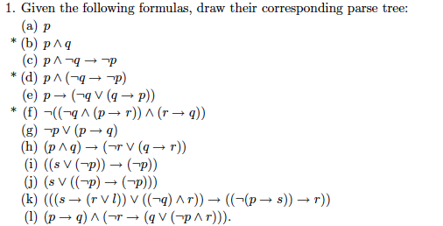
Exercises

Slide 22
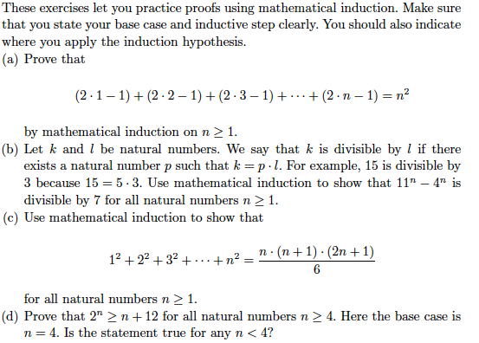
Exercises

