Slide 1
Formal Methods in software development
a.y.2017/2018
Prof. Anna Labella

Slide 2
An aside: mathematical induction
If a property is true for a base case, say P(0)
And, supposing it is true in a case n, say P(n)
we can prove in the following case, say P(n+1)
Then the property is true for every natural number
The property could be of “being defined”

Slide 3
Justification by contradiction (this is not a proof)
Suppose there is a number m s.t. P(m) does not hold
Then, or m=0, which is impossible, or we can take P(m-1), that cannot hold as well, because of what we have proven
In this way we can go back until we reach 0 and get the contradiction.
This is not a proof because we are supposing that we cannot indefinitely go back

Slide 4
Complete induction
Supposing that if a property is true in all the cases until n,
say P(0) ∧ P(1) ∧…∧ P(n),
we can prove in the following case, say P(n+1)
Then the property is true for every natural number
This definition can be used for ordinals more general
than natural numbers

Slide 5
Structural induction
Natural numbers can be associated with the structure of something
We can use induction w.r.t. the indexing
For example a complexity index

Slide 6
Propositional logic
Syntax
Semantics

Slide 7
Syntax
Inductive definition of wff
BNF
ϕ::= p|(¬ϕ)|(ϕ∧ϕ)|(ϕ∨ϕ)|(ϕ→ϕ)

Slide 8
Syntax
Be careful with substitution!

Slide 9
Syntax
Representation with parentheses
Tree-like representation

Slide 10
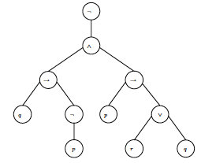
Syntax
¬ ((q→ ¬p) ∧ (p → (r∨q)))

Slide 11
Exercises

Slide 12
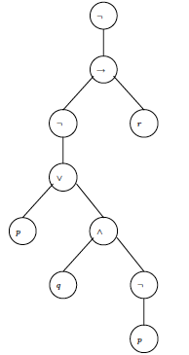
Exercises
Which is the formula?

Slide 13
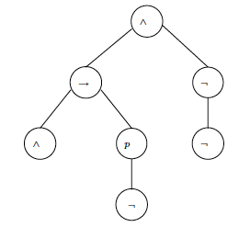
Exercises

Slide 14
Semantics
Meaning and truth: choosing truth values
Truth tables for connectives

Slide 15
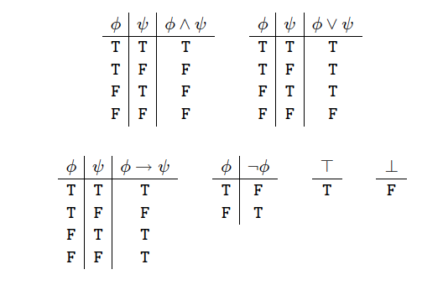
Semantics

Slide 16
Semantics

Slide 17
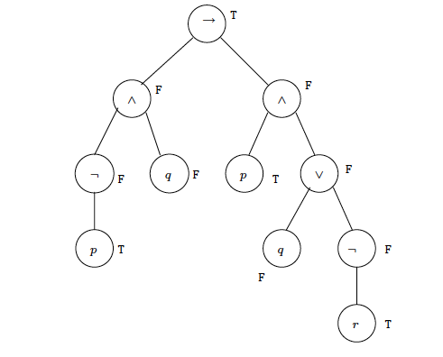
Semantics

Slide 18
Semantics

Slide 19
Semantics
Semantic equivalence
Making a quotient

Slide 20
Semantics
satisfiability - unsatisfiability
validity (tautology) - contradiction

Slide 21
Semantics
Logical consequence
ϕ₁, ϕ₂, ϕ₃, ….. ⏐== ψ

Slide 22
Playing a double game
Syntax
ı- A
Semantics
|= A
soundness
completeness

Slide 23
Soundness of natural deduction
ϕ₁, ϕ₂, ϕ₃, ….. ⏐⎯ ψ
⬇
ϕ₁, ϕ₂, ϕ₃, ….. ⏐== ψ

Slide 24
Soundness of natural deduction: proof
By induction on the length of proof
Opening the boxes (linearisation)
Control of last rule

Slide 25
Proof by induction on the lenght of the proof
We need to transform our proofs to suppress boxes.
In this way every prefix of a proof is again a proof.
We first eliminate boxes introduced by implication

Slide 26
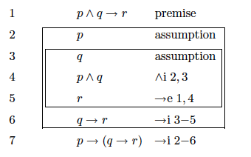
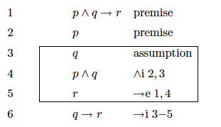
Eliminating boxes due to implication 1
E.g. we have a proof of |_
we transformed it into a proof of
, p |_

Slide 27
Eliminating boxes due to implication 2
We can continue the transformation:
premise
p premise
q premise
4.
5.
Hence we transformed the proof of
, p |_
into a proof of
,, p , q |_ r
But we know that they are interchangeable

Slide 28
Eliminating other boxes 1
Hence we can reduce all the boxes to those introduced
by →i and these are eliminated using the metatheorem
ϕ₁, ϕ₂, ϕ₃, ….. ⏐⎯ ψ is equivalent to
⏐⎯ (ϕ₁→ (ϕ₂→ ( ϕ₃→ ….. → ψ)))

Slide 29
Eliminating other boxes 2
i.e. p∨ q, ¬p ⏐⎯ q because
¬p
p q
p∨ q q q ∨e.
q
¬p → q, p∨¬p⏐⎯ p ∨ q
¬p → q
p ¬ p
p ∨ q ∨ i q → e
p ∨ q ∨i
________________________________
p ∨ q
In fact
p ∨ q ⏐⎯ ¬p → q
and
¬p → q⏐⎯ p ∨ q
.

Slide 30
Proof by induction on the lenght of the proof
Base case: one-line proof
i.e.
and

Slide 31
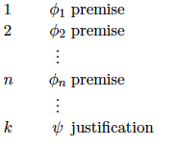
Proof by induction on the lenght of the proof
Inductive step

Slide 32
Proof by induction on the lenght of the proof
We have to look at the the last applied rule (by cases)
………………..

Slide 33
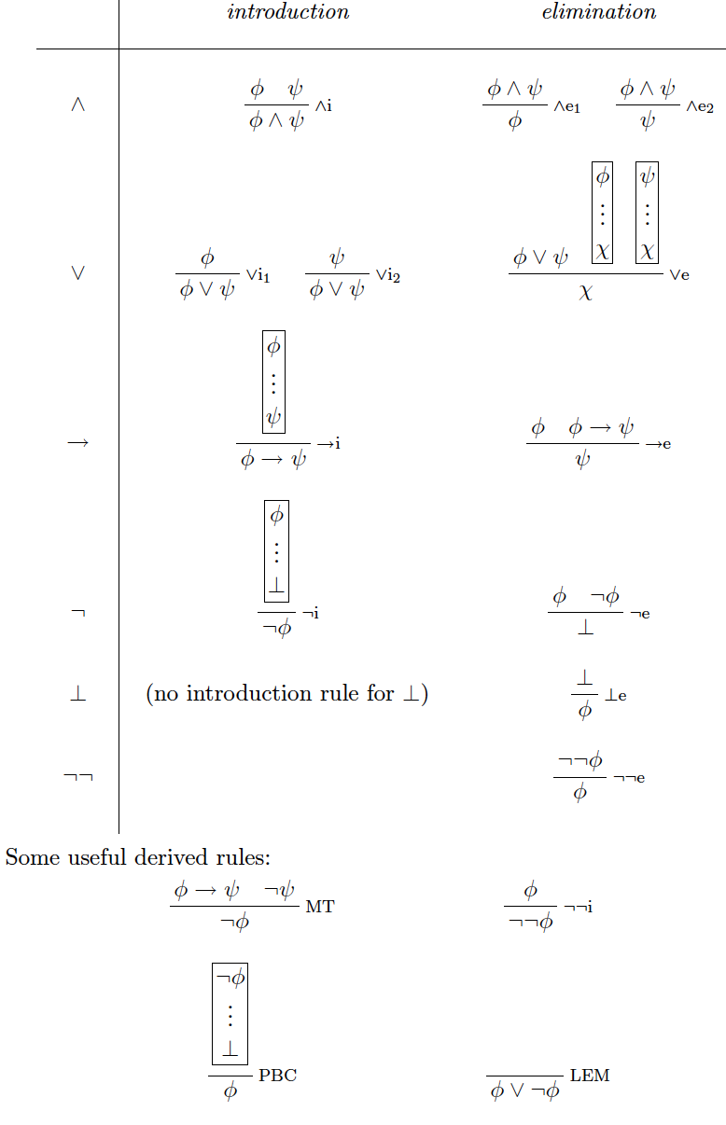

Slide 34
Completeness of natural deduction
ϕ₁, ϕ₂, ϕ₃, ….. ⏐⎯ ψ
⬆
ϕ₁, ϕ₂, ϕ₃, ….. ⏐== ψ

Slide 35
Exercises

Slide 36
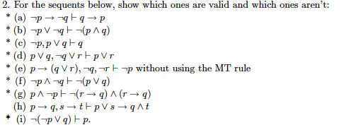
Exercises

