Slide 1
An intuition on hidden layers role in NN

Slide 2
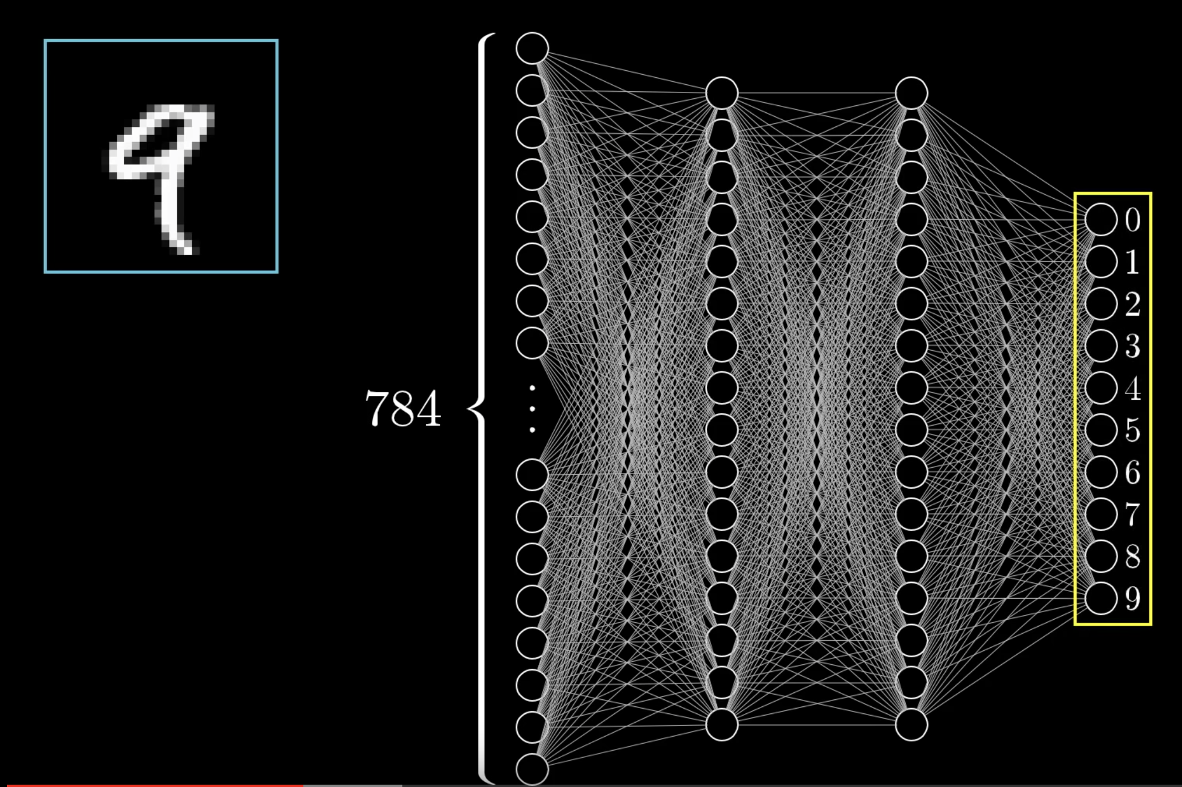
An intuition of how neural networks works

Slide 3
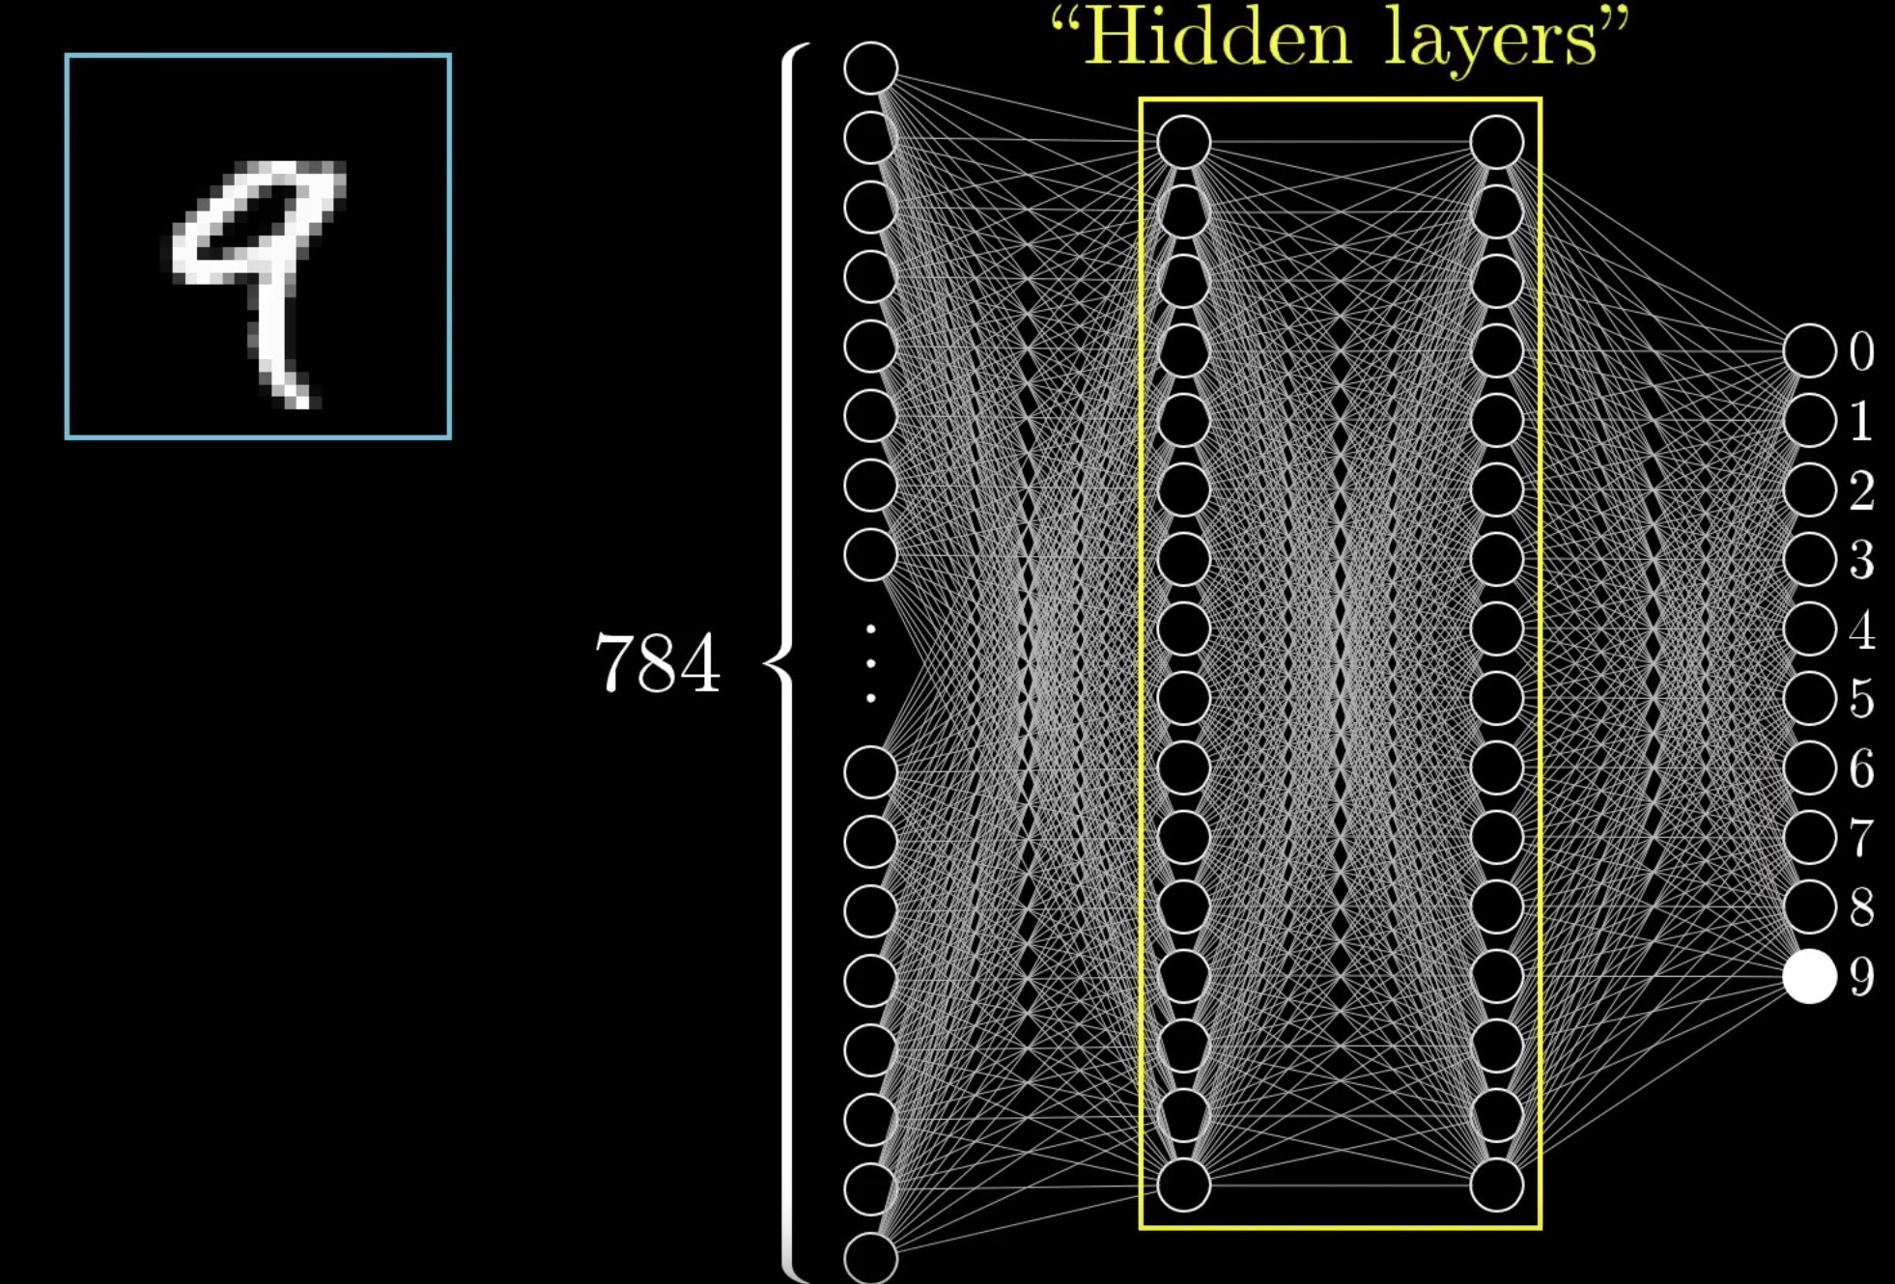
An intuition of neural networks (2)
Input are pixels output are
numbers from 0 to 9.
What are the hidden layers?

Slide 4
An intuition of neural networks (3)

Slide 5
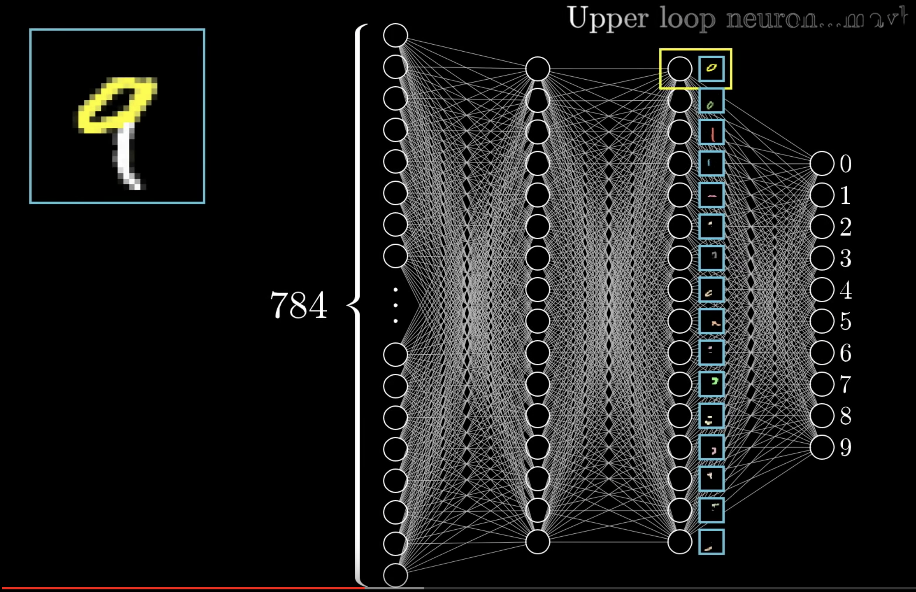
An intuition of neural networks (4)
Inner layer have a «hidden» meaning,
but we can think of them as «recognizers»
of simpler component of the input.
Once the weights are learned, they activate
when the component is recognized.

Slide 6
An intuition of neural networks (5)

Slide 7
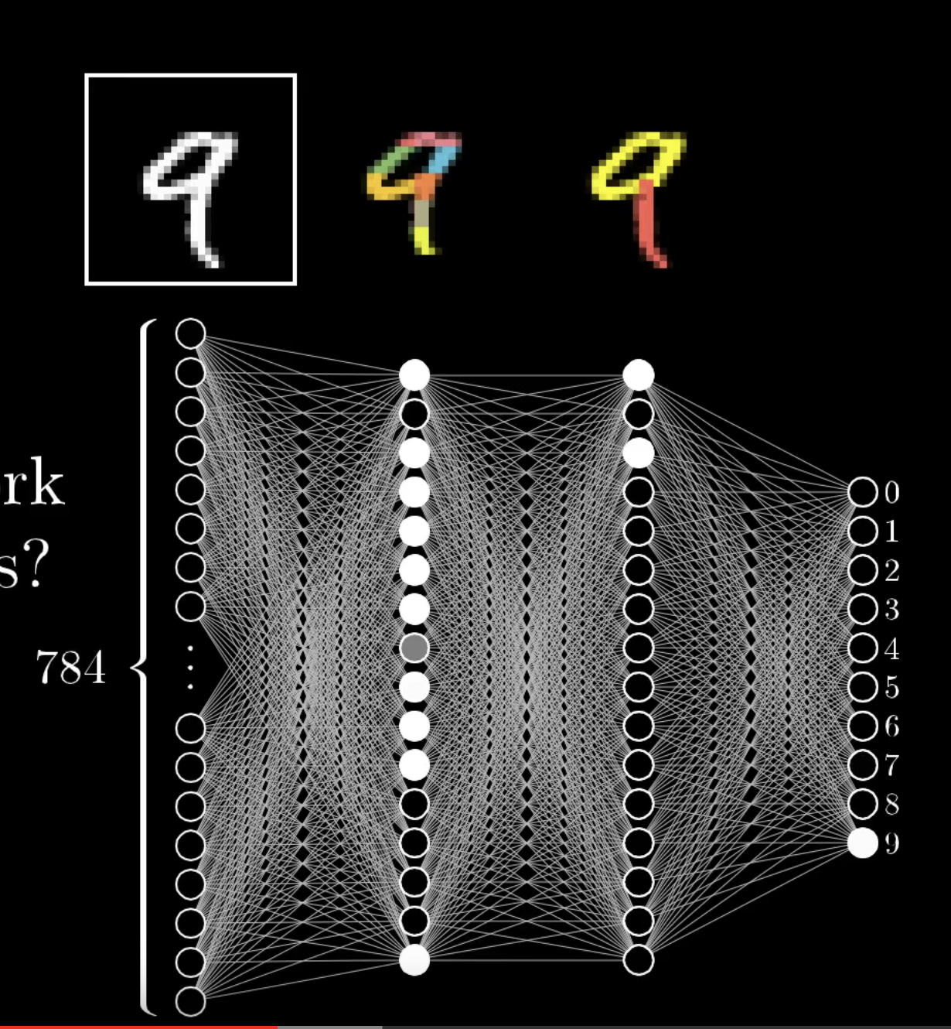
An intuition of neural networks (6)
Layer 2 recognizes smallest component, layer 3 more complex
component.
HOWEVER this is an intuitive explanation. We can’t actually tell
the network does this..

