Slide 1
Machine Learning Neural Networks and Deep Learning

Slide 2
Neural Networks
NN is a ML algorithm belonging to the category of supervised classification models
The learned classification model is an algebraic function (or a set of functions), rather than a boolean function, as for DTrees
The function is linear for Perceptron algorithm, non-linear for Backpropagation algorithm
Both features and the output class are allowed to be real valued (rather than discrete, as in Dtrees)

Slide 3
Neural Networks
Analogy to biological neural systems, the most robust learning systems we know.
Attempt to understand natural biological systems through computational modeling.
Massive parallelism allows for computational efficiency.
Help to understand “distributed” nature of neural computation (rather than “localist”) that allow robustness and graceful degradation.
Intelligent behavior as an “emergent” property of large number of simple units rather than from explicitly encoded symbolic rules and algorithms.

Slide 4
Neural Speed Constraints
Neurons have a “switching time” on the order of a few milliseconds, compared to nano/picoseconds for current computing hardware.
However, neural systems can perform complex cognitive tasks (vision, speech understanding) in tenths of a second, computers can’t.
Only time for performing 100 serial steps in this time frame, compared to orders of magnitude more for current computers.
Therefore, neural computation in humans exploits“massive parallelism.”
Human brain has about 10¹¹ neurons with an average of 10⁴ connections each.

Slide 5
Neural Network Learning
Learning approach of NN algorithm based on modeling adaptation in biological neural systems.
Two main algorithms:
Perceptron: Initial algorithm for learning simple neural networks (single layer) developed in the 1950’s.
Backpropagation: More complex algorithm for learning multi-layer neural networks developed in the 1980’s.

Slide 6
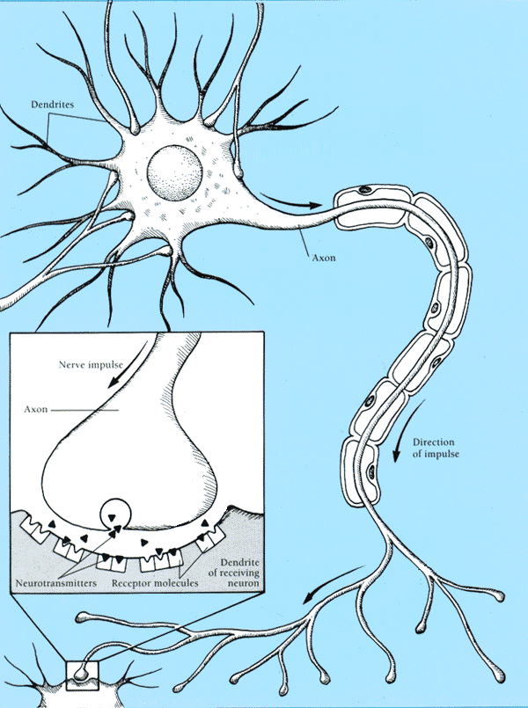
Real Neurons
Cell structures
Cell body
Dendrites
Axon
Synaptic terminals

Slide 7
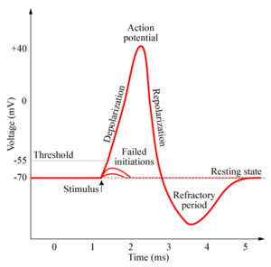
Neural Communication
Electrical potential across cell membrane exhibits spikes called action potentials.
Spike originates in cell body, travels down
axon, and causes synaptic terminals to
release neurotransmitters.
Chemical diffuses across synapse to
dendrites of other neurons.
Neurotransmitters can be excitatory or
inhibitory.
If net input of neurotransmitters to a neuron from other neurons is excitatory and exceeds some threshold, it fires an action potential.

Slide 8
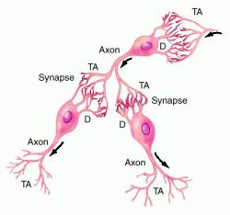
Neural connections

Slide 9
Real Neural Learning
Synapses change size and strength with experience (evolving structure).
Hebbian learning: When two connected neurons are firing at the same time, the strength of the synapse between them increases.
“Neurons that fire together, wire together.”

Slide 10
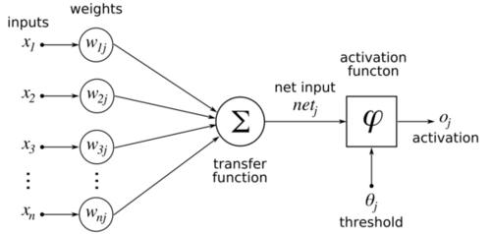
Artificial Neuron Model
Model network as a graph with cells as nodes, and synaptic connections as weighted edges from node i to node j, w_{ji}
Model net input to cell as
Cell output is:
Tj
o_{j}
1
(activation function φ is a
threshold function T_{j} )
0
T_{j}
net_{j}

Slide 11
Perceptron schema
Perceptron training phase = estimating edge weights w_{ji} and threshold T_{j}
x₁
x₂
x_{n}
∑
Threshold
Tj
o_{j}
net_{j}
Function to be learned is:

Slide 12
Perceptron learns a linear separator
This is an (hyper)-line in an n-dimensional space, what is learnt
are the coefficients w_{i}
Instances X(x₁,x₂..x₂) such that:
Are classified as positive, else they are classified as negative

Slide 13
Perceptron as a Linear Separator: example in two-dimensional space
x₁
x₂
x_{n}
∑
Threshold
Tj
o_{j}
net_{j}
x₂
??
x₂= mx₁+q
x₁
Or hyperplane in
n-dimensional space

Slide 14
Perceptron Training
Assume supervised training examples D: <x_{j},t_{j}> giving the desired output t, for a set of known instances x_{j} in X.
Note: we use t here rather than c for the class. We used c for “concepts”, i.e. discrete categorizations. t can be a real number (possibly within a range).
Objective: Learn synaptic weights (w_{ij}) so that each instance produces the correct output for each example (o_{j}=t_{j}).
Perceptron uses iterative update algorithm to learn a correct set of weights.

Slide 15
Perceptron Learning Rule
Initial weights selected at random.
Update weights by:
where η is a constant named the “learning rate”
t_{j} is the “teacher” specified output for unit j, (t_{j} -o_{j}) is the error in iteration t
Equivalent to rules:
If, for instance <xj,tj> in D, output is correct (t_{j}=o_{j}) do nothing (Err_{j}=0) and
If output is “high” (oj=1, tj=0, Err_{j}=-1), lower weights on active inputs
If output is “low” (Err_{j}=+1), increase weights on active inputs
Also adjust threshold to compensate:
NOTE: weights on edges are updated proportionally to the error observed
on the output (Err_{j} )AND to the intensity of the signal x_{i} travelling
on the edges

Slide 16
Perceptron Learning Algorithm
Training set D of vectors and their correct classification Ej : <x^{j}: (x₁..x_{n}), t_{j}>
Iteratively update weights until convergence.
(t is the iteration count)
Each execution of the outer loop is typically called an epoch.
Initialize weights to random values
Until outputs of all training examples are correct (or below error
threshold ε)
For each training pair, Ej < x^{j}(x₁,x₂,x_{n}),t_{j}>, do:
Compute current output o_{j} for Ej given its inputs
Compare current output to target value, t_{j ,} for Ej
Update synaptic weights and threshold using learning rule:

Slide 17
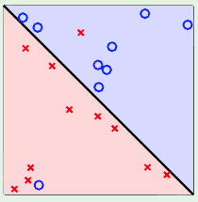
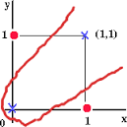
Concept Perceptron Cannot Learn
Cannot learn not linearly separable functions!
If our data (the learning set) are not separable by a line, then we need a more complex (polynomial?) function

Slide 18
Perceptron Convergence and Cycling Theorems
Perceptron convergence theorem: If the data is linearly separable and therefore a set of weights w_{i} exists that is consistent with the data (i.e. that identifies a line that separates positive from negative instances), then the Perceptron algorithm will eventually converge to a consistent set of weights.
Perceptron cycling theorem: If the data is not linearly separable, the Perceptron algorithm will repeat a set of weights and threshold at the end of some epoch and therefore enter an infinite loop.

Slide 19
Perceptron as Hill Climbing
The hypothesis space being searched is a set of weights and a threshold. (the w_{i} and T_{j})
Objective is to minimize classification error on the training set.
Perceptron effectively does hill-climbing (gradient descent) in this space, changing the weights of a small amount at each point, to decrease training set error. (see later on gradient descent)
For a single model neuron, the space is well behaved with a single minimum.
training
error
0
weights

Slide 20
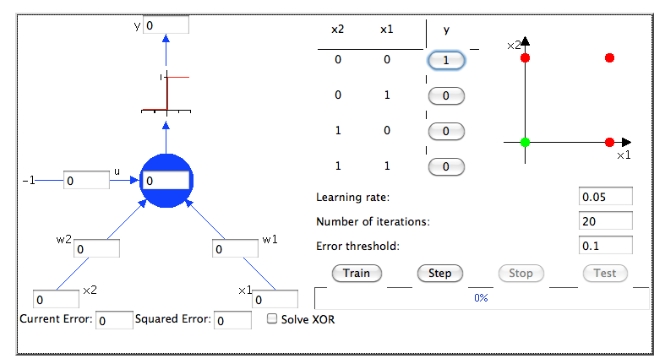
Example: Learn a NOR function
η

Slide 21
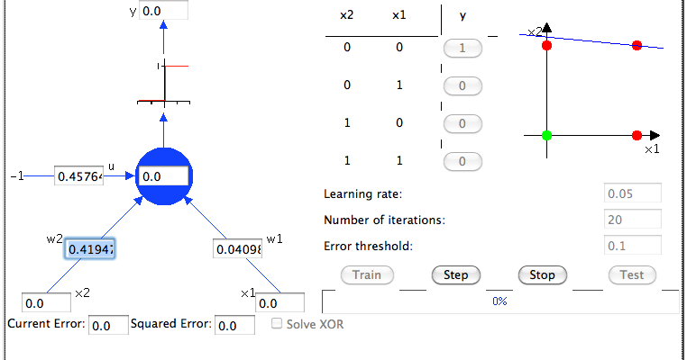

Slide 22
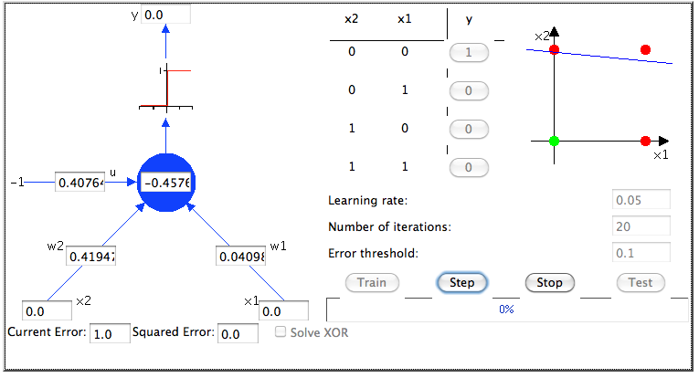

Slide 23
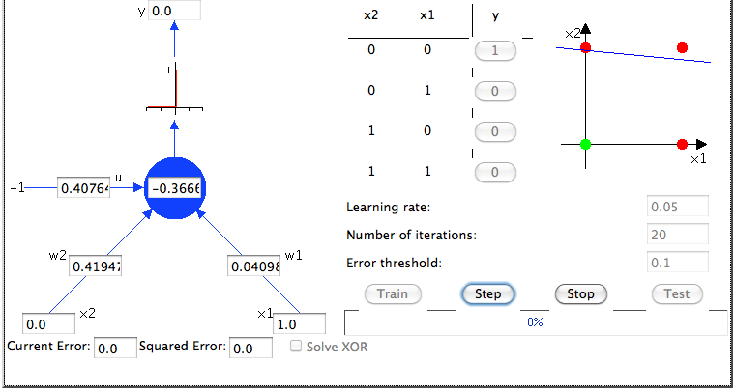

Slide 24
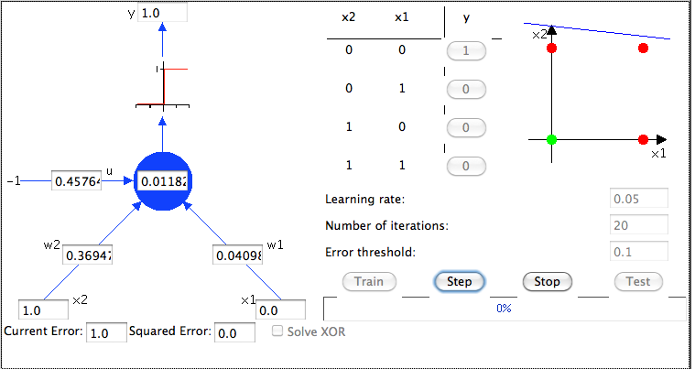

Slide 25
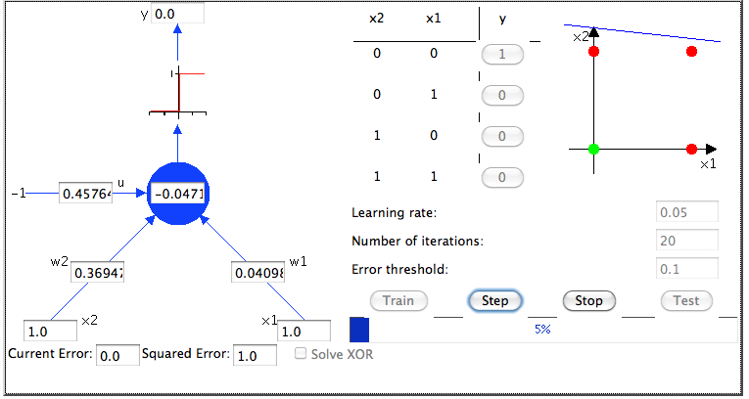

Slide 26
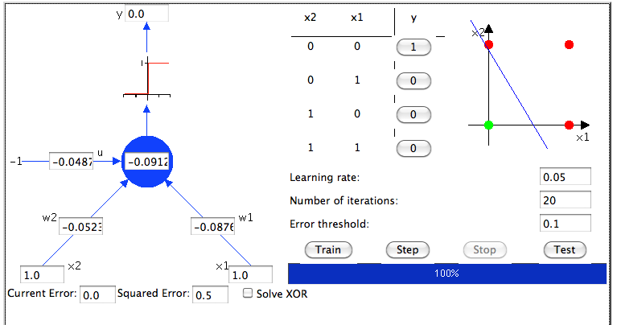
After 20 iterations

Slide 27
Perceptron Performance
In practice, converges fairly quickly for linearly separable data.
Can effectively use even incompletely converged results when only a few outliers are misclassified (outliers: data which are “exceptions”, like whales as mammals).
Experimentally, Perceptron does quite well on many benchmark data sets.

Slide 28
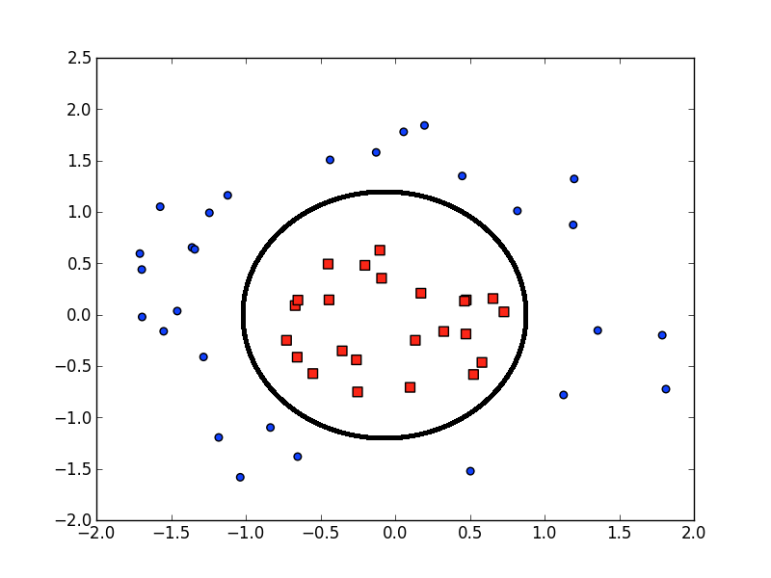
What if data not linearly separable?

Slide 29
Multi-Layer Networks
Multi-layer networks can represent arbitrary functions
A typical multi-layer network consists of an input, hidden and output layer, each fully connected to the next, with activation feeding forward.
Edges between nodes are weighted by w_{ji}
Instances <x^{i}(x^{i}₁,..x^{i}_{n}),(t^{i}₁,..t^{i}_{m})>from learning set D are connected to input nodes in first layer
Target is to learn the weights of edges such as to minimize the error between the output available on output nodes o_{j} and the true class values t^{i}_{j} in in training set
output
activation
hidden
input

Slide 30
Multilayer networks (2)
The output function is a vector of m values t^{i}₁,..t^{i}_{m} (complex output functions or multiple classifications)
Output values can be continuous rather than discrete as for boolean learners (VS, Dtrees), therefore are indicated with t rather than c (they are not necessarily “concepts” (=boolean), though they can be concepts)
Like for the perceptron, each node n_{j} receives in input a weighted sum of values net_{j} and computes a threshold function φ(net_{j})

Slide 31
Multilayer networks (3)
Like for the perceptron, edge weights are iteratively updated depending on the error (difference between true output and computed output). The iterative algorithm is called Backpropagation.
Weight updating rule is based on of hill-climbing
In a hill-climbing heuristic:
we start with an initial solution (= a random set of weights W).
Generate one or more “neighboring” solutions (weights which are “close” to previous values).
Pick the best and continue until there are no better neighboring solutions.
In the case of neural network, gradient descent is used to identify “best” neighboring solutions

Slide 32
Gradient and gradient descent
The gradient of a scalar field is a vector field that points in the direction of the greatest rate of increase of the scalar field, and whose magnitude is that rate of increase.
In simple terms, the variation of any quantity – e.g. an error function - can be represented (e.g. graphically) by a slope. The gradient represents the steepness and direction of that slope.

Slide 33
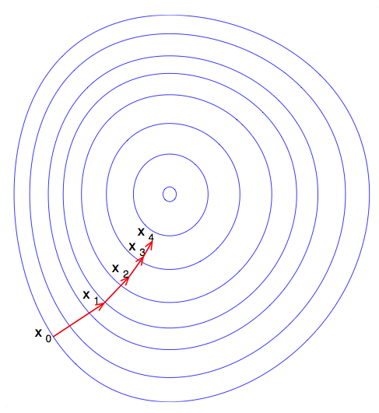
Gradient and gradient descent
To find a local minimum of a function (e.g. f=error(x)) using gradient descent, one takes (small) steps proportional to the negative of the gradient (or of the approximate gradient) of the function at the current point.
Matematically, this is obtained by computing the derivative of the squared (error) function over weights W , which is for the multilayer NN:

Slide 34
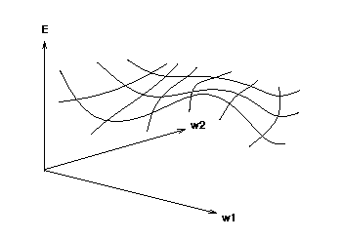
Gradient descent need a differentiable threshold function
Therefore, to do gradient descent with multiple neurons, we need the output of a unit to be a differentiable function of its input and weights.
Standard linear threshold (step) function is not differentiable at the threshold.
o_{i}
1
0
T_{j}
net_{j}

Slide 35
Differentiable Output Function
Need non-linear output function to move beyond linear functions.
Standard solution is to use the non-linear, differentiable sigmoidal “logistic” function:
1
0
T_{j}
net_{j}
Where x_{i} are the input to node j and also the output o_{i} of previous nodes.
This could be confusing!
i
j
o_{i} x_{i}

Slide 36
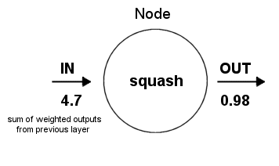
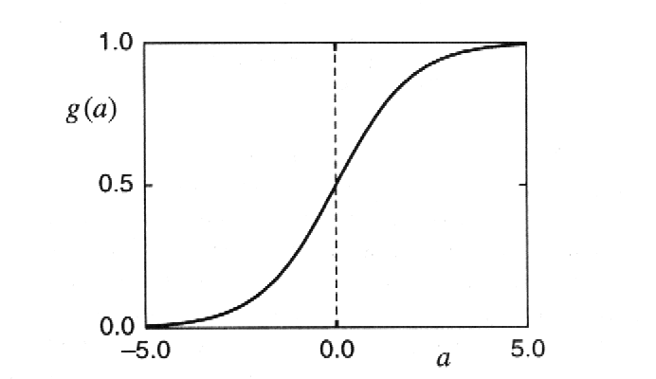
Structure of a node in NNs
threshold
Thresholding function limits node output
(Tj=0 in the example):
o_{j}

Slide 37
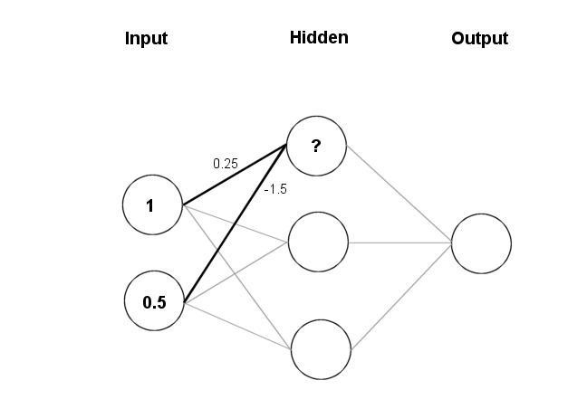
Feeding data through the net
net_{j}= (1 × 0.25) + (0.5 × (-1.5)) = 0.25 + (-0.75) = - 0.5
x:<x₁,x₂>=<1,0.5>
w_{ij}
Thresholding (with T=0):

Slide 38
Back to Gradient Descent
The objective is to minimize squared error:
where D is the set of training examples, W are current values for weights, O is the set of output units, t_{jx} and o_{jx} are, respectively, the “real” and current output for output node O_{j} for the example instance x in D:
In general, each instance in D has n features and m output values
Both features and output values can be real

Slide 39
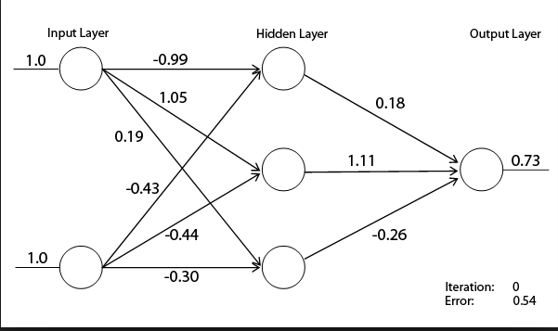
Example (1 output)
Input instance X<(1.0,1.0),0.50>; Error(W)=1/2(0.73-0.50)²=0.0529/2

Slide 40
Weight update rule (hill climbing)
Learning rule to change weights to minimize error at each iteration t is:
Weights are updated proportionally to the derivative of the error (move in the opposite direction of error gradient)

Slide 41
Computing the partial derivatives (using concatenation rule)
t_{j} is a costant value
How the error changes when weights change
How the error changes when output changes
How the output changes when weighted input sum changes
How the weighted sum changes when weights change

Slide 42
Computing the partial derivatives

Slide 43
Recall derivation steps and rules (from your math courses!)
Derivation rules: reciprocal, exponential, sum rule

Slide 44
Summary so far
Objective: learn o_{j}=f(w_{ji}, x) j=1…m output functions, where x:<x₁..x_{n}> are the input instances (represented by n features) and are the w_{i,j}weights on network edges. Target is to learn the (initially unknown) w_{ji}
General idea: start with random values for w_{ji} and then use gradient descent and “known” output values in learning set to iteratively update the values w_{ji}, until error (difference between “true” and “computed” output values) is below a thershold or does not decrease
We know introduce the complete algorithm, named Backpropagation

Slide 45
Backpropagation Learning Rule
o_{i}=xi
j
o_{j}
i
Each weight changed by:
where η is a constant called the learning rate
t_{j} is the correct output for unit j (as in learning set)
δ_{j} is the derivative of error for unit j (see previous slide)
wji
NOTE as for perceptron that weights w_{ji} are updated proportionally
to error δ_{j} observed on the output of a node j AND
to the intensity of the signal (x_{i}=o_{i}) travelling on edge ji

Slide 46
Error backpropagation in the hidden nodes
Notice that the error component is (t_{j}-o_{j}) for an output node,
while in a hidden node it is the weighted sum
of the errors generated by all the output nodes
to which it is connected! (the error
BACKPROPAGATES)

Slide 47
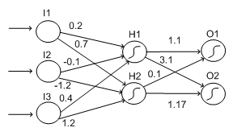
Hidden nodes are “responsible” of errors on output nodes for a fraction depending on the weight of their connections to output nodes
Derivative of error
at nodes O1 and O2
δ=0.4
δ=0.2
δ_{H2}=o_{H2}(1-o_{H2})[0.1×0.4+1.17×0.2]

Slide 48
Summary
To learn weights, a hill-climbing approach is used
Forward step: At each iteration and for each input, we compute the error on output nodes
Backward step: we then update weights starting from output nodes back to input nodes using gradient descent rule (=updates are proportional to the derivative δ of the error)

Slide 49
Backpropagation Training Algorithm
Create the 3-layer network with H hidden units with full connectivity
between layers. Set weights to small random real values.
Until all training examples produce the correct value (within ε), or
mean squared error ceases to decrease, or other termination criteria:
Begin epoch
For each training example, x in D, do:
Calculate network output for x’s input values
Compute error between current output and correct output for x
Update weights by backpropagating error and using learning rule
End epoch

Slide 50
Example
O_{j} one of the O output nodes
h_{k} the hidden nodes
n_{j} the input nodes
oj
O_{j}
w_{j1}
w_{j2}
h1
h2
…….
…...
…..
Step 1: feed with first example x1
and compute output on all nodes with
Initial (random) weights
n₁
n_{j}
n_{n}
x1: x₁₁ x₁₂…x_{1n}

Slide 51
Example (cont’d)
oj
w_{j1}
w_{j2}
…….
…...
…..
Compute the error on the output node, and backpropagate
computation on hidden nodes

Slide 52
Example (cont’d)
oj
w_{j1}
w_{j2}
…and on input nodes
w_{h1n1}
w_{h2n1}
…….
…...
…..

Slide 53
Example (cont’d): update weights and iterate
Update all weights
Consider the second example
Compute input and output in all nodes
Compute errors on outpus and on all nodes
Re-update weights
Until all examples have been considered (Epoch)
Repeat for n Epochs, until convergence

Slide 54
Another example (weight updates)
Training set
((0.1, 0.1), 0.1)
((0.1, 0.9), 0.9)
((0.9, 0.1), 0.9)
((0.9, 0.9), 0.1)
0,1
1
-0,1
-0,1
3
-0,1
0,1
2
0,1
Initial weights

Slide 55
1. Compute output and error on output node
First example:
((0.1, 0.1), 0.1)
0,1
1
-0,1
0,1
0,1
-0,1
-0,1
0,5
3
0,1
0,1
2
0,1
0,5
0,5

Slide 56
2. Backpropagate error
-0,025
1
0,1
-0,1
0,1
0,5
3
2
0,1
0,025
0,5
0,5

Slide 57
3. Update weights
0,1
-0,025
1
-0,1
0,1
-0,1
-0,1
0,1
0,5
3
-0,1
0,1
0,1
2
0,1
0,025
0,5
0,5

Slide 58
Read second input from D
2. ((0,1,0,9), 0,9)
0,1005
1
0,1
-0,11
-0,0995
0,48
0,9
3
-0,1005
0,9
0,09
2
0,501
0,0995
0,52
..etc!!

Slide 59
Yet another example
First calculate error of output units and use this to change the top layer of weights.
Current output: o_{j}=0.2
Correct output: t_{j}=1.0
Error δ_{j} = o_{j}(1–o_{j})(t_{j}–o_{j})
0.2(1–0.2)(1–0.2)=0.128
output
Update weights into j
hidden
input

Slide 60
Error Backpropagation
Next calculate error for hidden units based on errors on the output units it feeds into.
output
hidden
input

Slide 61
Error Backpropagation
Finally update bottom layer of weights based on errors calculated for hidden units.
output
hidden
Update weights into j
input

Slide 62
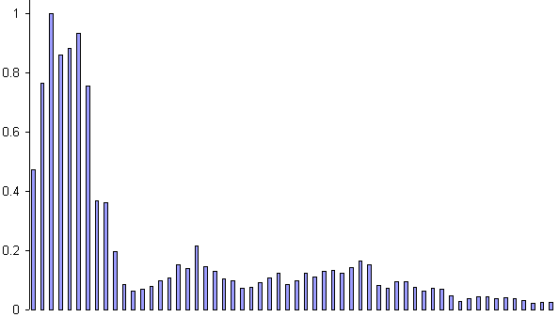
Example: Voice Recognition
Task: Learn to discriminate between two different voices saying “Hello”
Data
Sources
Steve Simpson
David Raubenheimer
Format
Frequency distribution (60 bins)

Slide 63
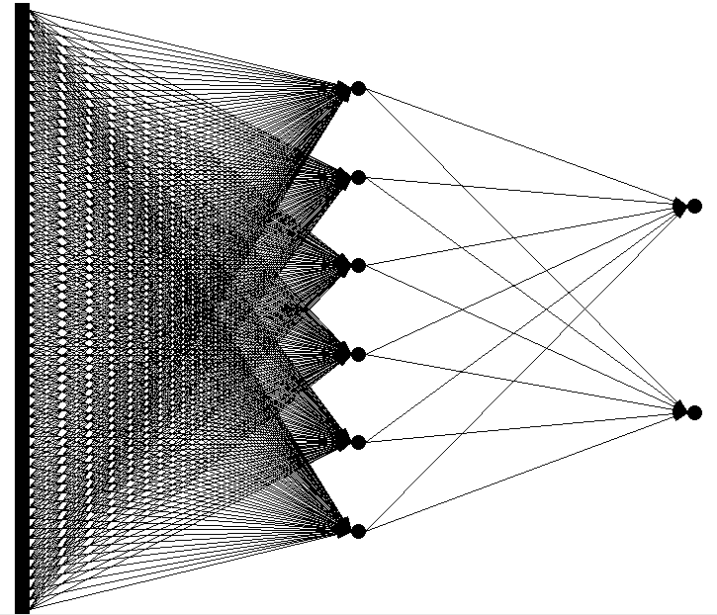
Network architecture
Feed forward network
60 input (one for each frequency bin)
6 hidden
2 output (0-1 for “Steve”, 1-0 for “David”)

Slide 64
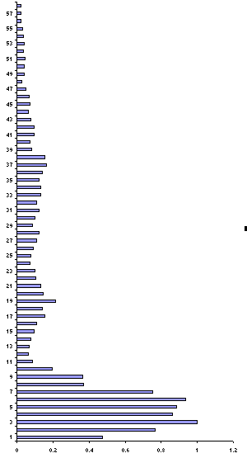
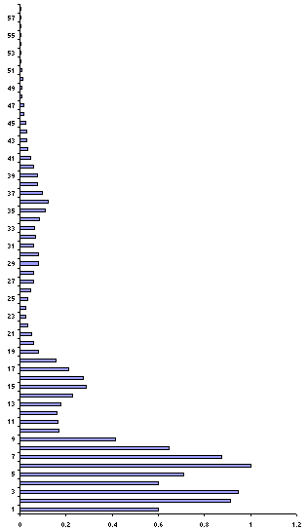
Presenting the data
Steve
David

Slide 65
Presenting the data (untrained network)
Steve
0.43
0.26
David
0.73
0.55

Slide 66
Calculate error
Steve
0.43 – 0 = 0.43
0.26 –1 = 0.74
David
0.73 – 1 = 0.27
0.55 – 0 = 0.55

Slide 67
Backprop error and adjust weights
Steve
0.43 – 0 = 0.43
0.26 – 1 = 0.74
1.17
David
0.73 – 1 = 0.27
0.55 – 0 = 0.55
0.82

Slide 68
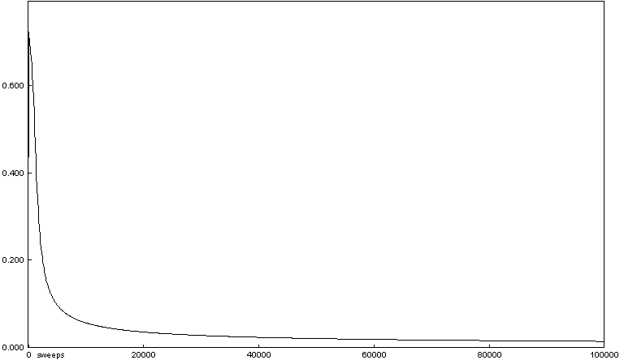
Repeat process (sweep) for all training pairs
Present data
Calculate error
Backpropagate error
Adjust weights
Repeat process multiple times

Slide 69
Presenting the data (trained network)
Steve
0.01
0.99
David
0.99
0.01

Slide 70
Comments on Training Algorithm
Not guaranteed to converge to zero training error, may converge to local optima or oscillate indefinitely.
However, in practice, does converge to low error for many large networks on real data.
Many epochs (thousands) may be required, hours or days of training for large networks.
To avoid local-minima problems, run several trials starting with different random weights (random restarts).
Take results of trial with lowest training set error.
Build a committee of results from multiple trials (possibly weighting votes by training set accuracy).

Slide 71
Representational Power
Boolean functions: Any boolean function can be represented by a two-layer network with sufficient hidden units.
Continuous functions: Any bounded continuous function can be approximated with arbitrarily small error by a two-layer network.
Sigmoid functions can act as a set of basis functions for composing more complex functions, like sine waves in Fourier analysis.
Arbitrary function: Any function can be approximated to arbitrary accuracy by a three-layer network.

Slide 72
Over-Training Prevention
Running too many epochs can result in over-fitting.
Keep a hold-out validation set and test accuracy on it after every epoch. Stop training when additional epochs actually increase validation error.
To avoid losing training data for validation:
Use internal 10-fold CV on the training set to compute the average number of epochs that maximizes generalization accuracy.
Train final network on complete training set for this many epochs.
error
on test data
on training data
0
# training epochs

Slide 73
Determining the Best Number of Hidden Units
Too few hidden units prevents the network from adequately fitting the data.
Too many hidden units can result in over-fitting.
Use internal cross-validation to empirically determine an optimal number of hidden units.
error
on test data
on training data
0
# hidden units

Slide 74
Successful Applications
Text to Speech (NetTalk)
Fraud detection
Financial Applications
HNC (eventually bought by Fair Isaac)
Chemical Plant Control
Pavillion Technologies
Automated Vehicles
Game Playing
Neurogammon
Handwriting recognition

Slide 75
Deep Learning
a.k.o. Neural Network

Slide 76
Shortcomings of Neural networks with backpropagation
Based on iterative weight-learning
NN work by making thousands and thousands of tiny adjustments to edge weights, each making the network do better at the most recent pattern, but perhaps a little worse on many others
Gets stuck in local minima, especially since it starts with random initialization
It needs labelled data (it is a trained method) but in many important problems (especially speech recognition, image understanding) data are unlabeled

Slide 77
A neural network with multiple internal layers
Wikipedia provides the following definition:
“Deep learning is set of algorithms in machine learning that attempt to learn layered models of inputs, commonly neural networks. The layers in such models correspond to distinct levels of concepts, where higher-level concepts are defined from lower-level ones, and the same lower-level concepts can help to define many higher-level concepts.”

Slide 78
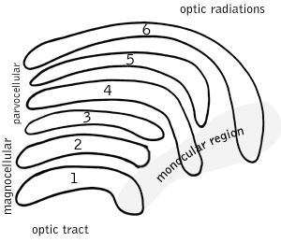
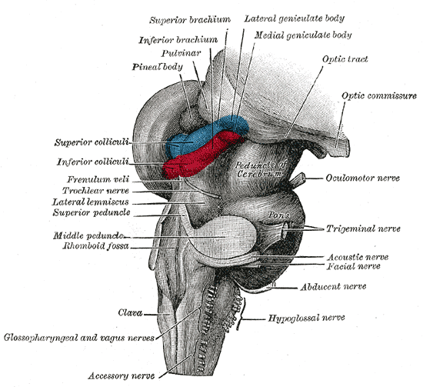
Multiple layers make sense
Our brain works that way

Slide 79
Multiple layers make sense
Many-layer neural network architectures should be capable of learning the true underlying features and ‘feature logic’, and therefore generalise very well …

Slide 80
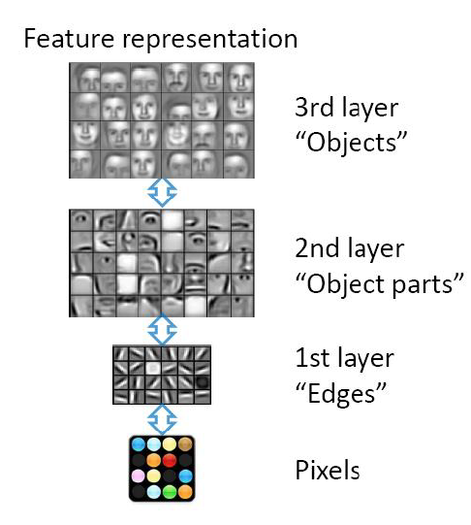
An example: image processing
Hierarchical learning
Natural progression from low level to higher level features as seen in many real problems
Easier to monitor what is being lernt in each level and guide subsequent layers

Slide 81
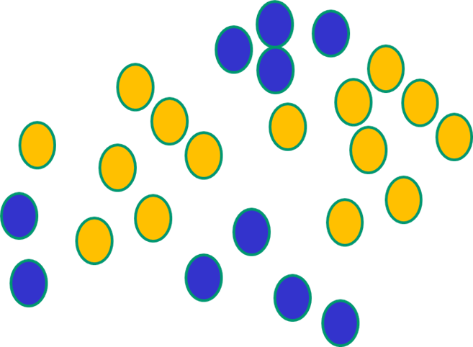
But, until very recently, our weight-learning algorithms simply did not work on multi-layer architectures

Slide 82
Deep Network Training
Use unsupervised learning (greedy layer-wise training)
With a small final trained step for fine-tuning
Allows abstraction to develop naturally from one layer to another
Help the network initialize with good parameters

Slide 83
Many Deep Learning algorithms
We will shortly introduce Stacking Denoising Autoencoders
They are basically a generalization of Backpropagation, but they allow multiple layers
More details on: Stacked Denoising Autoencoders: Learning Useful Representations in a Deep Network with a Local Denoising Criterion (Journ. of Machine Learning Research, 2010)

Slide 84
The new way to train multi-layer NNs…

Slide 85
The new way to train multi-layer NNs…
Train this layer first

Slide 86
The new way to train multi-layer NNs…
Train this layer first
then this layer

Slide 87
The new way to train multi-layer NNs…
Train this layer first
then this layer
then this layer

Slide 88
The new way to train multi-layer NNs…
Train this layer first
then this layer
then this layer
then this layer

Slide 89
The new way to train multi-layer NNs…
Train this layer first
then this layer
then this layer
then this layer
finally this layer

Slide 90
The new way to train multi-layer NNs…
EACH of the (non-output) layers is trained to be an auto-encoder

Slide 91
Auto-encoders
Encoder: The deterministic (= non stocastic) mapping f_{θ} that transforms an input vector x into hidden representation y=f_{θ}(x)
θ=(W,b) are the parameters of the encoder
Decoder: The resulting hidden representation y is then mapped back to a reconstructed d dimensional vector z
In general z is not to be interpreted as an exact reconstruction of x, but rather in probabilistic terms as the parameters (typically the mean) of a distribution p(X|Z = z) that may generate x with high probability.
Autoencoder training consists in minimizing the reconstruction error (the difference between x and g_{θ’}(y))
Intuitively, if a representation allows a good reconstruction of its input, it means that it has retained much of the information that was present in that input (=identifying the relevant features).

Slide 92
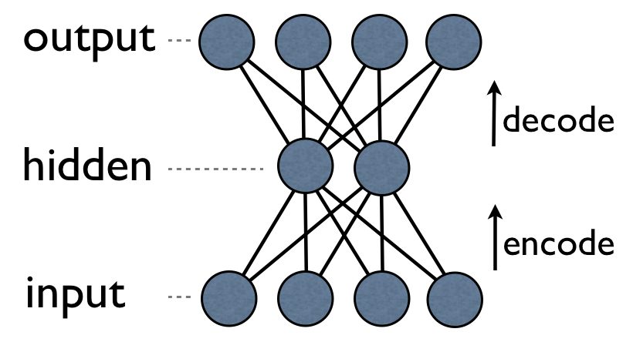
Autoencoders can be implemented with a NN with backpropagation
They can be implemented as a neural network with one hidden layer and equal number of nodes in input and output
Can be trained WITHOUT supervision, since we don’t need to know the class of an instance: the task is simply to learn the weights in order for the output to be similar to the input (or better: to learn the “essential” features of the input instances)
It can be also used an as anomaly detector: if an instance is very different from “normality”, the network is unable to reconstruct it.

Slide 93
Denoising Autoencoders (a better method)
The reconstruction criterion alone is unable to guarantee the extraction of useful features as it can lead to the obvious solution “simply copy the input”
Denoising criterion: “a good representation is one that can be obtained robustly from a corrupted input and that will be useful for recovering the corresponding clean input”

Slide 94
Denoising Autoencoders Architecture
Denoising autoencoders can still be learned using backpropagation with gradient descent
What is the advantage? As in the figure, y is a “compact” representation of x, one that
only retains only its essential features.

Slide 95
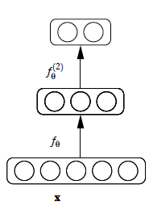
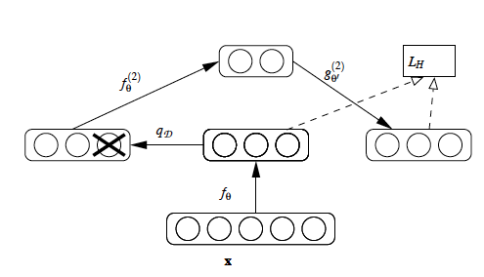
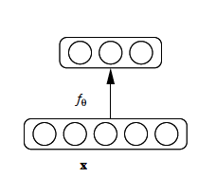
Stacking Denoising Autoencoder Architecture
After training a first level denoising autoencoder, its learnt encoding function f_{θ} is used on “clean” input.
The resulting representation is used to train a second level denoising autoencoder (middle) to learn a second level encoding function f.
From there, the procedure can be repeated (right).

Slide 96
Intermediate layers are each trained to be auto encoders

Slide 97
Final layer trained to predict class based on outputs from previous layers

Slide 98
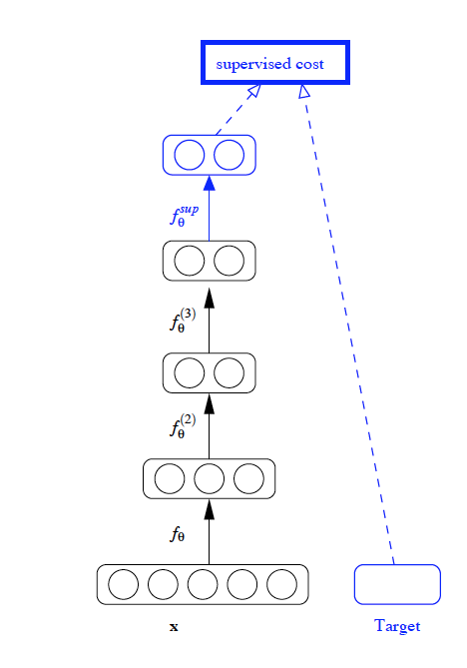
Final layer training is supervised
After training a stack of encoders as explained in the previous figure, an output layer is added on top of the stack.
The parameters of the whole system are fine-tuned to minimize the error in predicting the supervised target (e.g., class), by performing gradient descent.

Slide 99
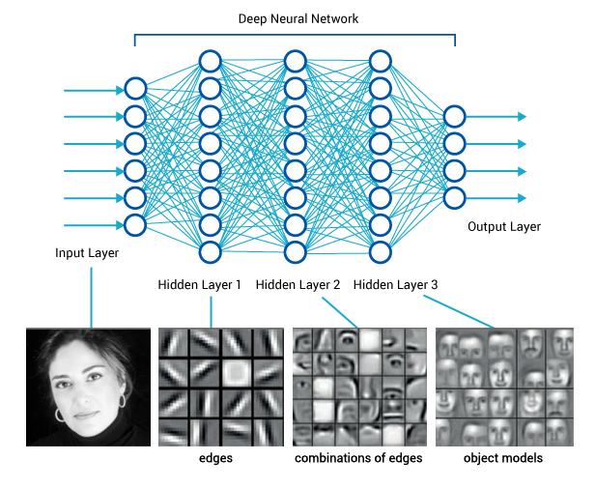
Applications: image understanding

Slide 100
Other applications/systems
Video, sound, text
DNA
time series (stock markets, economic tables, the weather)
Relevant players:
Deep Mind (acquired by Google in 2014) →learn playing videogames
Deep Brain (always by Google) (used by photosearch and to build recommenders)
May be Siri? (Apple’s Speech Interpretation and Recognition Interface)
Microsoft’s Cortana (Intelligent Assistent)

Slide 101
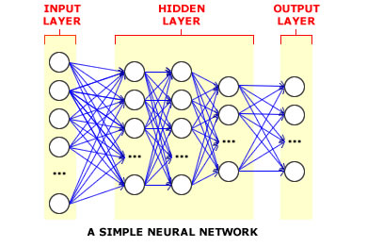
Conclusion on Deep Learning
That’s the basic idea
There are many many types of deep learning,
different kinds of autoencoder, variations on architectures and training algorithms, etc…
Very fast growing area …

